Slide 1
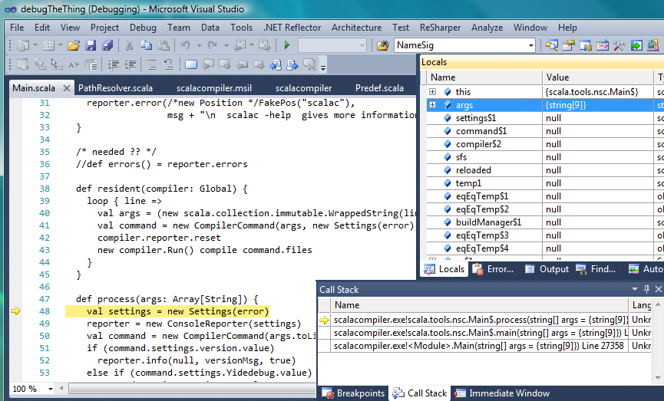
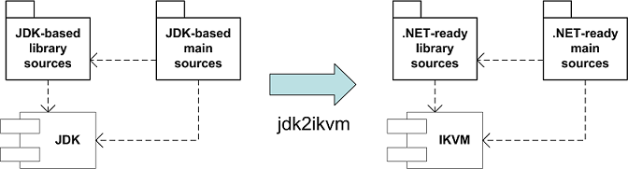
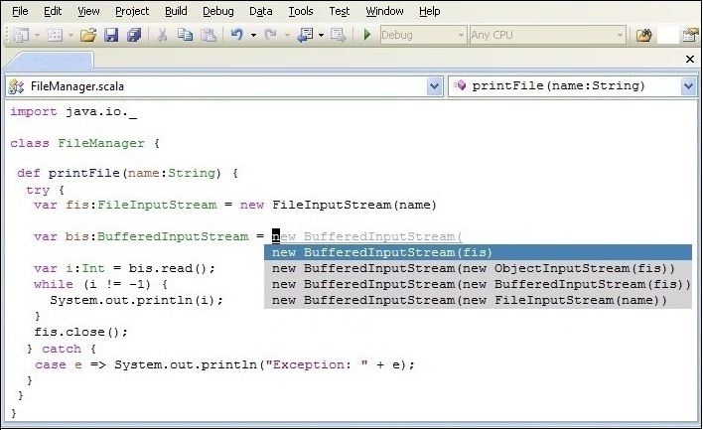
August 2008
M. Garcia,T. Gvero,H. Hojjat,V. Kuncak,M. Odersky,R. Piskac, L.Rytz
ProgLab.NET:
A Workbench for Ensuring Software Quality and Reliability
ProgLab.Net: programming environment equipped with a set of program analysis tools
Improve the productivity of software development with rapid feedbacks from the system
Increase the reliability of software by formal verification (sequential and concurrent)
Aid the programmer by automatic generation of code snippets
.Net Translation
Side-Effect Analysis
Scala.NET targets all .NET platforms
    desktop & server
    mobile
    game console
Programs using only Scala SDK
are cross-platform (JVM and .NET)
Additionally, a migration tool (jdk2ikvm) ports
JDK-based Scala sources to .NET
http://lamp.epfl.ch/~magarcia/ScalaNET/
Methods declare their side-effects
A compiler-plugin checks the actual side-effects of the code
class Set[A] {
def add(a: A): Unit @mod(this) = { ... }
def map[B](f: A => B): Set[B] @pc(f.apply(_)) =
{ ... }
}
def singletonSet[A](a: A): Set[A] @mod() = {
val s = new Set[A]()
s.add(a)
s}
Lightweight syntax for effect-polymorphism: the effect of map depends on the effect of f.apply
Non-observable side-effects can be masked
Eldarica: Predicate Abstraction for Concurrent Programs
InSynth: Interactive Synthesis of Code
Huge state space in a concurrent program
- unknown number of processes
- unbounded variables
Finite manageable state space
- locate error in abstract space
- generalize counter example in original program
Context
concrete space
Predicate Abstraction
abstract space
Abstract with respect to ‘important’ features
(critical messages, shared variables,…)
actor2 ! 1
p₀: (front(actor1)=0), p₁: (front(actor2)=1)
Desired Type
[front(actor1)=0]
dequeue(actor1)
actor1 ! 0
actor1 ! 0
dequeue(actor2)
{p₀}
[front(actor1)=0]
Using Scala API classes and methods is hard
Solution: Interactive Synthesis
  Input: desired type and declarations visible in context
  Encodes them to FOL formulas:
      Desired type – goal
      Declarations – axioms
  Assigns them weights
  Runs resolution algorithm modified to find solutions with
  smallest weights
  Output: ranked expressions that have desired type – code snippets
Supports: Generic types, higher order functions, sub-typing
Uses machine learning
  Uses source code corpus to learn weights
  Higher the method frequency, smaller the weight
Evaluation – 83 real-world API examples
  Recreates expected snippet in 72 examples (87%)
  Expected snippet has highest rank in 38 examples (46%)
[front(actor2)=1]
{p₀}
actor2 ! 1
actor1 ! 0
{p₀,p₁}
Control Flow Graph
{p₁}
dequeue(actor1)
Reachability Tree: unfolding the control flow graph in an abstract domain
Iterative process: refine the abstraction until:
- detect genuine error
- establish correctness
{p₁}
[front(actor2)=1]
{p₀,p₁}
actor1 ! 0
dequeue(actor2)
Reachability Tree

