Slide 1
Automating Construction of Lexers

Slide 2
Example in javacc
TOKEN: {
<IDENTIFIER: <LETTER> (<LETTER> | <DIGIT> | "_")* >
| <INTLITERAL: <DIGIT> (<DIGIT>)* >
| <LETTER: ["a"-"z"] | ["A"-"Z"]>
| <DIGIT: ["0"-"9"]>
}
SKIP: {
" " | "\n" | "\t"
}
--> get automatically generated code for lexer!
But how does javacc do it?

Slide 3
A Recap:
Simple RE to Programs
Regular Expression
Code
a
r1 r2
(r1|r2)
r*
if (current=a) next else error
(code for r1) ;
(code for r2)
if (current in first(r1))
code for r1
else
code for r2
while(current in first(r))
code for r

Slide 4
Regular Expression to Programs
How can we write a lexer for (a*b | a) ?
aaaab Vs aaaaa
Regular Expression
Finite state machine (FSA)
Program

Slide 5
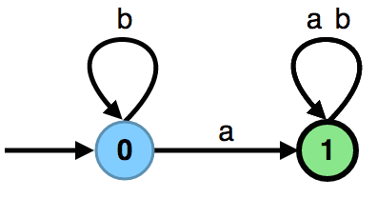


Finite Automaton (Finite State Machine)
$$δ ⊆Q×Σ×Q,$$
$$q_{0}∈Q,$$
$$F⊆Q$$
A = (Σ, Q, q₀, δ, F)
$$q_{0}∈Q,$$
$$q_{1}⊆Q$$
$$δ=\{ \left(q_{0}, a, q_{1}\right),\left(q_{0}, a, q_{0}\right)$$
$\left(q_{1}, a, q_{1}\right),\left(q_{1}, b, q_{1}\right)\}$
Σ - alphabet
Q - states (nodes in the graph)
q₀ - initial state (with ‘->' sign in drawing)
δ - transitions (labeled edges in the graph)
F - final states (double circles)

Slide 6
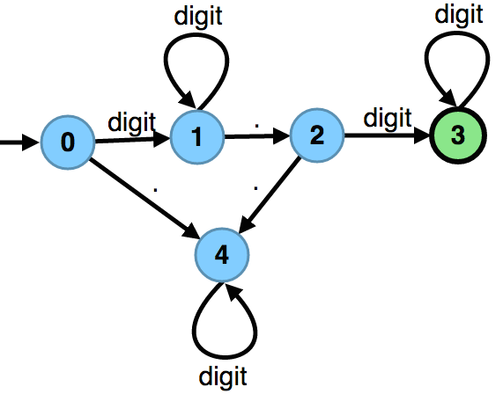
Numbers with Decimal Point
digit digit* . digit digit*
What if the decimal part is optional?

Slide 7
Automata Tutor www.automatatutor.com
A website for learning automata
We have posted some exercises for you to try.
Create an account for yourself
Register to the course
  Course Id: 23EPFL-CL
  Password: GHL2AQ3I

Slide 8
Exercise
Design a DFA which accepts all strings in {a, b}* that has an even length

Slide 9
Exercise
Construct an automaton that recognizes all strings over {a, b} that contain "aba" as a substring

Slide 10
Exercise
Construct an automaton that recognizes all strings over { a,b} that contain "aba" as a substring and is of even length

Slide 11
Exercise
Design a DFA which accepts all the numbers written in binary and divisible by 2. For example, your automaton should accept the words 0, 10, 100, 110…

Slide 12
Exercise
Design a DFA which accepts all the numbers written in binary and divisible by 3. For example your automaton should accept the words 0, 11, 110, 1001, 1100 …
Can you generalize this to any divisor ‘n’ ?
Can you generalize this to any base ‘b’ ?

Slide 13
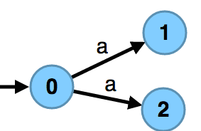
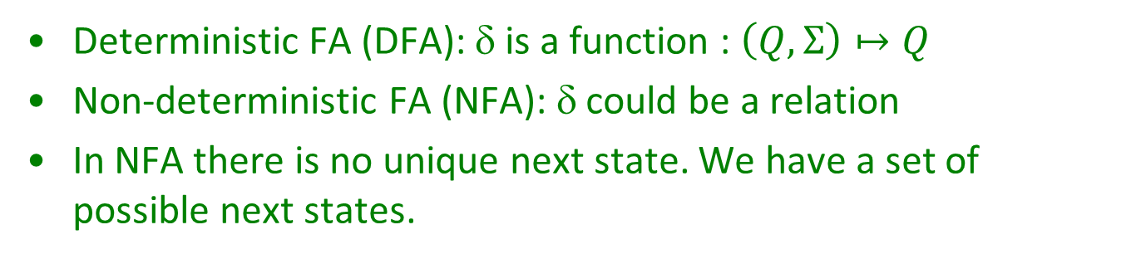
Kinds of Finite State Automata
Deterministic FA (DFA): δ is a function : $\left(Q,Σ\right)↦Q$
Non-deterministic FA (NFA): δ could be a relation
In NFA there is no unique next state. We have a set of possible next states.

Slide 14
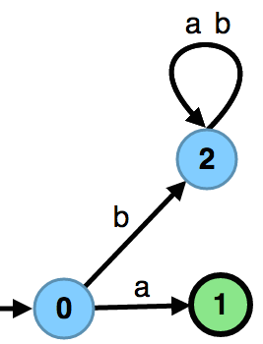
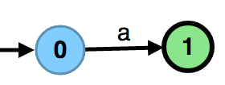
Undefined Transitions
Undefined transitions lead to a sink state from where no input can be accepted

Slide 15
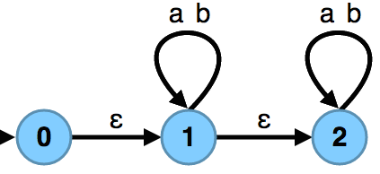
Epsilon Transitions
Epsilon transitions: traversing them does not consume anything (empty word)
More generally, transitions labeled by a word: traversing such transition consumes that entire word at a time

Slide 16
Interpretation of Non-Determinism
For a given word (string), a path in automaton lead to accepting, another to a rejecting state
Does the automaton accept in such case?
  yes, if there exists an accepting path in the automaton graph whose symbols give that word

Slide 17
Exercise
Construct a NFA that recognizes all strings over {a,b} that contain "aba" as a substring

Slide 18
NFA Vs DFA
For every NFA there exists an equivalent DFA that accepts the same set of strings
But, NFAs could be exponentially smaller.
That is, there are NFAs such that every DFA equivalent to it has exponentially more number of states

Slide 19
Exercise
Construct a NFA and a DFA that recognizes all strings over {a,b,c} that do not contain all the alphabets a, b and c.
(let’s start with a regular expression)
Food for thought:
  Can you prove that every DFA for this language will have exponentially more states than the NFA ?

Slide 20
Regular Expressions and Automata
Theorem:
If L is a set of words, it is describable by a regular expression iff (if and only if) it is the set of words accepted by some finite automaton.
Algorithms:
regular expression → automaton (important!)
automaton → regular expression (cool)

Slide 21
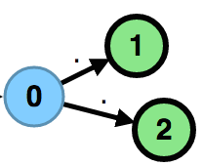
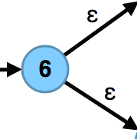
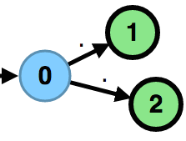
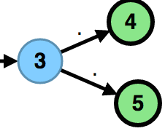
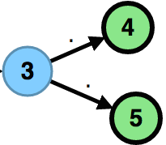
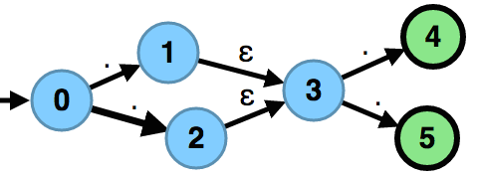
Recursive Constructions
Union
Concatenation

Slide 22
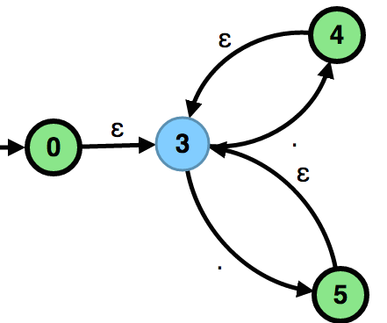
Recursive Constructions
Star

Slide 23
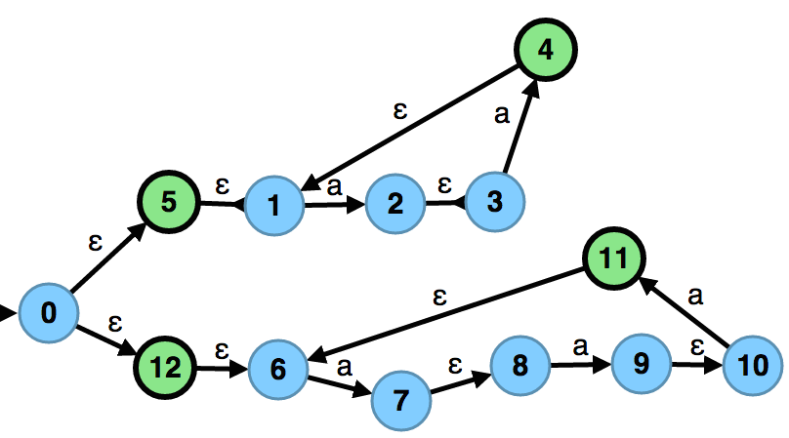
Exercise: (aa)* | (aaa)*
Construct an NFA for the regular expression

Slide 24
NFAs to DFAs (Determinisation)
keep track of a set of all possible states in which the automaton could be
view this finite set as one state of new automaton

Slide 25
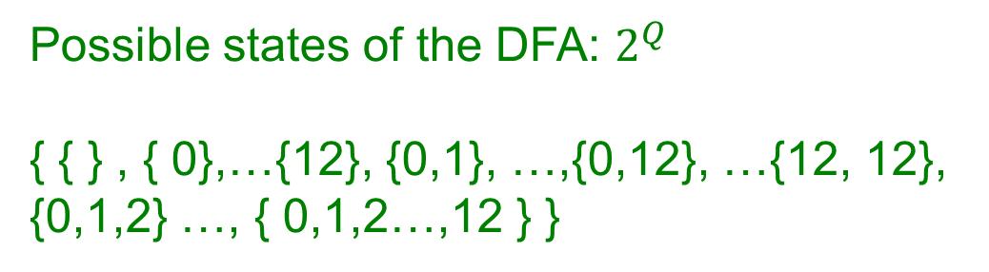
NFA to DFA Conversion
Possible states of the DFA: $2^{Q}$
{ { } , { 0},…{12}, {0,1}, …,{0,12}, …{12, 12},
{0,1,2} …, { 0,1,2…,12 } }

Slide 26
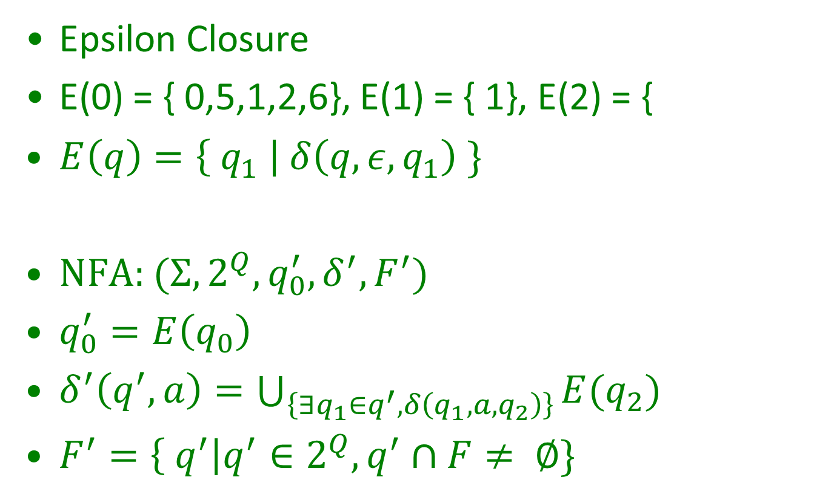
NFA to DFA Conversion
Epsilon Closure
E(0) = { 0,5,1,2,6}, E(1) = { 1}, E(2) = {
$E\left(q\right)=\left\{ q_{1} \right| δ\left(q,ε, q_{1}\right) \}$
NFA: $(Σ,2^{Q}, q_{0}^{′}, δ^{′}, F^{′})$
$q_{0}^{′}=E\left(q_{0}\right)$
$δ^{′}\left(q^{′},a\right)=\bigcup_{\left\{∃q_{1}∈q^{′}, δ\left(q_{1}, a,q_{2}\right)\right\}}{E(q_{2})}$
$F^{′}=\left\{ q^{′}\right|q^{′}∈2^{Q}, q^{′}∩F≠ ∅\}$

Slide 27
NFA to DFA Conversion
{0,5,12,1,6}
a
{2,7,3,8}
a
{4,1,9,10}
a
a
{4,1,11,6}
{9,10,2,3}
{4,1,7,8}
{11,6,2,3}
a
a
a

Slide 28
NFA to DFA Example
{0,5,12,1,6}
a
{2,7,3,8}
a
{4,1,9,10}
a
a
{4,1,11,6}
{9,10,2,3}
{4,1,7,8}
{11,6,2,3}
a
a
a

Slide 29
Remark: Relations and Functions
Relation r ⊆ B x C
r = { ..., (b,c1) , (b,c2) ,... }
Corresponding function: f : B -> 2^{C}
f = { ... (b,{c1,c2}) ... }
f(b) = { c | (b,c) ∈ r }
Given a state, next-state function returns the set of new states
  for deterministic automaton, the set has exactly 1 element

Slide 30
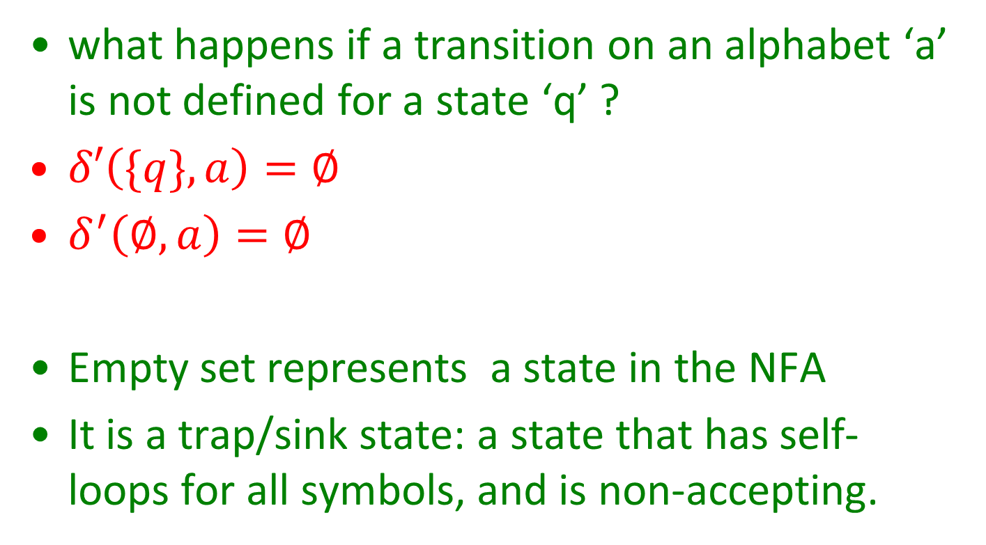
Clarifications
what happens if a transition on an alphabet ‘a’ is not defined for a state ‘q’ ?
$δ′\left(\{q\},a\right)=∅$
$δ^{′}\left(∅, a\right)=∅$
Empty set represents a state in the NFA
It is a trap/sink state: a state that has self-loops for all symbols, and is non-accepting.

Slide 31
Running NFA (without epsilons) in Scala
def δ(q : State, a : Char) : Set[States] = { ... }
def δ'(S : Set[States], a : Char) : Set[States] = {
for (q1 <- S, q2 <- δ(q1,a)) yield q2
}
def accepts(input : MyStream[Char]) : Boolean = {
var S : Set[State] = Set(q0) // current set of states
while (!input.EOF) {
val a = input.current
S = δ'(S,a) // next set of states
}
!(S.intersect(finalStates).isEmpty)
}

Slide 32
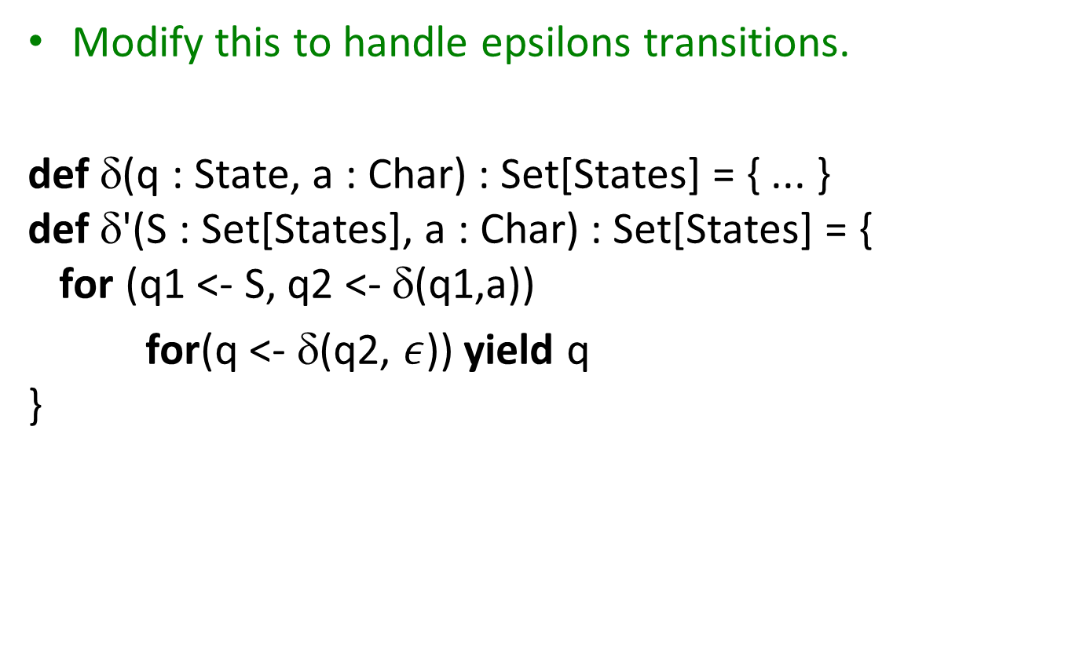
Running NFA in Scala
Modify this to handle epsilons transitions.
def δ(q : State, a : Char) : Set[States] = { ... }
def δ'(S : Set[States], a : Char) : Set[States] = {
for (q1 <- S, q2 <- δ(q1,a))
for(q <- δ(q2, $ε$)) yield q
}

Slide 33
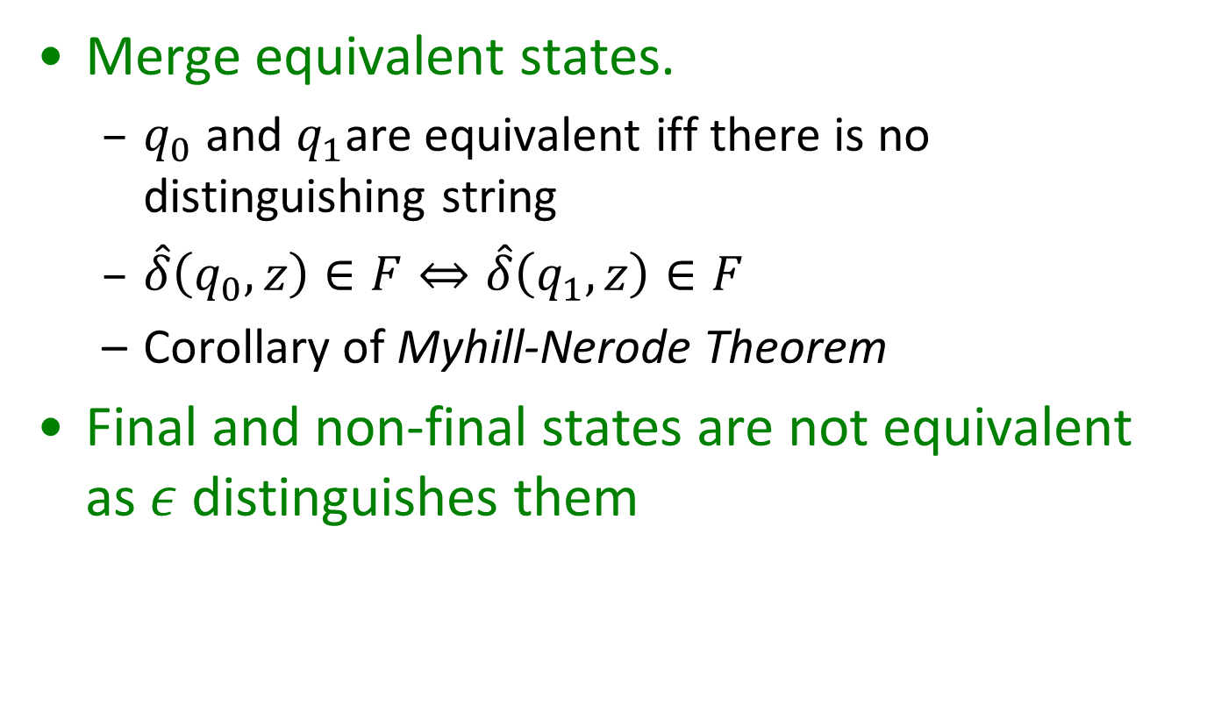
Minimizing DFAs
Merge equivalent states.
  $q_{0}$ and $q_{1}$are equivalent iff there is no distinguishing string
  $\hat{δ}\left(q_{0},z\right)∈F⇔\hat{δ}\left(q_{1},z\right)∈F$
  Corollary of Myhill-Nerode Theorem
Final and non-final states are not equivalent as $ε$ distinguishes them

Slide 34
Minimizing DFAs: Procedure
Maintain a partition A of states
Every set in the partition has a different behavior i.e, they have a distinguishing string
States within a partition may or may not be equivalent
Initially, we have (F, Q - F)

Slide 35
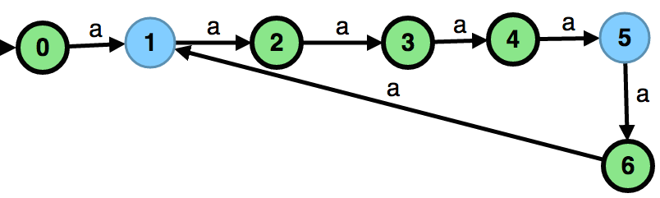
Minimizing DFAs: Procedure
A: {0,2,3,4,6} {1,5}
split based on {0,2,3,4,6}
  A: {0,4,6} {2,3} {1} {5}
split based on {1}
  A: {0,6} {4} {2,3} {1} {5} {6}
split based on {4}
  A: {0,6} {4} {2} {3} {1} {5} {6}

Slide 36
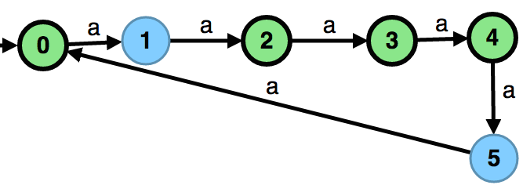
Minimizing DFAs: Procedure
The minimal DFA is unique (up to isomorphism)
Implication of Myhill-Nerode theorem
Food For Thought: Can we minimize NFA ?

Slide 37
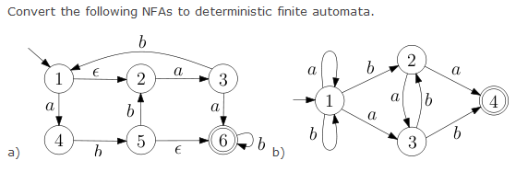
Exercise

Slide 38
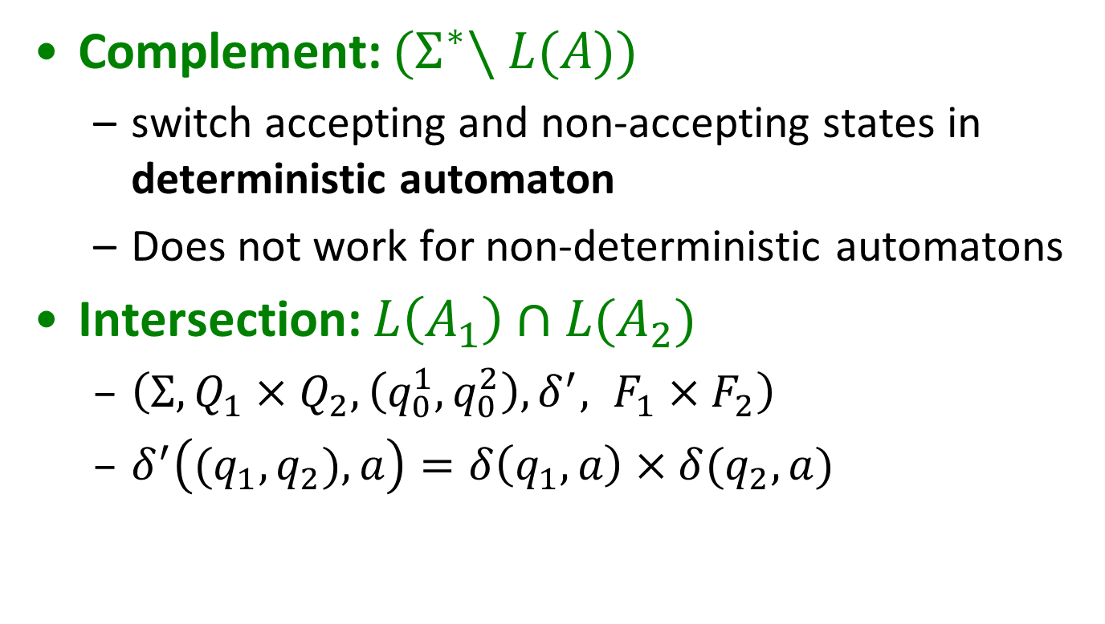
Properties of Automatons
Complement: ${(Σ}^{∗}∖L(A))$
  switch accepting and non-accepting states in deterministic automaton
  Does not work for non-deterministic automatons
Intersection: $L\left(A_{1}\right)∩L(A_{2})$
  $\left(Σ, Q_{1}×Q_{2}, \left(q_{0}^{1},q_{0}^{2}\right), δ^{′}, F_{1}×F_{2}\right)$
  $δ^{′}\left({(q}_{1},q_{2}), a\right)=δ\left(q_{1},a\right)×δ(q_{2},a)$

Slide 39
Properties of Automatons
Intersection:
  complement union of complements
Set difference: intersection with complement
Inclusion: emptiness of set difference
Equivalence: two inclusions

Slide 40
Exercise
Design a DFA which accepts all the numbers written in binary and divisible by 6. For example your automaton should accept the words 0, 110 (6 decimal) and 10010 (18 decimal).

Slide 41
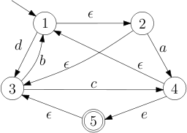
Exercise: first, nullable
For each of the following languages find the first set. Determine if the language is nullable.
  (a|b)* (b|d) ((c|a|d)* | a*)
  language given by automaton:

Slide 42
Automated Construction of Lexers
  let r₁, r₂, ..., r_{n} be regular expressions for token classes
  consider combined regular expression: (r₁ | r₂ | ... | r_{n} )
  recursively map a regular expression to a non-deterministic automaton
  eliminate epsilon transitions and determinize
  optionally minimize A₃ to reduce its size → A₄
  the result only checks that input can be split into tokens, does not say how to split it

Slide 43
From (r₁|r₂|...|r_{n} ) to a Lexer
For each accepting state of r_{i} specify the token class i being recognized
Longest match rule: remember last token and input position for a last accepted state
When no accepting state can be reached (effectively: when we are in a trap state)
  revert position to last accepted state
  return last accepted token
Why can’t we simply use (r₁|r₂|...|r_{n} )* ?

Slide 44
Exercise
Build lexical analyzer for the following two tokens using longest match. The first token class has a higher priority:
binaryDigit ::= (z|1)*
ternaryDigit ::= (0|1|2)*
1111z1021z1 →

Slide 45
Realistic Exercise: Integer Literals of Scala
Integer literals are in three forms in Scala: decimal, hexadecimal and octal. The compiler discriminates different classes from their beginning.
  Decimal integers are started with a non-zero digit.
  Hexadecimal numbers begin with 0x or 0X and may contain the digits from 0 through 9 as well as upper or lowercase digits from A to F.
  If the integer number starts with zero, it is in octal representation so it can contain only digits 0 through 7.
  l or L at the end of the literal shows the number is Long.
Draw a single DFA that accepts all the allowable integer literals.
Write the corresponding regular expression.

Slide 46
Exercise
Let L be the language of strings over {<, =} defined by regexp (<|=| <====*). That is,
L contains <,=, and words <=^{n} for n >= 3.
Construct a DFA that accepts L
Describe how the lexical analyzer will tokenize the following inputs.
  1) <=====
  2) ==<==<==<==<==
  3) <=====<

Slide 47
More Questions
For which of the following languages can you find an automaton or regular expression:
  Sequence of open or closed parentheses of even length? E.g. (), ((, )), )()))(, …
  as many digits before as after decimal point?
  Sequence of balanced parentheses
  ( ( () ) ()) - balanced
  ( ) ) ( ( ) - not balanced
  Comments from // until LF
  Nested comments like /* ... /* */ … */

