Slide 1
Soundness of Types
Ensuring that a type system is not broken

Slide 2

Example: Tootool 0.1 Language
Tootool is a rural community in the central east part of the Riverina
[New South Wales, Australia]. It is situated by road, about 4 kilometres east from French Park and 16 kilometres west from The Rock.
Tootool Post Office opened on 1 August 1901 and closed in 1966. [Wikipedia]

Slide 3
Type System for Tootool 0.1
unsound
does it type check?
def intSqrt(x:Pos) : Pos = { ...}
var p : Pos
var q : Neg
var r : Pos
q = -5
p = q
r = intSqrt(p)
Pos <: Int
Neg <: Int
assignment
Γ = {(p, Pos), (q, Neg), (r, Pos), (intSqrt, Pos → Pos)}
subtyping
Runtime error: intSqrt invoked
with a negative argument!

Slide 4
What went wrong in Tootool 0.1 ?
does it type check? – yes def intSqrt(x:Pos) : Pos = { ...}
var p : Pos
var q : Neg
var r : Pos
q = -5
p = q
r = intSqrt(p)
Pos <: Int
Neg <: Int
assignment
Γ= {(p, Pos), (q, Neg), (r, Pos), (intSqrt, Pos → Pos)}
subtyping
Runtime error: intSqrt invoked
with a negative argument!
x must be able to store any value from T
e can have any value from T
Cannot use $⊢e:T$ to mean “x promises it can store any e ∈ T”

Slide 5
Recall Our Type Derivation
does it type check? – yes def intSqrt(x:Pos) : Pos = { ...}
var p : Pos
var q : Neg
var r : Pos
q = -5
p = q
r = intSqrt(p)
Pos <: Int
Neg <: Int
assignment
¡ = {(p, Pos), (q, Neg), (r, Pos), (intSqrt, Pos → Pos)}
subtyping
Runtime error: intSqrt invoked
with a negative argument!
Values from p are integers. But p did not promise to store all kinds of integers/ Only positive ones!

Slide 6
Corrected Type Rule for Assignment
does it type check?
def intSqrt(x:Pos) : Pos = { ...}
var p : Pos
var q : Neg
var r : Pos
q = -5
p = q
r = intSqrt(p)
Pos <: Int
Neg <: Int
assignment
¡ = {(p, Pos), (q, Neg), (r, Pos), (intSqrt, Pos → Pos)}
subtyping
does not type check
x must be able to store any value from T
e can have any value from T
Γ stores declarations (promises)

Slide 7
Corrected Type Rule for Assignment
does it type check?
def intSqrt(x:Pos) : Pos = { ...}
var p : Pos
var q : Neg
var r : Pos
q = -5
p = q
r = intSqrt(p)
Pos <: Int
Neg <: Int
assignment
¡ = {(p, Pos), (q, Neg), (r, Pos), (intSqrt, Pos → Pos)}
subtyping
does not type check
Is there another way to fix the type system ?

Slide 8
How could we ensure that some other programs will not break?
Type System Soundness

Slide 9
Proving Soundness of Type Systems
Goal of a sound type system:
  if a program type checks, it never “crashes”
  crash = some precisely specified bad behavior
  e.g. invoking an operation with a wrong type
    dividing a string by another string: “cat” / “frog”
    trying to multiply a Window object by a File object
  e.g. dividing an integer by zero
Never crashes: no matter how long it executes
  proof is done by induction on program execution

Slide 10
Proving Soundness by Induction
VG
VG
VG
VG
VG
VG
VG
VG
VG
VG
VG
VG
Good
Program moves from state to state
Bad state = state where program is about to exhibit a bad operation ( “cat” / “frog” )
Good state = state that is not bad
To prove:
program type checks → states in all executions are good
Usually need a stronger inductive hypothesis;
some notion of very good (VG) state such that:
program type checks → program’s initial state is very good
state is very good → next state is also very good
state is very good → state is good (not about to crash)

Slide 11
A Simple Programming Language

Slide 12
Program State
var x : Pos
var y : Int
var z : Pos
x = 3
y = -5
z = 4
x = x + z
y = x / z
z = z + x
Initially, all variables have value 1
values of variables:
x = 1
y = 1
z = 1
position in source

Slide 13
Program State
var x : Pos
var y : Int
var z : Pos
x = 3
y = -5
z = 4
x = x + z
y = x / z
z = z + x
values of variables:
x = 3
y = 1
z = 1
position in source

Slide 14
Program State
var x : Pos
var y : Int
var z : Pos
x = 3
y = -5
z = 4
x = x + z
y = x / z
z = z + x
values of variables:
x = 3
y = -5
z = 1
position in source

Slide 15
Program State
var x : Pos
var y : Int
var z : Pos
x = 3
y = -5
z = 4
x = x + z
y = x / z
z = z + x
values of variables:
x = 3
y = -5
z = 4
position in source

Slide 16
Program State
var x : Pos
var y : Int
var z : Pos
x = 3
y = -5
z = 4
x = x + z
y = x / z
z = z + x
values of variables:
x = 7
y = -5
z = 4
position in source

Slide 17
Program State
var x : Pos
var y : Int
var z : Pos
x = 3
y = -5
z = 4
x = x + z
y = x / z
z = z + x
values of variables:
x = 7
y = 1
z = 4
position in source
formal description of such program execution is called operational semantics

Slide 18
Operational semantics
Operational semantics gives meaning to programs by describing how the program state changes as a sequence of steps.
Small-step Operational Semantics (SOS): consider individual steps (e.g. z = x + y)
  V: set of variables in the program
  pc: integer variable denoting the program counter
  g: V → Int function giving the values of program variables
  (g, pc) program state
  Then, for each possible statement in the program we define how it changes the program state.
Big-step semantics: consider the effect of entire blocks

Slide 19
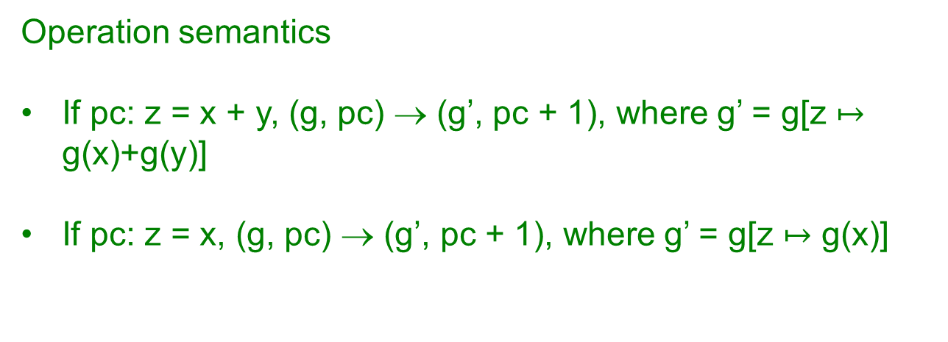


Operational semantics
g
g
pc: z = x+y
pc: z = x
g’ = g[z $↦$ g(x) + g(y)]
g’ = g[z $↦$ g(x)]
Operation semantics
If pc: z = x + y, (g, pc) → (g’, pc + 1), where g’ = g[z $↦$ g(x)+g(y)]
If pc: z = x, (g, pc) → (g’, pc + 1), where g’ = g[z $↦$ g(x)]

Slide 20
Type Rules of Simple Language
Type rules:
Γ = { (x₁, Pos),
(x₂, Int),
…
(x_{n}, Pos)}
Pos <: Int
Programs:
var x₁ : Pos
var x₂ : Int
...
var x_{n} : Pos
x_{i} = x_{j}
x_{p} = x_{q} + x_{r}
x_{a} = x_{b} / x_{c}
...
x_{p} = x_{q} + x_{r}
variable declarations
var x: Pos (strictly positive)
or
var x: Int
followed by
statements of one of the forms
x_{i}=k
x_{i} = x_{j}
x_{i} = x_{j} / x_{k}
x_{i} = x_{j} + x_{k}
(No complex expressions)

Slide 21
Bad State: About to Divide by Zero (Crash)
var x : Pos
var y : Int
var z : Pos
x = 1
y = -1
z = x + y
x = x + z
y = x / z
z = z + x
values of variables:
x = 1
y = -1
z = 0
position in source
Definition: state is bad if the next instruction is of the form
x_{i} = x_{j} / x_{k} and x_{k} has value 0 in the current state.

Slide 22
Good State: Not (Yet) About to Divide by Zero
var x : Pos
var y : Int
var z : Pos
x = 1
y = -1
z = x + y
x = x + z
y = x / z
z = z + x
values of variables:
x = 1
y = -1
z = 1
position in source
Good
Definition: state is good if it is not bad.
Definition: state is bad if the next instruction is of the form
x_{i} = x_{j} / x_{k} and x_{k} has value 0 in the current state.

Slide 23
Good State: Not (Yet) About to Divide by Zero
var x : Pos
var y : Int
var z : Pos
x = 1
y = -1
z = x + y
x = x + z
y = x / z
z = z + x
values of variables:
x = 1
y = -1
z = 0
position in source
Good
Definition: state is good if it is not bad.
Definition: state is bad if the next instruction is of the form
x_{i} = x_{j} / x_{k} and x_{k} has value 0 in the current state.

Slide 24
Moved from Good to Bad in One Step!
Being good is not preserved by one step, not inductive!
It is very local property, does not take future into account.
var x : Pos
var y : Int
var z : Pos
x = 1
y = -1
z = x + y
x = x + z
y = x / z
z = z + x
values of variables:
x = 1
y = -1
z = 0
position in source
Bad
Definition: state is good if it is not bad.
Definition: state is bad if the next instruction is of the form
x_{i} = x_{j} / x_{k} and x_{k} has value 0 in the current state.

Slide 25
Being Very Good: A Stronger Inductive Property
Pos = { 1, 2, 3, ... }
var x : Pos
var y : Int
var z : Pos
x = 1
y = -1
z = x + y
x = x + z
y = x / z
z = z + x
values of variables:
x = 1
y = -1
z = 0
This state is already not very good.
∉ Pos
position in source
Definition: state is good if it is not about to divide by zero.
Definition: state is very good if each variable belongs to the domain determined by its type (if z:Pos, then z is strictly positive).

Slide 26
Proving Soundness - Intuition
We want to show if a program type checks:
  It will be very good at the start
  if it is very good in the current step, it will remain
  very good in the next step
  If it is very good, it will not crash
Hence, please type check your program, and it will never crash!
Soundnes proof = defining “very good” and checking the properties above.

Slide 27
Proving Soundness in Our Case
Holds: in initial state, variables are =1
If a program type checks :
  It will be very good from at start.
  if it is very good in the current step, it will remain very good in the next
  If it is very good, it will not crash.
1 ∈ Pos
1 ∈ Int
If next state is x / z, type rule ensures z has type Pos
Because state is very good, it means z ∈ Pos
so z is not 0, and there will be no crash.
Definition: state is very good if each variable belongs to the domain determined by its type (if z:Pos, then z is strictly positive).

Slide 28
Proving that “very goodness” is preserved by state transition
How do we prove
  if you are very good, then you will remain
  very good in the next step
  Irrespective of the actual program
We could use SOS – small step operational semantics here.

Slide 29

Proving that “very goodness” is preserved by state transition
Hypothesize that g is very good
g
g
pc: z = x+y
pc: z = x
g’ = g[z $↦$ g(x) + g(y)]
g’ = g[z $↦$ g(x)]
Prove that g’ is very good
When the program type checks
Do this for every possible “step” of the operational semantics

Slide 30


Proving this for our little type system
Hypothesize that the following holds in g
For all vars x, x:Pos => x is strictly positive
$$∀x. Γ⊢x :Pos⇒g\left(x\right)>0$$
g
: var -> Int
g
pc: z = x+y
pc: z = x
g’ = g[z $↦$ g(x) + g(y)]
g’ = g[z $↦$ g(x)]
Prove that the following holds in g’
For all vars x, x:Pos => x is strictly positive
$$∀x. Γ⊢x :Pos⇒g′\left(x\right)>0$$
Can we prove this ?
  Only if we are given that the program type checks

Slide 31
Recall the Type Rules
Pos <: Int

Slide 32
Back to the start
Does the proof still work?
If not, where does it break?

Slide 33
Let’s type check some programs
Example 1
var x : Pos
var y : Pos
var z : Pos
y = 3
z = 2
z = x + y
x = x + z
y = x / z
z = z + x
values of variables:
x = 1
y = 3
z = 2
position in source
the next statement is: z=x+y
where x,y,z are declared Pos.
Goal: provide a type derivation for the program

Slide 34
Example 2
var x : Pos
var y : Int
var z : Pos
y = -5
z = 2
z = x + y
x = x + z
y = x / z
z = z + x
values of variables:
x = 1
y = -5
z = 2
position in source
the next statement is: z=x+y
where x,z declared Pos, y declared Int
Goal: prove that the program type checks
impossible, because z=x+y would not type check
How do we know it could not type check?

Slide 35
Must Carefully Check Our Type Rules
Type rules:
Γ = { (x₁, Pos),
(x₂, Int),
…
(x_{n}, Pos)}
Pos <: int
var x : Pos
var y : Int
var z : Pos
y = -5
z = 2
z = x + y
x = x + z
y = x / z
z = z + x
Conclude that the only types we can derive are:
x : Pos, x : Int
y : Int
x + y : Int
Cannot type check
z = x + y in this environment.

Slide 36
We would need to check all cases
(there are many, but they are easy)

Slide 37
Remark
We used in examples Pos <: Int
Same examples work if we have
class Int { ... }
class Pos extends Int { ... }
and is therefore relevant for OO languages

Slide 38
What if we want more complex types?
class A { }
class B extends A {
void foo() { }
}
class Test {
public static void main(String[] args) {
B[] b = new B[5];
A[] a;
a = b;
System.out.println("Hello,");
a[0] = new A();
System.out.println("world!");
b[0].foo();
}
}
Should it type check?
Does this type check in Java?
  can you run it?
Does this type check in Scala?

Slide 39
What if we want more complex types?
Suppose we add to our language a reference type:
class Ref[T](var content : T)
Programs:
Exercise 1:
Extend the type rules to use with Ref[T] types.
Show your new type system is sound.
var x₁ : Pos
var x₂ : Int
var x₃ : Ref[Int]
var x₄ : Ref[Pos]
x = y
x = y + z
x = y / z
x = y + z.content
x.content = y
…
Exercise 2:
Can we use the subtyping rule?
If not, where does the proof break?

Slide 40
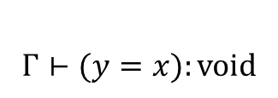


Simple Parametric Class
class Ref[T](var content : T)
Can we use the subtyping rule
var x : Ref[Pos]
var y : Ref[Int]
var z : Int
x.content = 1
y.content = -1
y = x
y.content = 0
z = z / x.content
Γ
$Γ⊢x:Ref\left[Pos\right] Γ⊢Ref\left[Pos\right]<:Ref[Int]$
$$Γ⊢x:Ref[Int]$$
$$\left(y, Ref\left[Int\right]\right)∈Γ$$
$$Γ⊢(y=x):void$$
type checks

Slide 41
Simple Parametric Class
class Ref[T](var content : T)
Can we use the subtyping rule
var x : Ref[Pos]
var y : Ref[Int]
var z : Int
x.content = 1
y.content = -1
y = x
y.content = 0
z = z / x.content
Ref[Pos]
1
x
Ref[Int]
y
-1

Slide 42
Simple Parametric Class
class Ref[T](var content : T)
Can we use the subtyping rule
var x : Ref[Pos]
var y : Ref[Int]
var z : Int
x.content = 1
y.content = -1
y = x
y.content = 0
z = z / x.content
Ref[Pos]
1
x
Ref[Int]
y
-1

Slide 43
Simple Parametric Class
class Ref[T](var content : T)
Can we use the subtyping rule
var x : Ref[Pos]
var y : Ref[Int]
var z : Int
x.content = 1
y.content = -1
y = x
y.content = 0
z = z / x.content
Ref[Pos]
0
x
Ref[Int]
y
-1
CRASHES

Slide 44
Analogously
class Ref[T](var content : T)
Can we use the converse subtyping rule
var x : Ref[Pos]
var y : Ref[Int]
var z : Int
x.content = 1
y.content = -1
x = y
y.content = 0
z = z / x.content
Ref[Pos]
1
x
Ref[Int]
y
0
CRASHES

Slide 45
Mutable Classes do not
Preserve Subtyping
class Ref[T](var content : T)
Even if T <: T’,
Ref[T] and Ref[T’] are unrelated types
var x : Ref[T]
var y : Ref[T’]
...
x = y
...
type checks only if T=T’

Slide 46
Same Holds for Arrays, Vectors, all mutable containers
Even if T <: T’,
Array[T] and Array[T’] are unrelated types
var x : Array[Pos](1)
var y : Array[Int](1)
var z : Int
x[0] = 1
y[0] = -1
y = x
y[0] = 0
z = z / x[0]

Slide 47
Case in Soundness Proof Attempt
class Ref[T](var content : T)
Can we use the subtyping rule
var x : Ref[Pos]
var y : Ref[Int]
var z : Int
x.content = 1
y.content = -1
y = x
y.content = 0
z = z / x.content
Ref[Pos]
1
x
Ref[Int]
y
-1
prove that runtime value of each variable belongs to its type.

Slide 48
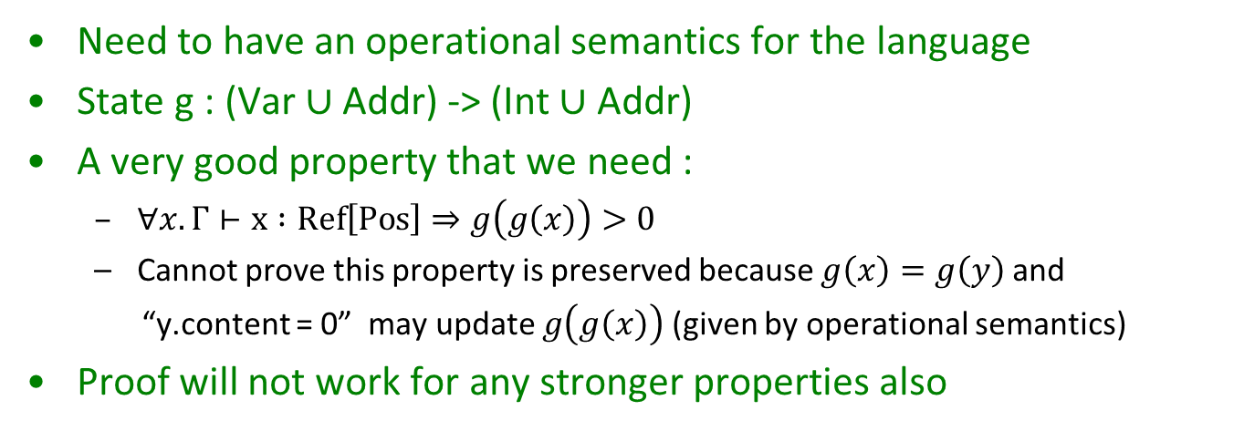
Soundness Proof Attempt [Cont.]
var x : Ref[Pos]
var y : Ref[Int]
var z : Int
x.content = 1
y.content = -1
y = x
y.content = 0
z = z / x.content
Ref[Pos]
1
x
y
-1
Ref[Int]
prove that runtime value of each variable belongs to its type.
Need to have an operational semantics for the language
State g : (Var $∪$ Addr) -> (Int $∪$ Addr)
A very good property that we need :
  $∀x. Γ⊢x :Ref\left[Pos\right]⇒g\left(g\left(x\right)\right)>0$
  Cannot prove this property is preserved because $g\left(x\right)=g\left(y\right)$ and
  “y.content = 0” may update $g\left(g\left(x\right)\right)$ (given by operational semantics)
Proof will not work for any stronger properties also

Slide 49
Mutable vs Immutable Containers
Immutable container, Coll[T]
  has methods of form e.g. get(x:A) : T
  if T <: T’, then Coll[T’] has get(x:A) : T’
  we have (A → T) <: (A→ T’)
  covariant rule for functions, so Coll[T] <: Coll[T’]
Write-only data structure have
  setter-like methods, set(v:T) : B
  if T <: T’, then Container[T’] has set(v:T’) : B
  would need (T’ → B) <: (T → B)
  contravariance for arguments, so Coll[T’] <: Coll[T]
Read-Write data structure need both. That is coll[T] is invariant in T

Slide 50
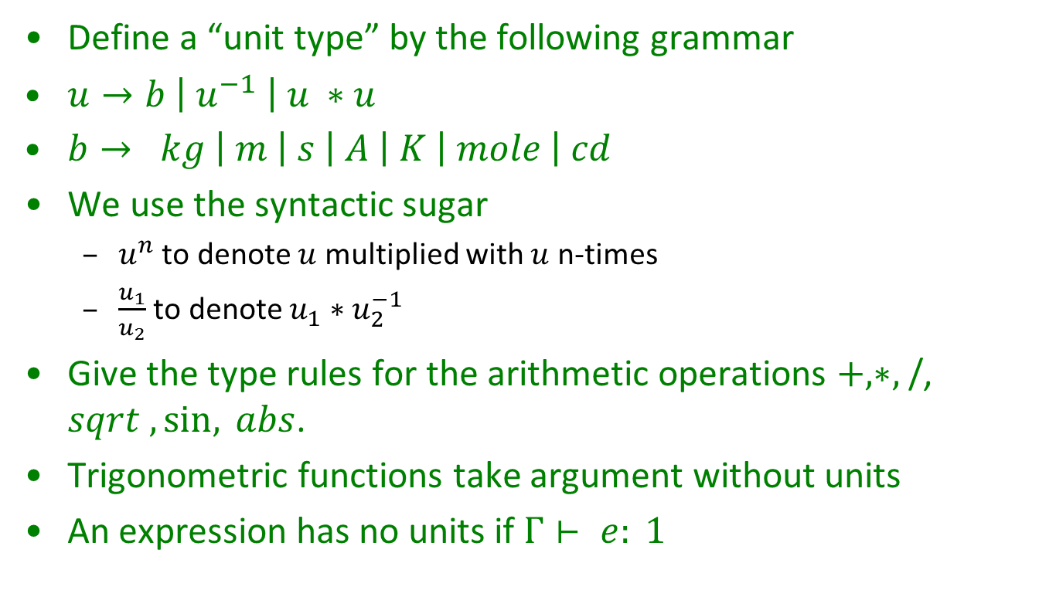
A cool exercise –
Physical Units as Types
Define a “unit type” by the following grammar
$u→b \left| u^{−1} \right| u ∗u$
$b→ kg \left| m \right| s \left| A \left| K \right| mole \right| cd$
We use the syntactic sugar
  $u^{n}$ to denote $u$ multiplied with $u$ n-times
  $\frac{u_{1}}{u_{2}}$ to denote $u_{1}∗u_{2}^{−1}$
Give the type rules for the arithmetic operations $+,∗,$ /, $sqrt , \sin{, } abs$.
Trigonometric functions take argument without units
An expression has no units if $Γ⊢ e: 1$

Slide 51

Physical Units as Types
Part 2
The unit expressions are strings, so
$\frac{S^{2}m^{2}}{m^{2}s}$ and $s$ will not be considered as same types though they have same units
How can we modify the type rules so that they type check expressions, whenever their units match as per physics?

Slide 52
Physical Units as Types
Part 3
Determine the type of T in the following code fragment.
val x: <m> = 800
val y: <m> = 6378
val g: <m/(s*s)> = 9.8
val R = x + y
val w = sqrt(g/R)
val T = (2 * Pi) / w

Slide 53
Physical Units as Types
Part 4
Suppose you want to use the unit feet in addition to the SI units. How can you extend your type system to accommodate for this?
(Assume that 1m = 3.28084 feet.)

