Slide 1
Exercises on Grammars
1. Consider the following grammar:
S -> ( L ) | a
L -> L , S | S
Is this grammar ambiguous ?
Is this grammar LL(1) ?
Compute the First and Follow sets for the new grammar.
Construct the parsing table for the LL(1) parser

Slide 2
Finding an LL(1) grammar
No procedural way ! Practice …
But there are some recommended practices that generally help in finding one.
Eg. try to eliminate left recursion.
  There is a procedure for this but you don’t have to faithfully follow the entire approach.
  Just think of what left recursion brings and what can be done to eliminate them

Slide 3
Removing Left Recursion
S -> ( L ) | a
L -> L , S | S
How does a derivation starting from ‘L’ look ?
L => L , S
=> L , S , S
=>* L , S , … , S
=> S , … , S
L -> L , S | S is equivalent to L -> S , L | S
S -> ( L ) | a
L -> S , L | S

Slide 4
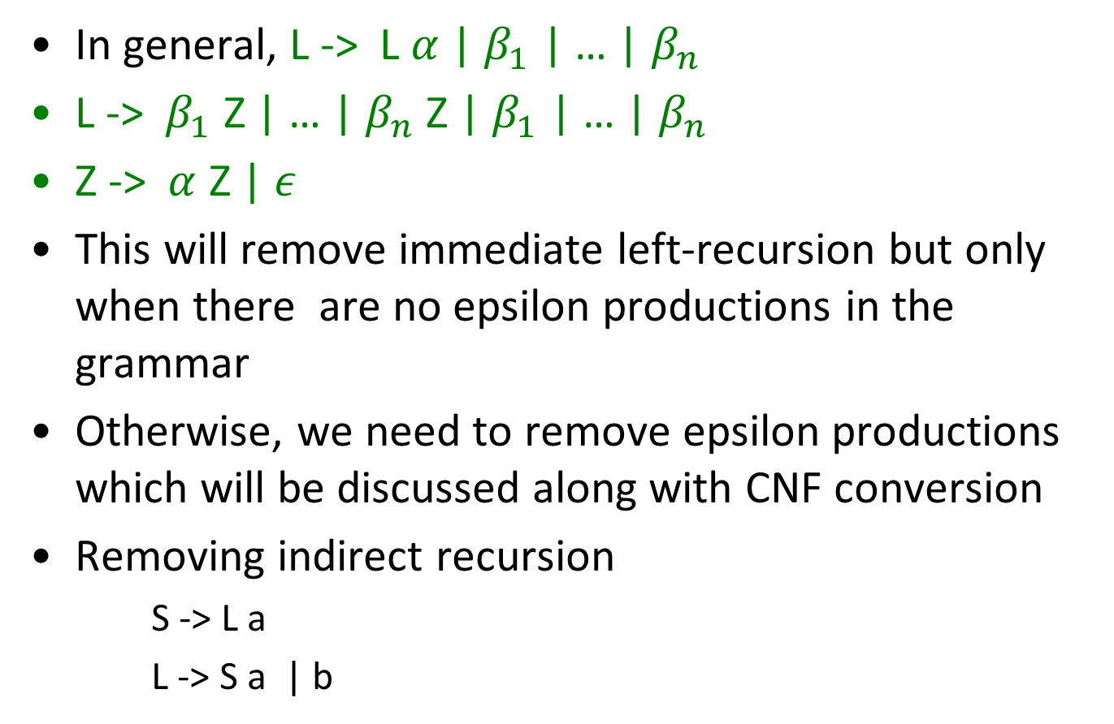
Removing Left Recursion
In general, L -> L $α$ | $β_{1}$ | … | $β_{n}$
L -> $β_{1}$ Z | … | $β_{n}$ Z | $β_{1}$ | … | $β_{n}$
Z -> $α$ Z | $ε$
This will remove immediate left-recursion but only when there are no epsilon productions in the grammar
Otherwise, we need to remove epsilon productions which will be discussed along with CNF conversion
Removing indirect recursion
  S -> L a
  L -> S a | b

Slide 5
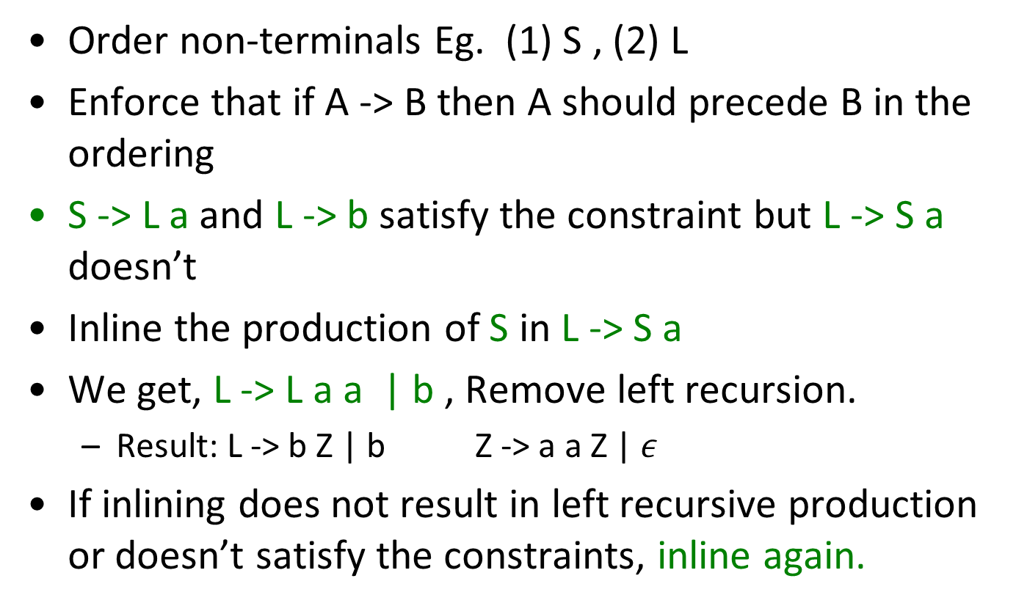
Removing Left Recursion
Order non-terminals Eg. (1) S , (2) L
Enforce that if A -> B then A should precede B in the ordering
S -> L a and L -> b satisfy the constraint but L -> S a doesn’t
Inline the production of S in L -> S a
We get, L -> L a a | b , Remove left recursion.
  Result: L -> b Z | b Z -> a a Z | $ε$
If inlining does not result in left recursive production or doesn’t satisfy the constraints, inline again.

Slide 6
Example 1 [Cont.]
S -> ( L ) | a
L -> L , S | S
After eliminating left recursion
S -> ( L ) | a
L -> S , L | S
Is this LL(1) now ?

Slide 7
Example 1 [Cont.]
S -> ( L ) | a
L -> L , S | S
After eliminating left recursion
S -> ( L ) | a
L -> S , L | S
Is this LL(1) now ?

Slide 8
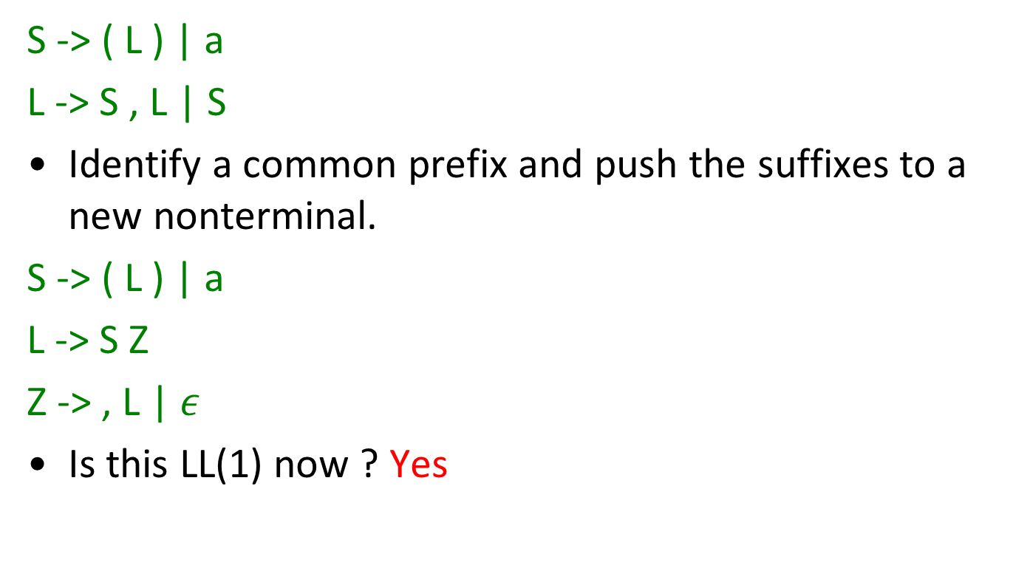
Left factorization
S -> ( L ) | a
L -> S , L | S
Identify a common prefix and push the suffixes to a new nonterminal.
S -> ( L ) | a
L -> S Z
Z -> , L | $ε$
Is this LL(1) now ? Yes

Slide 9
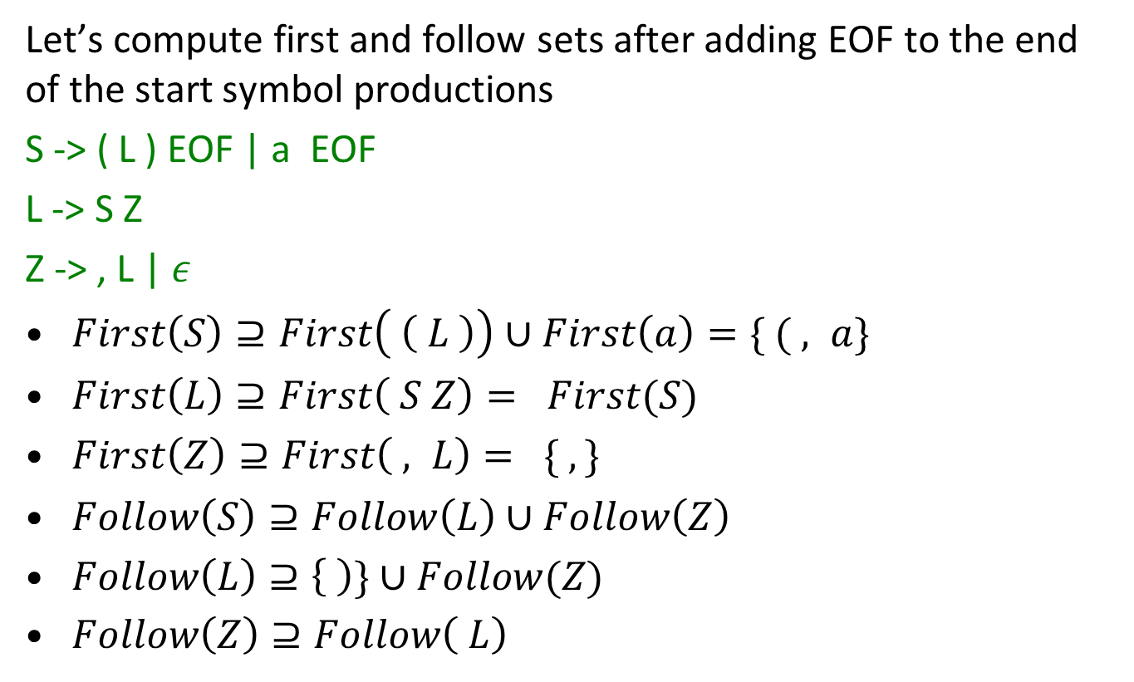
Exercise 1 - First and Follow sets
(with EOF)
Let’s compute first and follow sets after adding EOF to the end of the start symbol productions
S -> ( L ) EOF | a EOF
L -> S Z
Z -> , L | $ε$
$First\left(S\right)⊇First\left( \left( L \right)\right)∪First\left(a\right)=\{ ( , a\}$
$First\left(L\right)⊇First\left( S Z\right)= First(S)$
$First\left(Z\right)⊇First\left( , L\right)= \{ , \}$
$Follow\left(S\right)⊇Follow\left(L\right)∪Follow\left(Z\right)$
$Follow\left(L\right)⊇\left\{ \right)\}∪Follow(Z)$
$Follow\left(Z\right)⊇Follow\left( L\right)$

Slide 10
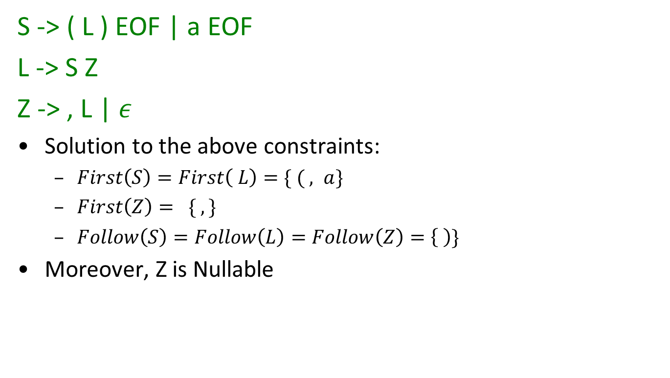
First and Follow sets [Cont.]
S -> ( L ) EOF | a EOF
L -> S Z
Z -> , L | $ε$
Solution to the above constraints:
  $First\left(S\right)=First\left( L\right)=\{ ( , a\}$
  $First\left(Z\right)= \{ , \}$
  $Follow\left(S\right)=Follow\left(L\right)=Follow\left(Z\right)=\left\{ \right)\}$
Moreover, Z is Nullable

Slide 11
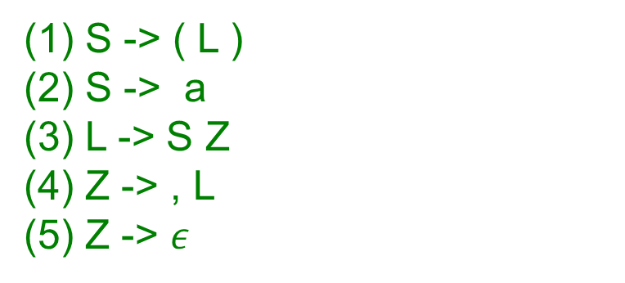
LL(1) parsing table
S -> ( L )
S -> a
L -> S Z
Z -> , L
Z -> $ε$
 | a | ( | ) | , | EOF
S | 2 | 1 | Error | Error | Error
L | 3 | 3 | Error | Error | Error
Z | Error | Error | 5 | 4 | Error

Slide 12
Exercise 2
Consider a grammar for expressions where the multiplication sign is optional.
ex ::= ex + ex | ex * ex | ex ex |ID
Find an LL(1) grammar recognizing the same language
Create the LL(1) parsing table.

Slide 13
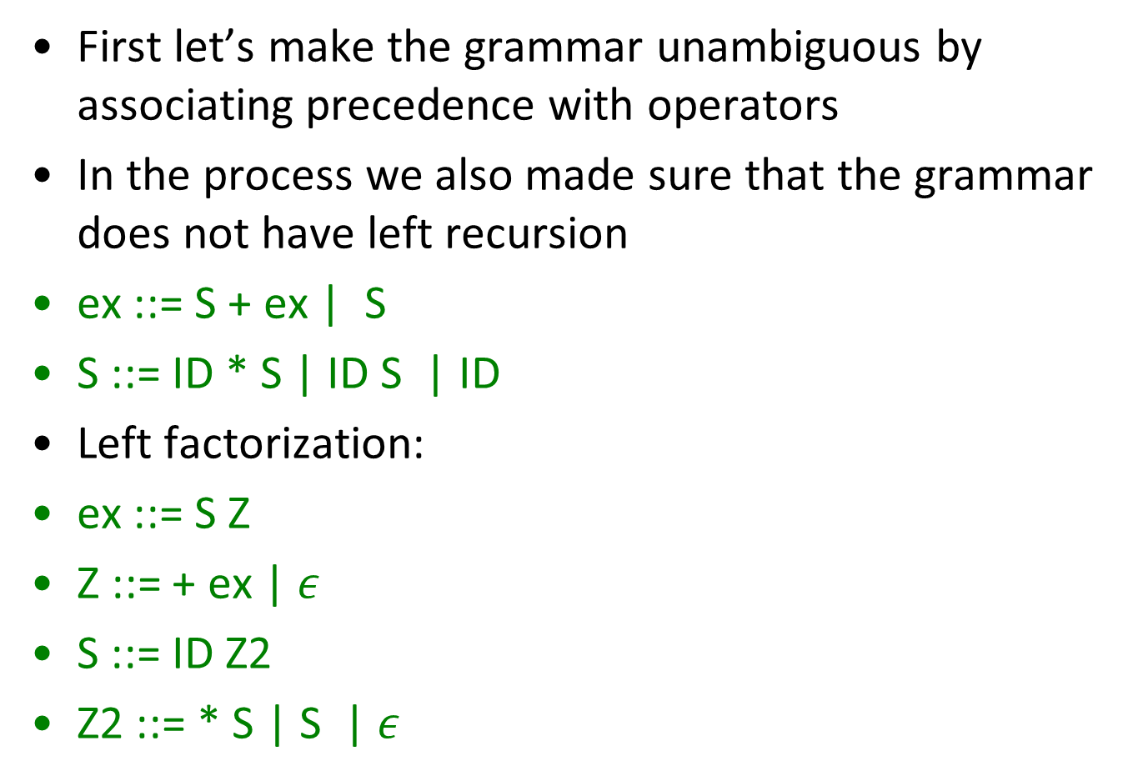
Exercise 2 – Solution
First let’s make the grammar unambiguous by associating precedence with operators
In the process we also made sure that the grammar does not have left recursion
ex ::= S + ex | S
S ::= ID * S | ID S | ID
Left factorization:
ex ::= S Z
Z ::= + ex | $ε$
S ::= ID Z2
Z2 ::= * S | S | $ε$

Slide 14
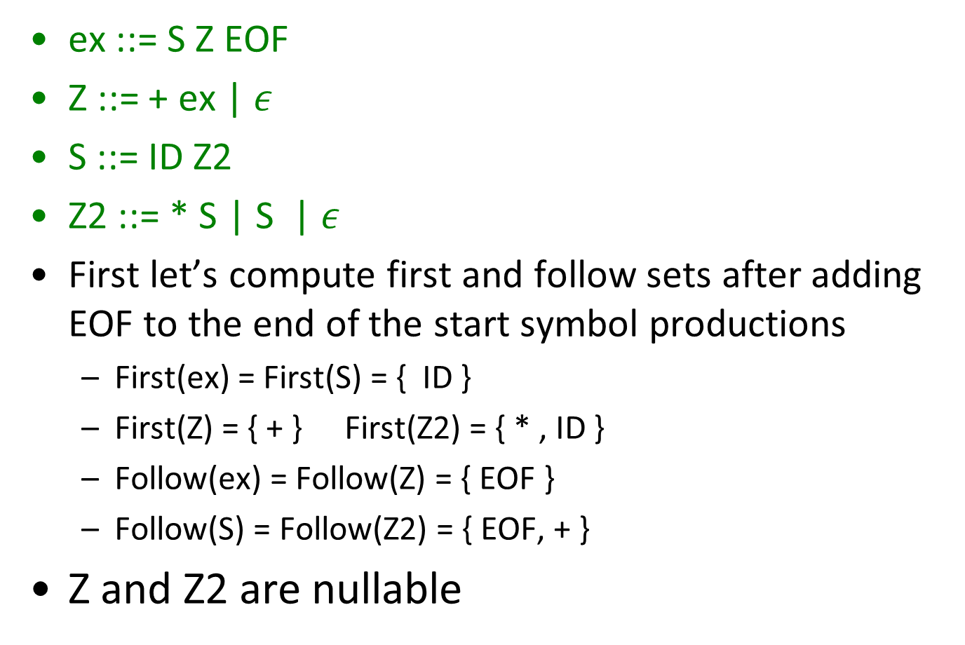
Exercise 2 – LL(1) parsing table
ex ::= S Z EOF
Z ::= + ex | $ε$
S ::= ID Z2
Z2 ::= * S | S | $ε$
First let’s compute first and follow sets after adding EOF to the end of the start symbol productions
  First(ex) = First(S) = { ID }
  First(Z) = { + } First(Z2) = { * , ID }
  Follow(ex) = Follow(Z) = { EOF }
  Follow(S) = Follow(Z2) = { EOF, + }
Z and Z2 are nullable

Slide 15

LL(1) parsing table
ex ::= S Z
Z ::= + ex
Z ::= $ε$
S ::= ID Z2
Z2 ::= * S
Z2 ::= S
Z2 ::= $ε$
 | ID | + | * | EOF
ex | 1 | Error | Error | Error
Z | Error | 2 | Error | 3
S | 4 | Error | Error | Error
Z2 | 6 | 7 | 5 | 7

Slide 16

Exercise 3
Balanced Parentheses over { ( , [ }
S ::= ( S )| [ S ] | S S | $ε$
Find an LL(1) grammar recognizing the language

Slide 17
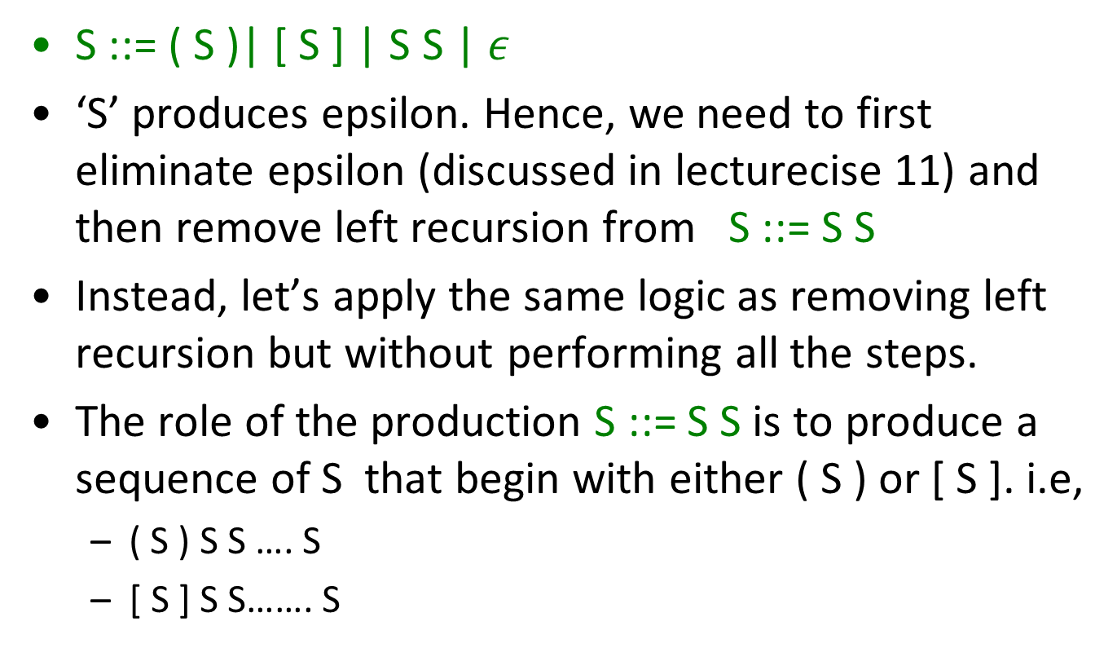
Exercise 3 - Solution
S ::= ( S )| [ S ] | S S | $ε$
‘S’ produces epsilon. Hence, we need to first eliminate epsilon (discussed in lecturecise 11) and then remove left recursion from S ::= S S
Instead, let’s apply the same logic as removing left recursion but without performing all the steps.
The role of the production S ::= S S is to produce a sequence of S that begin with either ( S ) or [ S ]. i.e,
  ( S ) S S …. S
  [ S ] S S……. S

Slide 18
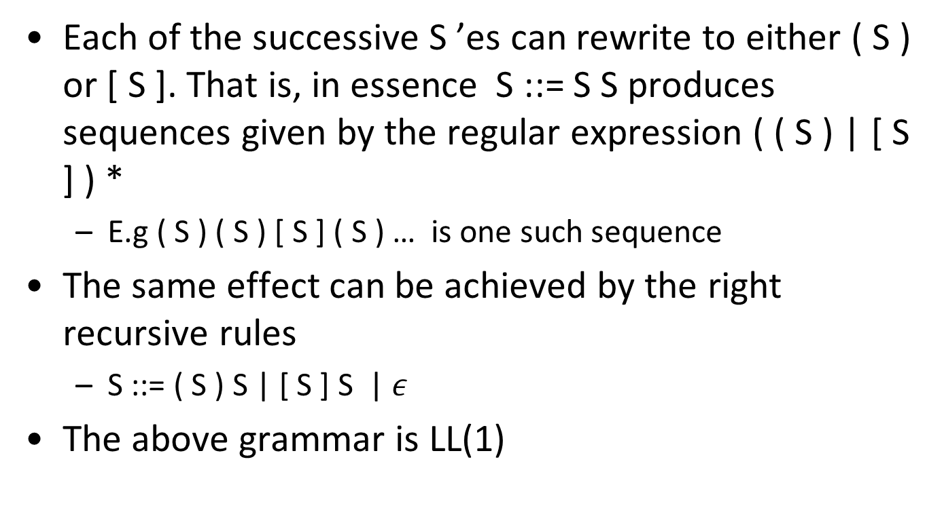
Exercise 3 - Solution
Each of the successive S ’es can rewrite to either ( S ) or [ S ]. That is, in essence S ::= S S produces sequences given by the regular expression ( ( S ) | [ S ] ) *
  E.g ( S ) ( S ) [ S ] ( S ) … is one such sequence
The same effect can be achieved by the right recursive rules
  S ::= ( S ) S | [ S ] S | $ε$
The above grammar is LL(1)

Slide 19
Exercise 4
Prove that every LL(1) grammar is unambiguous.

Slide 20
Solution to Exercise 4
Intuition:
Every production of a non-terminal belonging to an LL(1) grammar generates a set of strings that is completely disjoint from the other alternatives because of the following two reasons:
For every nonterminal, the first sets of every alternative are disjoint which implies that they produce disjoint non-empty strings
There is at most one production for a non-terminal that can produce an empty string
Formal proof is presented in the next slide

Slide 21
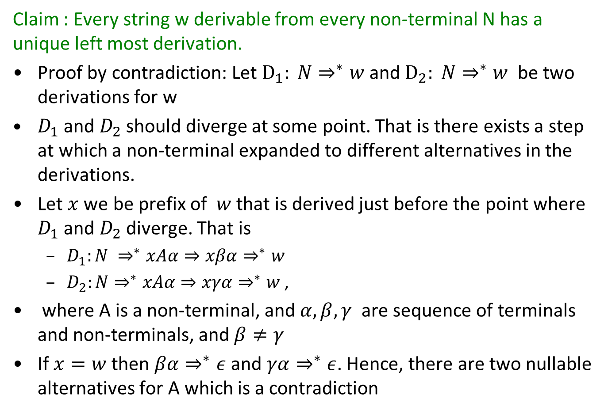
Solution to Exercise 4 [Cont.]
Claim : Every string w derivable from every non-terminal N has a unique left most derivation.
Proof by contradiction: Let $D_{1}: N⇒^{∗}w$ and $D_{2}: N⇒^{∗}w$ be two derivations for w
$D_{1}$ and $D_{2}$ should diverge at some point. That is there exists a step at which a non-terminal expanded to different alternatives in the derivations.
Let $x$ we be prefix of $w$ that is derived just before the point where $D_{1}$ and $D_{2}$ diverge. That is
  $D_{1}:N ⇒^{∗}xAα{⇒xβα⇒}^{∗}w$
  $D_{2}:N⇒^{∗}xAα{⇒xγα⇒}^{∗}w$ ,
where A is a non-terminal, and $α, β,γ$ are sequence of terminals and non-terminals, and $β≠γ$
If $x=w$ then $βα⇒^{∗}ε$ and $γα⇒^{∗}ε$. Hence, there are two nullable alternatives for A which is a contradiction

Slide 22
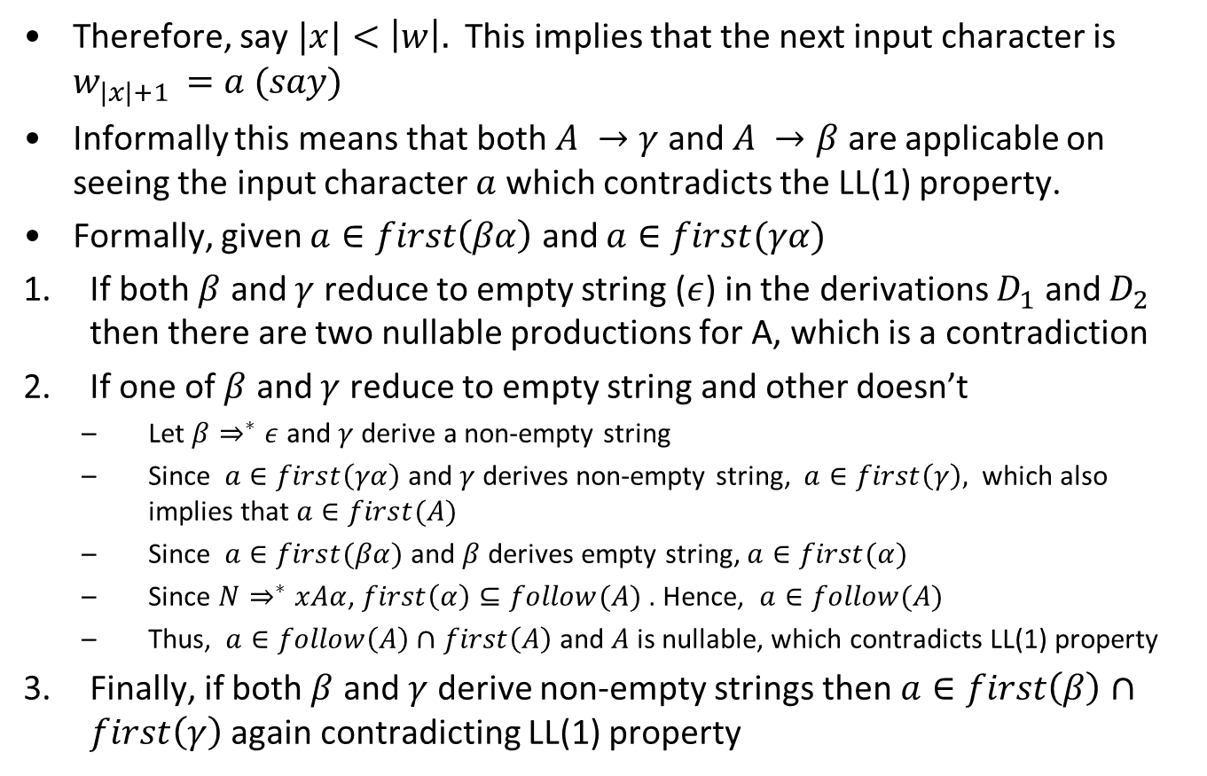
Solution to Exercise 4 [Cont.]
Therefore, say $|x|<\left|w\right|.$ This implies that the next input character is $w_{|x|+1 }=a (say)$
Informally this means that both $A →γ$ and $A →β$ are applicable on seeing the input character $a$ which contradicts the LL(1) property.
Formally, given $a∈first\left(βα\right)$ and $a∈first(γα)$
If both $β$ and $γ$ reduce to empty string ($ε$) in the derivations $D_{1}$ and $D_{2}$ then there are two nullable productions for A, which is a contradiction
If one of $β$ and $γ$ reduce to empty string and other doesn’t
  Let $β⇒^{∗}ε$ and $γ$ derive a non-empty string
  Since $a∈first\left(γα\right)$ and $γ$ derives non-empty string, $a∈first\left(γ\right),$ which also implies that $a∈first(A)$
  Since $a∈first(βα)$ and $β$ derives empty string, $a∈first(α)$
  Since $N⇒^{∗}xAα$, $first\left(α\right)⊆follow(A)$ . Hence, $a∈follow(A)$
  Thus, $a∈follow\left(A\right)∩first\left(A\right)$ and $A$ is nullable, which contradicts LL(1) property
Finally, if both $β$ and $γ$ derive non-empty strings then $a∈first\left(β\right)∩first\left(γ\right)$ again contradicting LL(1) property

Slide 23
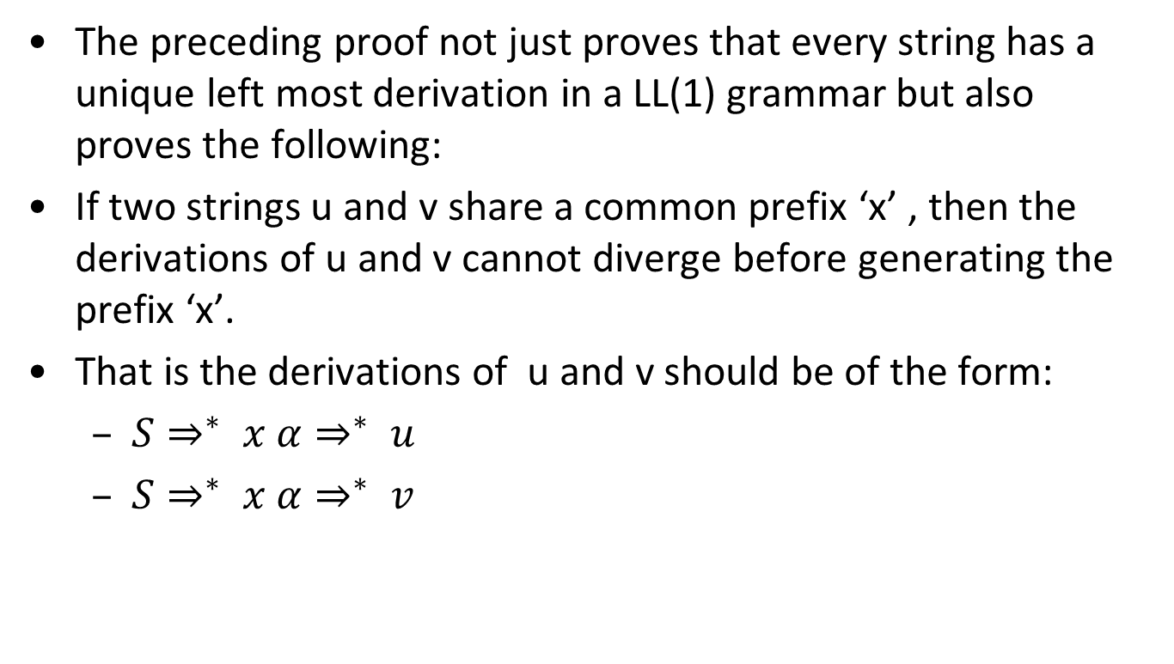
Corollary of the proof
The preceding proof not just proves that every string has a unique left most derivation in a LL(1) grammar but also proves the following:
If two strings u and v share a common prefix ‘x’ , then the derivations of u and v cannot diverge before generating the prefix ‘x’.
That is the derivations of u and v should be of the form:
  $S⇒^{∗} x α⇒^{∗} u$
  $S⇒^{∗} x α⇒^{∗} v$

Slide 24
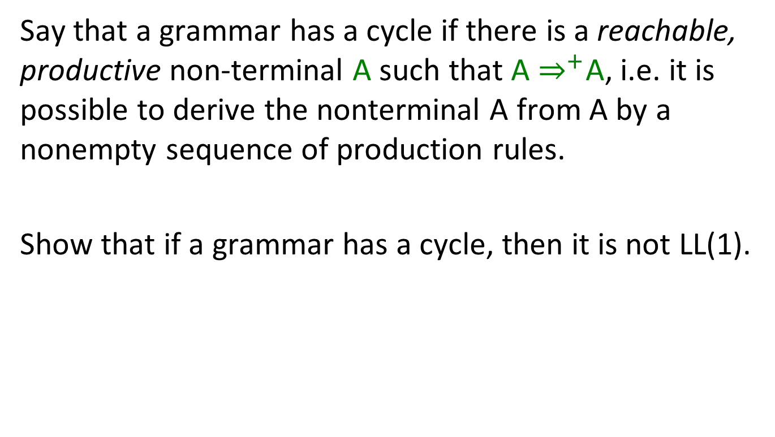
Exercise 5
Say that a grammar has a cycle if there is a reachable, productive non-terminal A such that A $⇒^{+}$A, i.e. it is possible to derive the nonterminal A from A by a nonempty sequence of production rules.
Show that if a grammar has a cycle, then it is not LL(1).

Slide 25
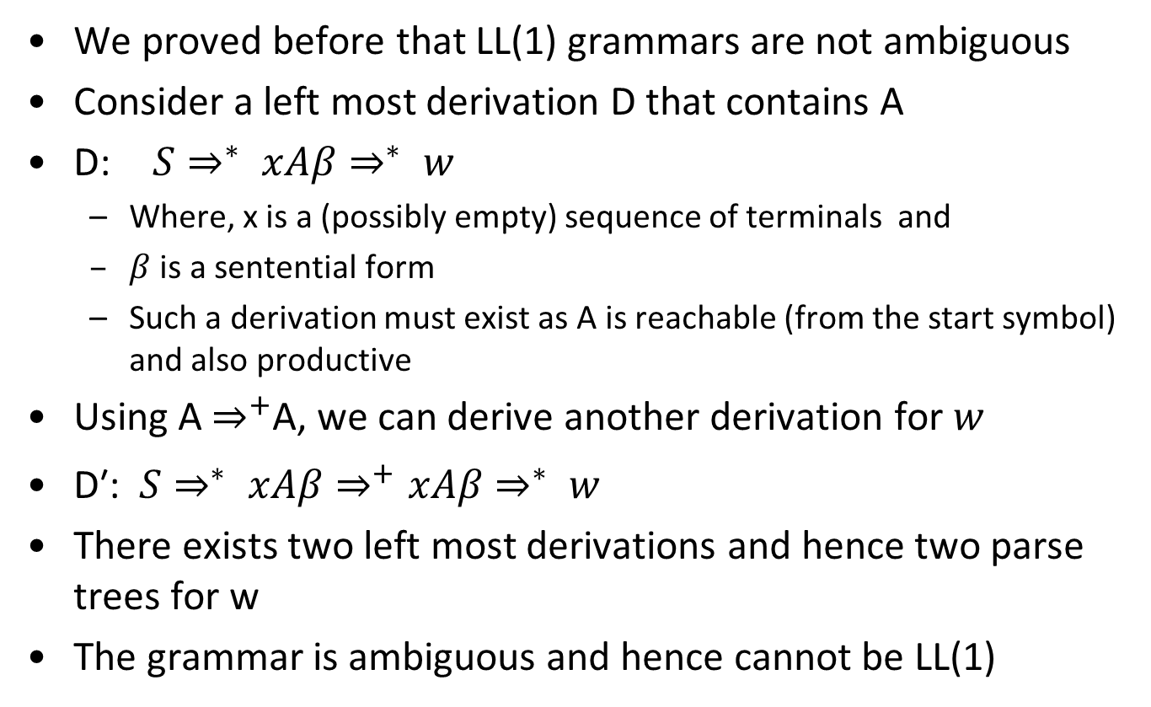
Solution to Exercise 5
We proved before that LL(1) grammars are not ambiguous
Consider a left most derivation D that contains A
D: $S⇒^{∗} xAβ⇒^{∗} w$
  Where, x is a (possibly empty) sequence of terminals and
  $β$ is a sentential form
  Such a derivation must exist as A is reachable (from the start symbol) and also productive
Using A $⇒^{+}$A, we can derive another derivation for $w$
$\text{D}\text{′}\text{: }S⇒^{∗} xAβ⇒^{+}xAβ⇒^{∗} w$
There exists two left most derivations and hence two parse trees for w
The grammar is ambiguous and hence cannot be LL(1)

Slide 26
Exercise 6
Show that the regular languages can be recognized with LL(1) parsers. Describe a process that, given a regular expression, constructs an LL(1) parser for it.

Slide 27
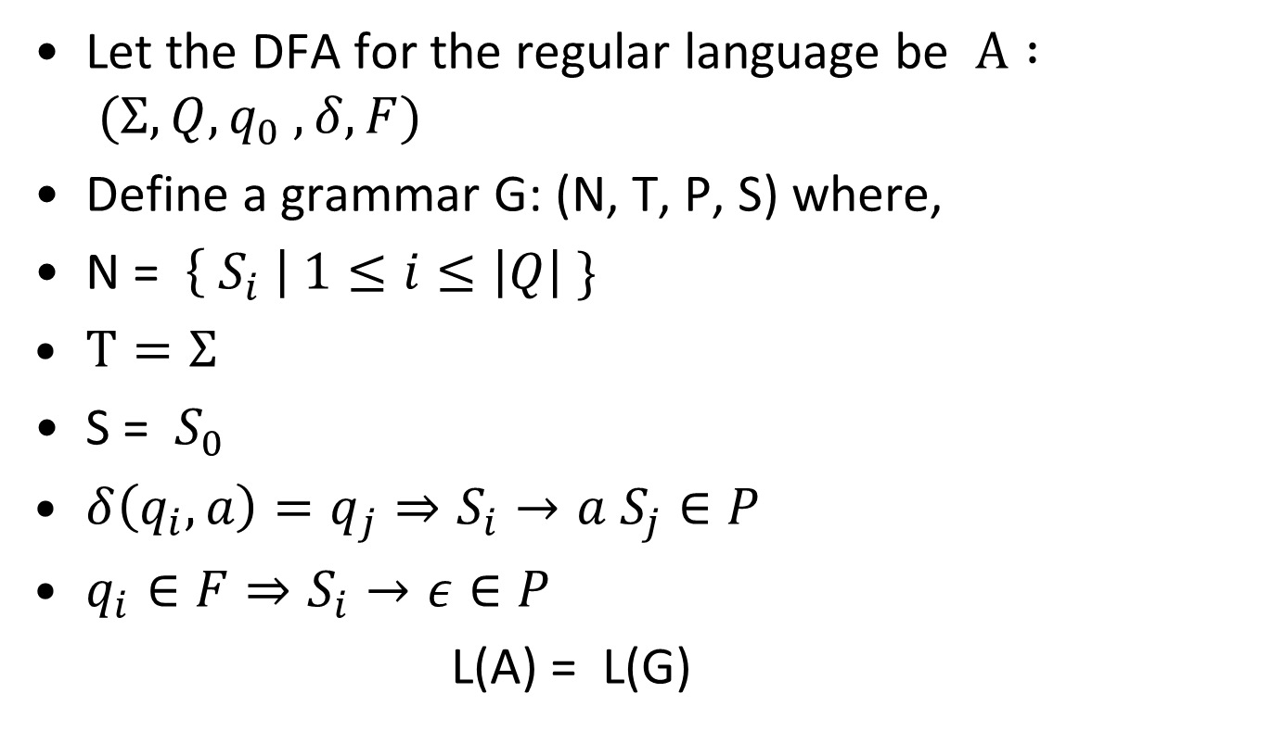
Solution for Exercise 6
Let the DFA for the regular language be $A : (Σ, Q, q_{0} , δ, F)$
Define a grammar G: (N, T, P, S) where,
N = $\left\{ S_{i} \right| 1≤i≤\left|Q\right| \}$
$T=Σ$
S = $S_{0}$
$δ\left(q_{i}, a\right)=q_{j}⇒S_{i}→a S_{j}∈P$
$q_{i}∈F⇒S_{i}→ε∈P$
L(A) = L(G)

Slide 28
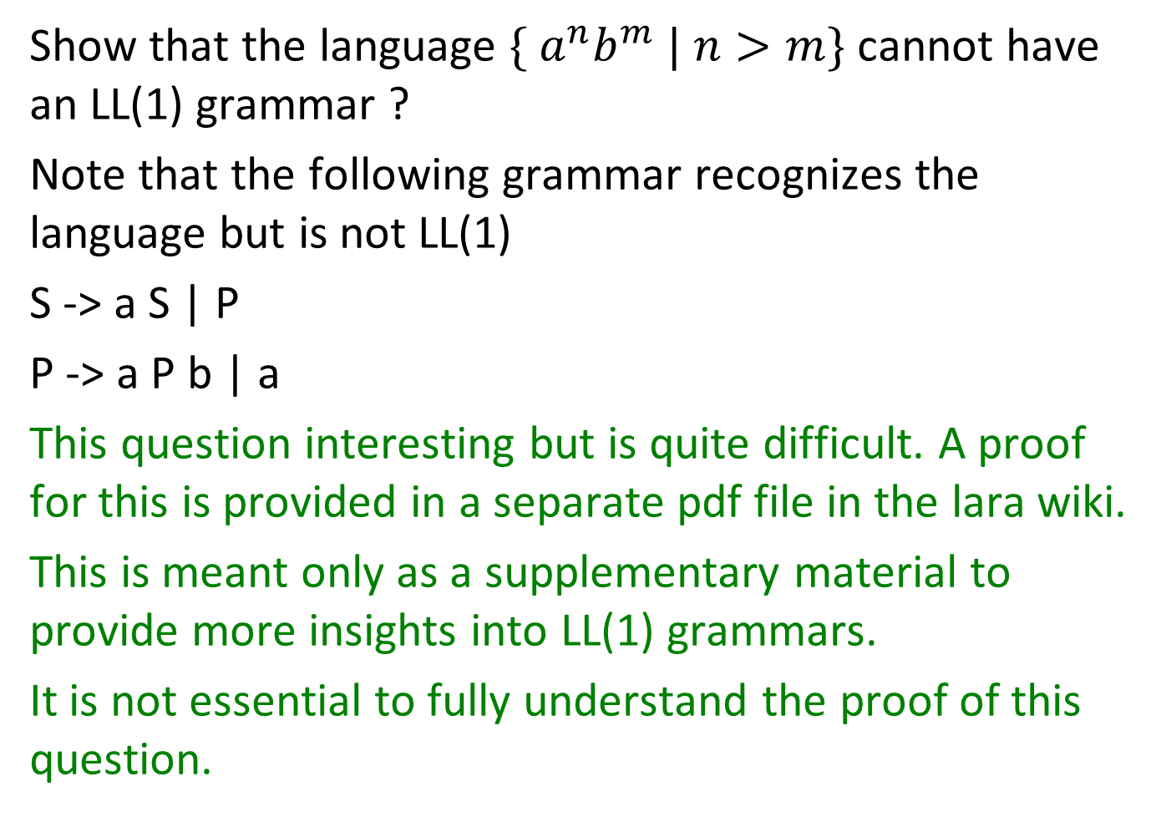
Exercise 7
Show that the language $\{ a^{n}b^{m} | n>m\}$cannot have an LL(1) grammar ?
Note that the following grammar recognizes the language but is not LL(1)
S -> a S | P
P -> a P b | a
This question interesting but is quite difficult. A proof for this is provided in a separate pdf file in the lara wiki.
This is meant only as a supplementary material to provide more insights into LL(1) grammars.
It is not essential to fully understand the proof of this question.

