Slide 1
Data-flow analysis exercises

Slide 2
Draw the control-flow graph for the following program, then perform range analysis.
All integer range [-128…127]

Slide 3
prog1:
var a = input()
var b = 50-a
var c = -1
if(a > b && a > c) {
c = a
} else if(b > c) {
c = b
}
var c = 100/c
prog2:
var a = input()
var c = 1
val r = 1
while(c < a) {
if( a % c == 0 ) r = c
c = c + 1
}
r = 64/(64-r)
prog3:
var x = 2
var y = input()
if (x == y) {
do {
y = y + 1
x = x + y + 3
} while (y < 4)
} else if (y <= -1 && y >= -7) {
y = y * y
} else {
y = x - 3
}
val z = x/y

Slide 4
1. Draw the control-flow graph for the following program, then perform range analysis.
All integer range [-128…127]
var a = input()
var b = 50-a
var c = -1
if(a > b && a > c) {
c = a
} else if(b > c) {
c = b
}
var c = 100/c

Slide 5
1. Solution
1
c=100/c
8
c = b
9
10
a = input()
2
b > c
c = a
7
!(b > c)
b = 50-a
6
3
c = -1
!(a > b)
!(a > c)
a > c
4
a > b
5

Slide 6
1. Range analysis
a b c
1: bottom bottom bottom
2: [-128, 127] bottom bottom
3: [-128, 127] [-77;127] bottom
4: [-128, 127] [-77;127] [-1]
5: [-76, 127] [-77;126] [-1]
6: [0, 127] [-77;126] [-1]
7: [-128, 127] [-77;127] [-1]
8: [-128, 127] [0;127] [-1]
9: [-128, 127] [-77;127] [0,127]
10:[-128, 127] [-77;127] [0,100]

Slide 7
2. Draw the control-flow graph for the following program, then perform range analysis.
All integer range [-128,127]
var a = input()
var c = 1
val r = 1
while(c < a) {
if( a % c == 0 ) r = c
c = c + 1
}
r = 64/(64-r)

Slide 8
2. Solution
1
8
r = 64/(64-r)
9
a = input()
2
!(c < a)
7
c = 1
r = c
6
3
r = 1
c = c+1
a%c != 0
a%C == 0
4
c < a
5

Slide 9
2. Range analysis
a c r
1: bottom bottom bottom
2: [-128, 127] bottom bottom
3: [-128, 127] [1] bottom
4: [-128, 127] [1] [1]
5: [2, 127] [1] [1]
6: [2, 127] [1] [1]
7: [2, 127] [1] [1]
8: [-128, 1] [1] [1]
9: [-128, 1] [1] [1]

Slide 10
2. Range analysis
a c r
1: bottom bottom bottom
2: [-128, 127] bottom bottom
3: [-128, 127] [1] bottom
4: [-128, 127] [1,2] [1]
5: [2, 127] [1,2] [1]
6: [2, 127] [1,2] [1]
7: [2, 127] [1,2] [1,2]
8: [-128, 2] [1,2] [1,2]
9: [-128, 2] [1,2] [1]

Slide 11
2. Range analysis
a c r
1: bottom bottom bottom
2: [-128, 127] bottom bottom
3: [-128, 127] [1] bottom
4: [-128, 127] [1,3] [1,2]
5: [2, 127] [1,3] [1,2]
6: [2, 127] [1,3] [1,2]
7: [2, 127] [1,3] [1,3]
8: [-128, 3] [1,3] [1,3]
9: [-128, 3] [1,3] [1]

Slide 12
2. Range analysis
a c r
1: bottom bottom bottom
2: [-128, 127] bottom bottom
3: [-128, 127] [1] bottom
4: [-128, 127] [1,127] [1,126]
5: [2, 127] [1,126] [1,126]
6: [2, 127] [1,63] [1,63]
7: [2, 127] [1,126] [1,126]
8: [-128, 127] [1,126] [1,126]
9: [-128, 127] [1,127] [0,64]

Slide 13
3. Draw the control-flow graph for the following program, then perform range analysis.
All integer range [-128,127]
var x = 2
var y = input()
if (x == y) {
do {
y = y + 1
x = x + y + 3
} while (y < 4)
} else if (y <= -1 && y >= -7) {
y = y * y
} else {
y = x - 3
}
val z = x/y

Slide 14
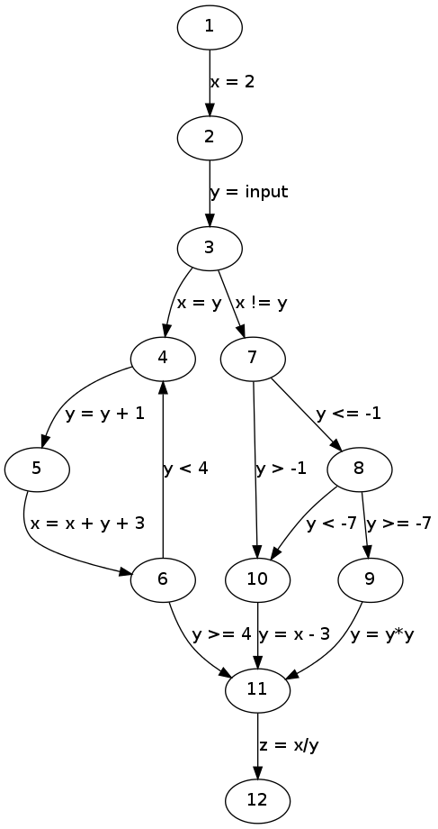
3. Solution

Slide 15
3. Range analysis
x y
1: bottom bottom
2: [2, 2] [-128, 127]
3: [2, 2] [-128, 127]
4: [2, 127] [2, 3]
5: [2, 127] [3, 4]
6: [8, 127] [3, 4]
7: [2, 2] [-128, 127]
8: [2, 2] [-128, -1]
9: [2, 2] [-7, -1]
10: [2, 2] [-128, 127]
11: [2, 127] [-1, 49]
12: [2, 127] [-1, 49] z: T

