Slide 1
Constraint-based Invariant
Inference

Slide 2
Invariants
Dictionary Meaning: A function, quantity, or property which remains unchanged
Property (in our context): a predicate that holds for some, all, or no states
Invariant is a property of a program
  at a specific program location
  that holds for every program state that reaches the program point
Specifications are invariants at exit points of programs or procedures
Also called reachability properties.

Slide 3
Invariants
x = 0
y = n
while(y > 0){
x = x + 1
y = y - 1
}
//invariant: x+y = n
//invariant: y>=0 => x<=n

Slide 4

Inductive Invariants
x = 0
y = n
//x+y = n
while(y > 0){
//x+y = n $∧$ y > 0
x = x + 1
//x+y = n+1
y = y – 1
//x+y = n
}
//invariant: x+y = n
Invariant holds initially
Invariant holds at the start of the loop
=>
invariant holds at the end of the loop

Slide 5

Not all Invariants are Inductive
x = 0
y = n
//y>=0 => x<=n
while(y > 0){
//x <= n $∧$ y > 0
x = x + 1
//x <= n+1 $∧$ y > 0
y = y – 1
//x <= n+1 $∧$ y >= 0
}
//invariant: y>=0 => x <= n
Invariant cannot be
proved by induction

Slide 6
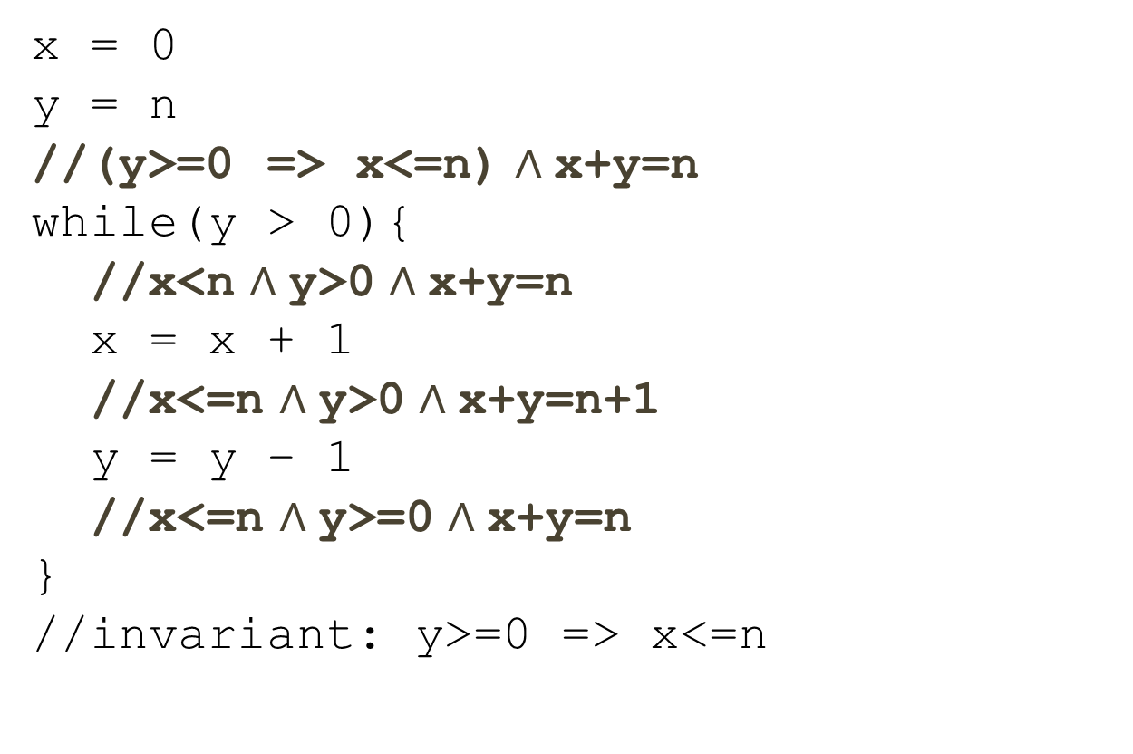
Inductive Strengthening
x = 0
y = n
//(y>=0 => x<=n) $∧$x+y=n
while(y > 0){
//x<n $∧$y>0 $∧$x+y=n
x = x + 1
//x<=n $∧$y>0 $∧$x+y=n+1
y = y – 1
//x<=n $∧$y>=0 $∧$x+y=n
}
//invariant: y>=0 => x<=n
Implied by the stronger inductive invariant

Slide 7


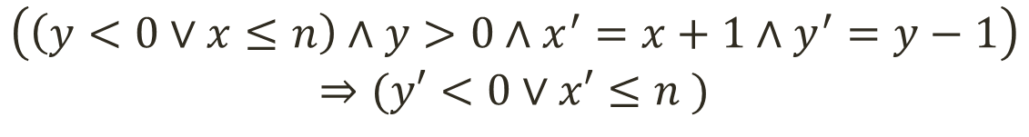
Formulating Inductiveness
x = 0
y = n
while(y > 0){
x = x + 1
y = y – 1
} //invariant: y>=0 => x<=n
Generally referred to as the verification condition (VC)
$$(x=0∧y=n)⇒(y<0∨x≤n )$$
$$I$$
Guard
Transition
$$\left(\left(y<0∨x≤n\right)∧y>0∧x^{′}=x+1∧y^{′}=y−1\right)$$
$$⇒(y′<0∨x′≤n )$$

Slide 8

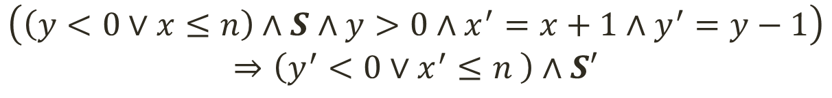
Formulating Inductive Strengthening
x = 0
y = n
while(y > 0){
x = x + 1
y = y – 1
} //invariant: y>=0 => x<=n
$$\left(x=0∧y=n\right)⇒\left(y<0∨x≤n \right)∧S$$
$$I$$
Guard
Transition
$$\left(\left(y<0∨x≤n\right)∧S∧y>0∧x^{′}=x+1∧y^{′}=y−1\right)$$
$$⇒\left(y^{′}<0∨x^{′}≤n \right)∧S′$$

Slide 9

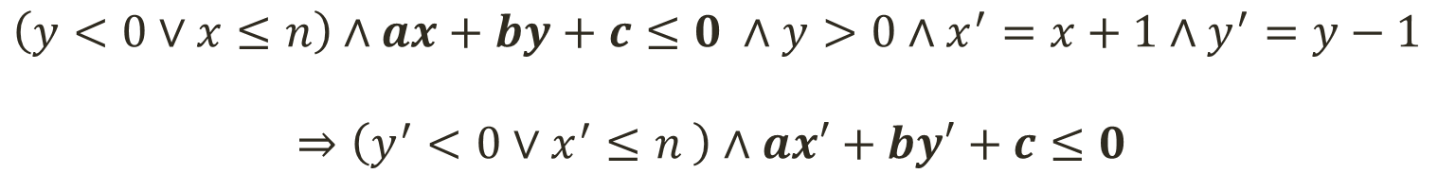
Finding Linear Invariants
[Colon et al. CAV ‘03]
x = 0
y = n
while(y > 0){
x = x + 1
y = y – 1
} //invariant: y>=0 => x<=n
Perhaps could be called a parametric VC
$$\left(x=0∧y=n\right)⇒\left(y<0∨x≤n \right)∧ax+by+c≤0$$
$$I$$
Guard
Transition
$$\left(y<0∨x≤n\right)∧ax+by+c≤0 ∧y>0∧x^{′}=x+1∧y^{′}=y−1$$
$$⇒\left(y^{′}<0∨x^{′}≤n \right)∧ax′+by′+c≤0$$

Slide 10



Finding Template Coefficients
Find values for a,b,c
s.t. the formula becomes valid
$$\left(x≥0∧y≥n\right)⇒ax+by+c<0$$
$$A⇒B≡¬(A∧¬B)$$
Find values for a,b,c
s.t. the formula becomes unsatisfiable
$$x≥0∧y≥n∧ax+by+c≥0$$
Farkas’ Lemma: A conjunction of linear inequalities is unsatisfiable
iff we can derive 1 <= 0 by performing the following operations:
Multiplying the inequalities by a non-negative constant
Adding two inequalities
Adding (or subtracting) a non-negative constant to one side

Slide 11
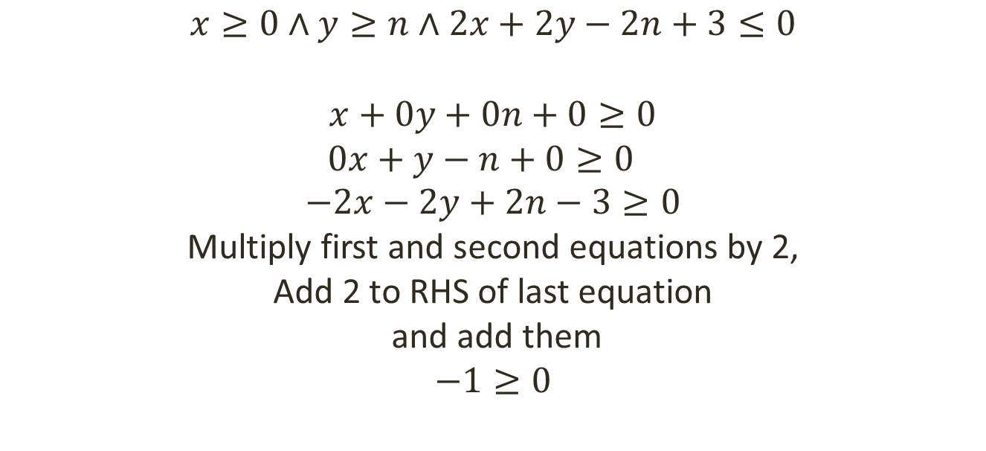
Farkas’ Lemma Example
$$x≥0∧y≥n∧2x+2y−2n+3≤0$$
$$x+0y+0n+0≥0$$
$$0x+y−n+0≥0$$
$$−2x−2y+2n−3≥0$$
Multiply first and second equations by 2,
Add 2 to RHS of last equation
and add them
$$−1≥0$$
Farkas’ Lemma: A conjunction of linear inequalities (over reals) is unsatisfiable iff we can derive 1 <= 0 by performing the following operations:
Multiplying the inequalities by a non-negative constant
Adding two inequalities
Adding (or subtracting) a non-negative constant to one side

Slide 12

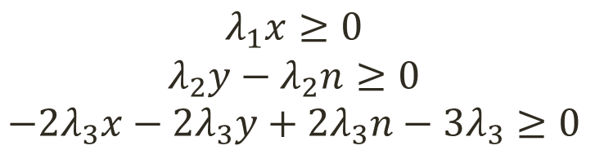
Automating Coefficient Finding
$$x≥0∧y−n≥0∧2x+2y−2n+3≤0$$
Prove unsat
$$λ_{1}x≥0$$
$$λ_{2}y{ − λ}_{2}n≥0$$
$${−2λ}_{3}x−{2λ}_{3}y+2λ_{3}n−{3λ}_{3}≥0$$
Multiplying by unknown non-negative values
Adding the inequalities
$${(λ}_{1}−2λ_{3})x+\left(λ_{2}−2λ_{3}\right)y+(2λ_{3}−λ_{2})n−3λ_{3}≥0$$
Adding an unknown non-neg value
$${(λ}_{1}−2λ_{3})x+\left(λ_{2}−2λ_{3}\right)y+(2λ_{3}−λ_{2})n−3λ_{3}+λ ≥0$$
$$≡−1≥0$$
Equate to 1 <= 0

Slide 13

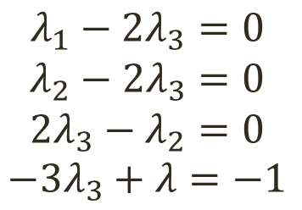

Automating Coefficient Finding [Cont.]
$${(λ}_{1}−2λ_{3})x+\left(λ_{2}−2λ_{3}\right)y+(2λ_{3}−λ_{2})n−3λ_{3}+λ ≥0$$
$$≡−1≥0$$
$$λ_{1}−2λ_{3}=0$$
$$λ_{2}−{2λ}_{3}=0$$
$$2λ_{3}−λ_{2}=0$$
$${−3λ}_{3}+λ=−1$$
Every solution for
the constraints will
make the inequalities
unsatisfiable
$$λ_{1}=2 , { λ}_{2}=2 , λ_{3}=1, λ=2$$

Slide 14

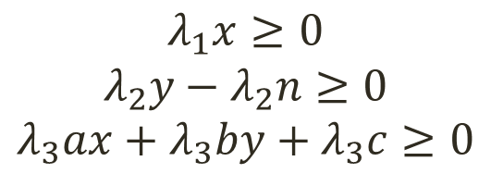
Template-based Invariant Inference
Find values for a,b,c
s.t. the formula becomes unsatisfiable
$$x≥0∧y−n≥0∧ax+by+c≥0$$
$$λ_{1}x≥0$$
$$λ_{2}y{ − λ}_{2}n≥0$$
$$λ_{3}ax+λ_{3}by+λ_{3}c≥0$$
Multiplying by unknown non-negative values
Adding the inequalities
$${(λ}_{1}+λ_{3}a)x+\left(λ_{2}+λ_{3}b\right)y−λ_{2}n+λ_{3}c≥0$$
Adding an unknown non-neg value
$${(λ}_{1}+λ_{3}a)x+\left(λ_{2}+λ_{3}b\right)y−λ_{2}n+λ_{3}c+λ_{4}≥0$$
$$≡−1≥0$$
Equate to 1 <= 0

Slide 15
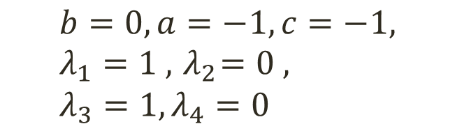
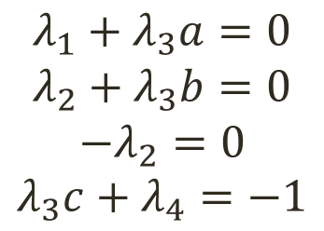
Farkas’ Constraints [Cont.]
$${(λ}_{1}+λ_{3}a)x+\left(λ_{2}+λ_{3}b\right)y−λ_{2}n+λ_{3}c+λ_{4}≥0$$
$$≡−1≥0$$
$$λ_{1}+λ_{3}a=0$$
$$λ_{2}+λ_{3}b=0$$
$$−λ_{2}=0$$
$$λ_{3}c+λ_{4}=−1$$
Every solution for
the constraints will
make the inequalities
unsatisfiable
$$b=0, a=−1, c=−1, λ_{1}=1 , { λ}_{2}=0 , λ_{3}=1, λ_{4}=0$$

Slide 16
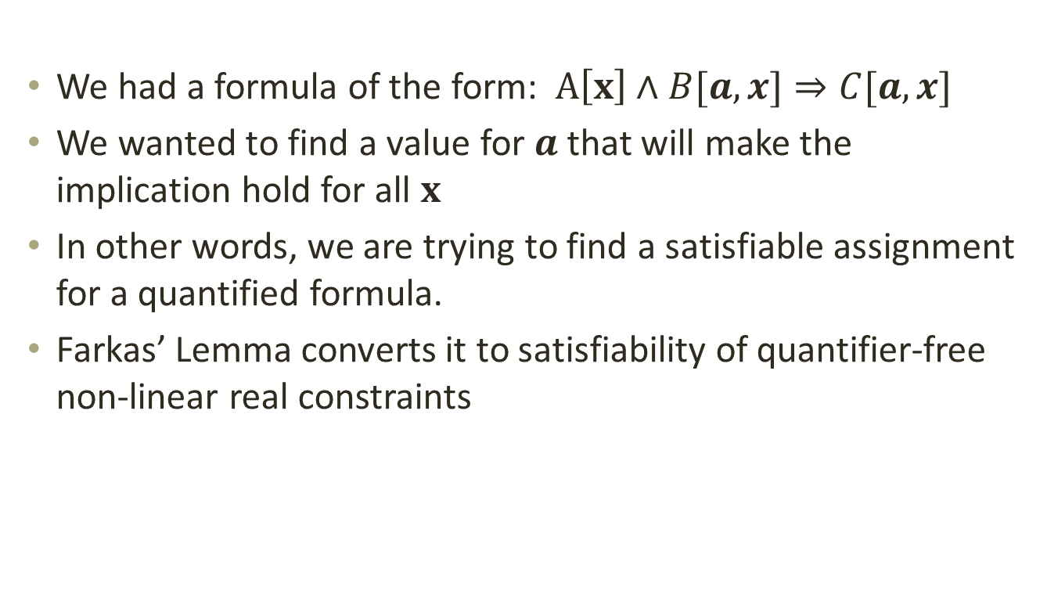
In summary
We had a formula of the form: $A\left[x\right]∧B[a,x]⇒C[a,x]$
We wanted to find a value for $a$ that will make the implication hold for all $x$
In other words, we are trying to find a satisfiable assignment for a quantified formula.
Farkas’ Lemma converts it to satisfiability of quantifier-free non-linear real constraints

Slide 17
Limitations
The Farkas’ Lemma approach provides a way to find linear invariants for programs that
do not have many disjunctions
do not have functions
do not have data structures
do not have nonlinear arithmetic

Slide 18
Further Reading and Software
We developed an approach that addresses some of these limitations.
For more details see:
“Symbolic Resource Bounds Inference For Functional Programs”, CAV 2014: pdf , slides
An extension of Leon (a slightly old version) that supports templates:
  Orb : http://lara.epfl.ch/w/rbound
More Related Works
  “Linear invariant generation using non-linear constraint solving.”, Colon et al., CAV 2003
  “Program analysis as constraint solving.”, S. Gulwani et al., PLDI 2008
  “Constraint solving for interpolation.”, A.Rybalchenko et al., VMCAI 2007
  “Non-linear loop invariant generation using grobner bases.” Sankaranarayanan et al., POPL 2004

