Slide 1
Examples and Sets

Slide 2
Synthesize each of These
choose((x,y) => 10 x + 14 y == a )
choose((x,y) => 10 x + 14 y == a && x < y)
choose((x,y) => 10 x + 14 y == a
&& 0 < x && x < y)

Slide 3
Constructive (Extended) Euclid’s Algorithm: gcd(10,14)
10 14 10 4
6 4
4
2 2
2 0
10 x + 14 y == 10 x + 14 y == a

Slide 4
Result of Synthesis for one Equation
choose((x,y) => 10 x + 14 y == a )
assert ( )
val x = val y =
check the solution:
Change in requirements! Customer also wants: x < y
does our solution work for e.g. a=2

Slide 5
Idea: Eliminate Variables
choose((x,y) => 10 x + 14 y == a && x < y)
Cannot easily eliminate one of the x,y.
Eliminate both x,y, get one free - z
x = 3/2 a + c₁ z
y = -a + c₂ z
c₁ = ?
c₂ = ?
Find general form, characterize all solutions,
parametric solution

Slide 6
Idea: Eliminate Variables
choose((x,y) => 10 x + 14 y == a && x < y)
x = 3/2 a + c₁ z
y = -a + c₂ z
c₁ = ?
c₂ = ?
10 x₀ + 14 y₀ + (10 c₁ + 14 c₂) == a
10 c₁ + 14 c₂ == 0

Slide 7
choose((x,y) => 10 x + 14 y == a && x < y)
x = 3/2 a + 5 z
y = -a - 7 z

Slide 8
Synthesis for sets
def splitBalanced[T](s: Set[T]) : (Set[T], Set[T]) =
choose((a: Set[T], b: Set[T]) ⇒ (
a union b == s && a intersect b == empty
&& a.size – b.size ≤ 1
&& b.size – a.size ≤ 1
))
def splitBalanced[T](s: Set[T]) : (Set[T], Set[T]) =
val k = ((s.size + 1)/2).floor
val t1 = k
val t2 = s.size – k
val s1 = take(t1, s)
val s2 = take(t2, s minus s1)
(s1, s2)
s
b
a

Slide 9
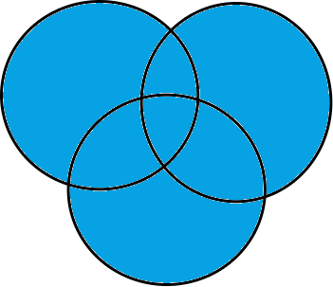
From Data Structures to Numbers
Observation:
Reasoning about collections reduces to reasoning about linear integer arithmetic!
a.size == b.size && a union b == bigSet && a intersect b == empty
a
b
bigSet

Slide 10
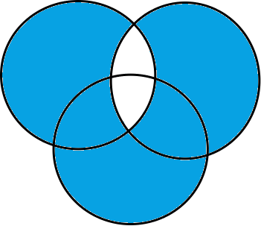
From Data Structures to Numbers
Observation:
Reasoning about collections reduces to reasoning about linear integer arithmetic!
a.size == b.size && a union b == bigSet && a intersect b == empty
a
b
bigSet

Slide 11
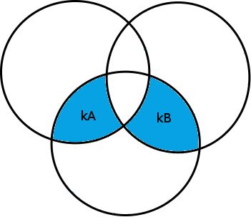
From Data Structures to Numbers
Observation:
Reasoning about collections reduces to reasoning about linear integer arithmetic!
a.size == b.size && a union b == bigSet && a intersect b == empty
a
b
bigSet

Slide 12
From Data Structures to Numbers
Observation:
Reasoning about collections reduces to reasoning about linear integer arithmetic!
a.size == b.size && a union b == bigSet && a intersect b == empty
New specification:
kA = kB
a
b
bigSet

Slide 13
From Data Structures to Numbers
Observation:
Reasoning about collections reduces to reasoning about linear integer arithmetic!
a.size == b.size && a union b == bigSet && a intersect b == empty
New specification:
kA = kB && kA +kB = |bigSet|
a
b
bigSet

