Slide 1
Synthesis, Analysis, and Verification Lecture 01
Introduction, Overview, Logistics
Lectures:
Viktor Kuncak
Exercises and Labs:
Eva Darulová
Giuliano Losa
Monday, 21 February 2011 and 22 February 2011

Slide 2
Today
Introduction and overview of topics
Analysis and Verification
Synthesis
Course organization and grading

Slide 3
SAV in One Slide
We study how to build software analysis, verification, and synthesis tools that automatically answer questions about software systems.
We cover theory and tool building through lectures, exercises, and labs.
Grade is based on
quizzes
home works (theory and programming)
a mini project, presented in the class

Slide 4
Steps in Developing Tools
Modeling: establish precise mathematical meaning for: software, environment, and questions of interest
discrete mathematics, mathematical logic, algebra
Formalization: formalize this meaning using appropriate representation of programming languages and specification languages
program analysis, compilers, theory of formal languages, formal methods
Designing algorithms: derive algorithms that manipulate such formal objects - key technical step
algorithms, dataflow analysis, abstract interpretation, decision procedures, constraint solving (e.g. SAT), theorem proving
Experimental evaluation: implement these algorithms and apply them to software systems
developing and using tools and infrastructures, learning lessons to improve and repeat previous steps

Slide 5
Comparison to other Sciences
Like science we model a part of reality (software systems and their environment) by introducing mathematical models. Models are by necessity approximations of reality, because 1) our partial knowledge of the world is partial and 2) too detailed models would become intractable for automated reasoning
Specific to SAV is the nature of software as the subject of study, which has several consequences:
software is an engineering artifact: to an extent we can choose our reality through programming language design and software methodology
software has complex discrete, non-linear structure: millions of lines of code, gigabytes of bits of state, one condition in if statement can radically change future execution path (non-continuous behavior)
high standards of correctness: interest in details and exceptional behavior (bugs), not just in general trends of software behavior
high standards along with large the size of software make manual analysis infeasible in most cases, and requires automation
automation requires not just mathematical modeling, where we use everyday mathematical techniques, but also formal modeling, which requires us to specify the representation of systems and properties, making techniques from mathematical logic and model theory relevant
automation means implementing algorithms for processing representation of software (e.g. source code) and representation of properties (e.g. formulas expressing desired properties), the study of these algorithms leads to questions of decidability, computational complexity, and heuristics that work in practice.

Slide 6
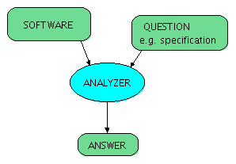
Analysis and Verification
auxiliary information
(hints, proof steps)

Slide 7
Questions of Interest
Example questions in analysis and verification (with sample links to tools or papers):
Will the program crash?
Does it compute the correct result?
Does it leak private information?
How long does it take to run?
How much power does it consume?
Will it turn off automated cruise control?

Slide 8
Viewer Discretion is Advised

Slide 9
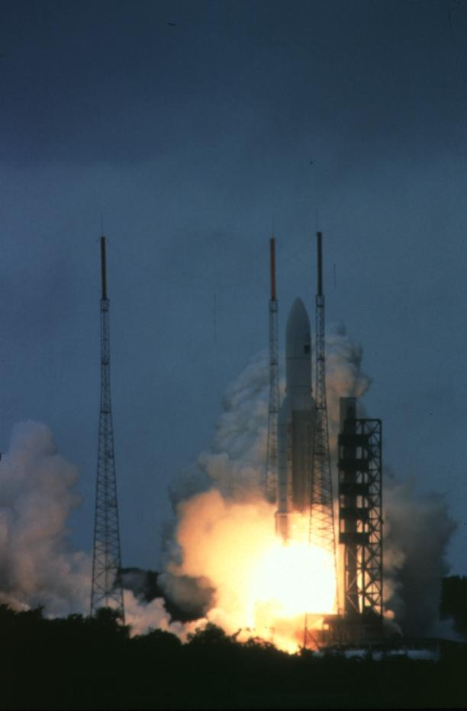
French Guyana, June 4, 1996
t = 0 sec
t = 40 sec
$800 million software failure
Space Missions

Slide 10
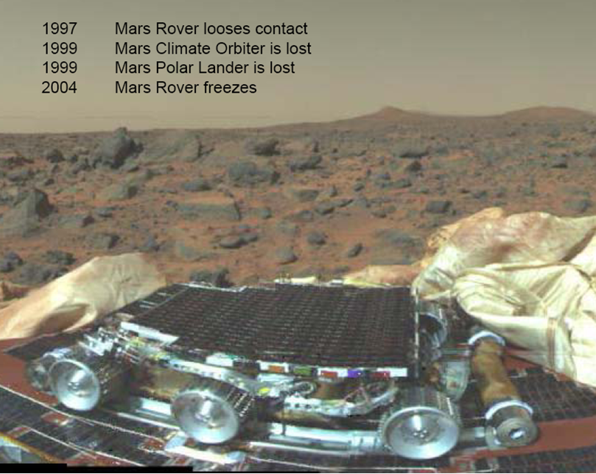
(Jun 18, 2008 – Scientific data lost from flash memory)
Space Missions

Slide 11
Air Transport

Slide 12
Air Transport

Slide 13
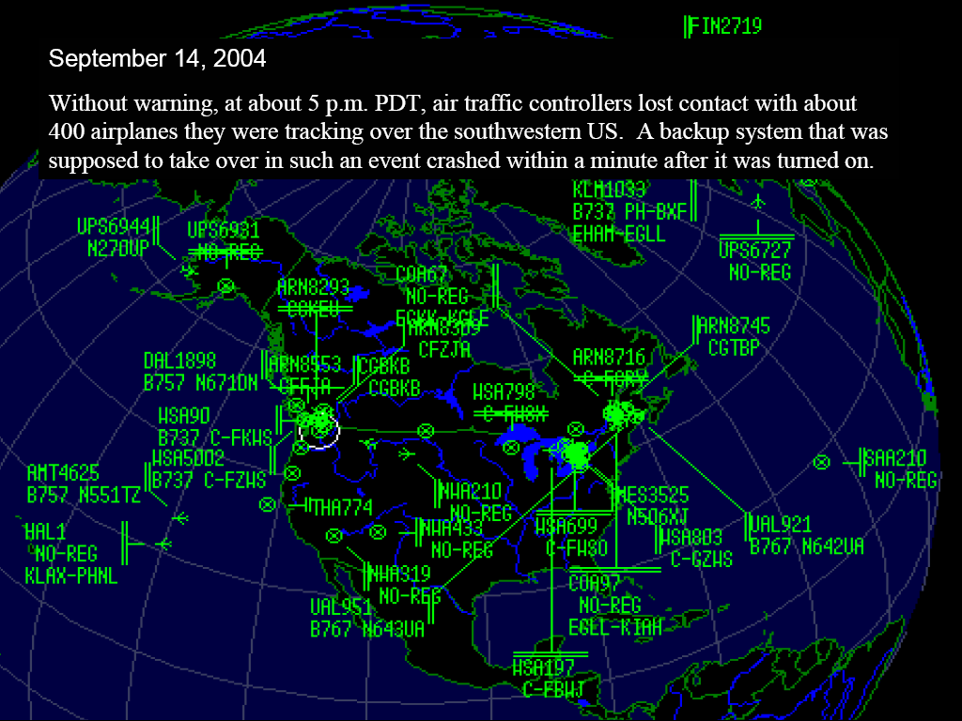
Air Transport

Slide 14
Car Industry

Slide 15
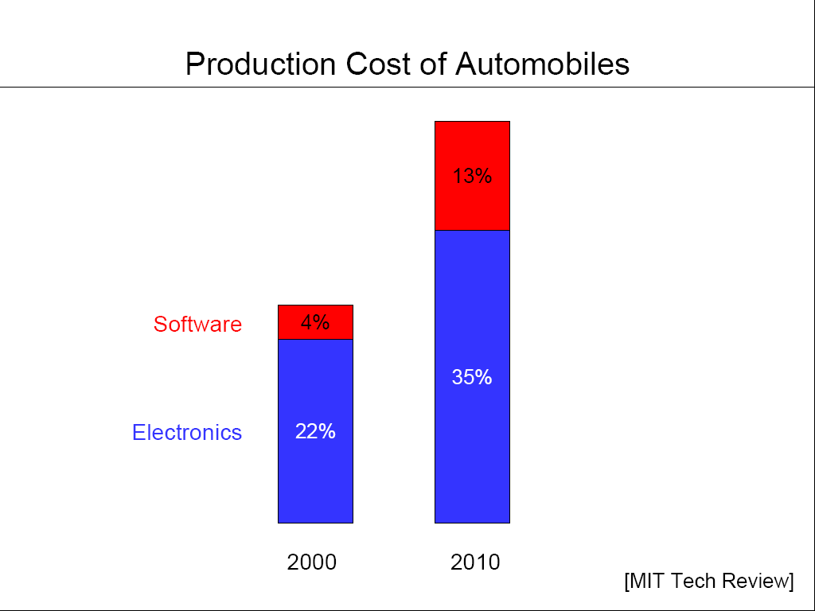
Car Industry

Slide 16
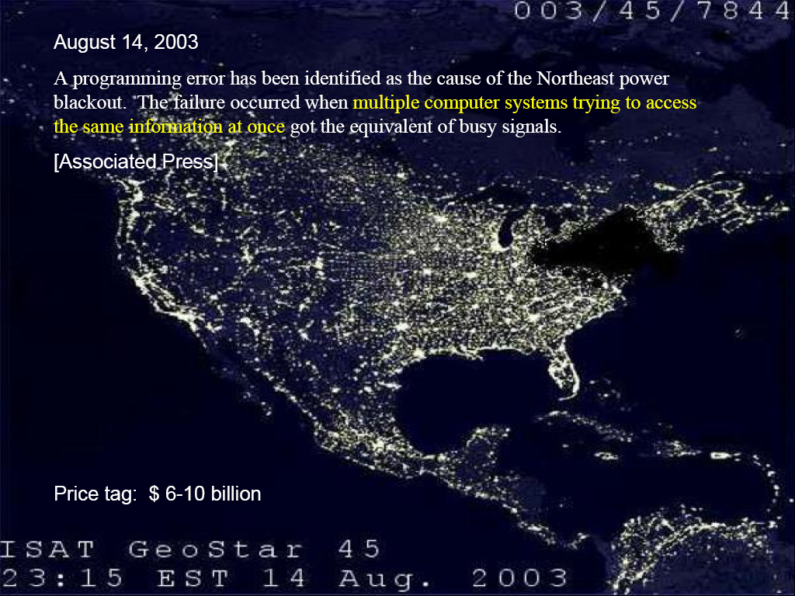
Essential Infrastructure: Northeast Blackout

Slide 17
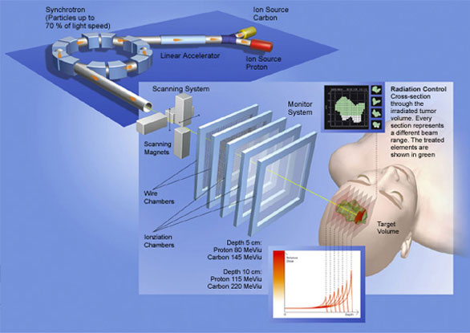
Radio Therapy
Nancy Leveson
Safeware: System Safety and Computers
Addison-Wesley, 1995
Life-Critical Medical Devices

Slide 18
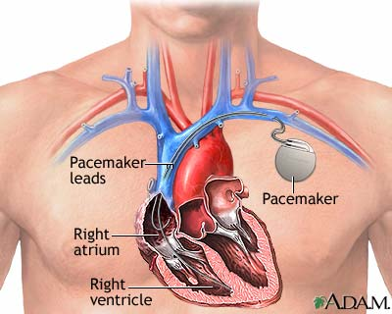
Life-Critical Medical Devices

Slide 19
Air-Traffic Control System in LA Airport
Incident Date: 9/14/2004
(IEEE Spectrum) -- It was an air traffic controller's worst nightmare. Without warning, on Tuesday, 14 September, at about 5 p.m. Pacific daylight time, air traffic controllers lost voice contact with 400 airplanes they were tracking over the southwestern United States. Planes started to head toward one another, something that occurs routinely under careful control of the air traffic controllers, who keep airplanes safely apart. But now the controllers had no way to redirect the planes' courses.
The controllers lost contact with the planes when the main voice communications system shut down unexpectedly. To make matters worse, a backup system that was supposed to take over in such an event crashed within a minute after it was turned on. The outage disrupted about 800 flights across the country.
Inside the control system unit is a countdown timer that ticks off time in milliseconds. The VCSU uses the timer as a pulse to send out periodic queries to the VSCS. It starts out at the highest possible number that the system's server and its software can handle—2³². It's a number just over 4 billion milliseconds. When the counter reaches zero, the system runs out of ticks and can no longer time itself. So it shuts down.
Counting down from 2³² to zero in milliseconds takes just under 50 days. The FAA procedure of having a technician reboot the VSCS every 30 days resets the timer to 2³² almost three weeks before it runs out of digits.

Slide 20
Zune 30 leapyear problem
December 31, 2008
“After doing some poking around in the source code for the Zune’s clock driver (available free from the Freescale website), I found the root cause of the now-infamous Zune 30 leapyear issue that struck everyone on New Year’s Eve. The Zune’s real-time clock stores the time in terms of days and seconds since January 1st, 1980. When the Zune’s clock is accessed, the driver turns the number of days into years/months/days and the number of seconds into hours/minutes/seconds. Likewise, when the clock is set, the driver does the opposite.
The Zune frontend first accesses the clock toward the end of the boot sequence. Doing this triggers the code that reads the clock and converts it to a date and time...”
“...The function keeps subtracting either 365 or 366 until it gets down to less than a year’s worth of days, which it then turns into the month and day of month. Thing is, in the case of the last day of a leap year, it keeps going until it hits 366. Thanks to the if (days > 366), it stops subtracting anything if the loop happens to be on a leap year. But 366 is too large to break out of the main loop, meaning that the Zune keeps looping forever and doesn’t do anything else.”
http://www.zuneboards.com/forums/zune-news/38143-cause-zune-30-leapyear-problem-isolated.html

Slide 21
More Information
http://mtc.epfl.ch/~tah/Lectures/EPFL-Inaugural-Dec06.pdf
http://www.cse.lehigh.edu/~gtan/bug/softwarebug.html

Slide 22
Success Stories

Slide 23
ASTREE Analyzer
“In Nov. 2003, ASTRÉE was able to prove completely automatically the absence of any RTE in the primary flight control software of the Airbus A340 fly-by-wire system, a program of 132,000 lines of C analyzed in 1h20 on a 2.8 GHz 32-bit PC using 300 Mb of memory (and 50mn on a 64-bit AMD Athlon™ 64 using 580 Mb of memory).”
http://www.astree.ens.fr/

Slide 24
AbsInt
7 April 2005. AbsInt contributes to guaranteeing the safety of the A380, the world's largest passenger aircraft. The Analyzer is able to verify the proper response time of the control software of all components by computing the worst-case execution time (WCET) of all tasks in the flight control software. This analysis is performed on the ground as a critical part of the safety certification of the aircraft.

Slide 25
Interactive Theorem Provers
A Mechanically Checked Proof of IEEE Compliance of a Register-Transfer-Level Specification of the AMD K7 Floating Point Multiplication, Division and Square Root Instructions, doine using ACL2 Prover
Formal certification of a compiler back-end, or: programming a compiler with a proof assistant. by Xavier Leroy

Slide 26
Coverity Prevent
SAN FRANCISCO - January 8, 2008 - Coverity®, Inc., the leader in improving software quality and security, today announced that as a result of its contract with US Department of Homeland Security (DHS), potential security and quality defects in 11 popular open source software projects were identified and fixed. The 11 projects are Amanda, NTP, OpenPAM, OpenVPN, Overdose, Perl, PHP, Postfix, Python, Samba, and TCL.

Slide 27
Microsoft’s Static Driver Verifier
Static Driver Verifier (SDV) is a thorough, compile-time, static verification tool designed for kernel-mode drivers. SDV finds serious errors that are unlikely to be encountered even in thorough testing. SDV systematically analyzes the source code of Windows drivers that are written in the C language. SDV uses a set of interface rules and a model of the operating system to determine whether the driver interacts properly with the Windows operating system. SDV can verify device drivers (function drivers, filter drivers, and bus drivers) that use the Windows Driver Model (WDM), Kernel-Mode Driver Framework (KMDF), or NDIS miniport model. SDV is designed to be used throughout the development cycle. You should run SDV as soon as the basic structure of a driver is in place, and continue to run it as you make changes to the driver. Development teams at Microsoft use SDV to improve the quality of the WDM, KMDF, and NDIS miniport drivers that ship with the operating system and the sample drivers that ship with the Windows Driver Kit (WDK). SDV is included in the Windows Driver Kit (WDK) and supports all x86-based and x64-based build environments.

Slide 28
Impact on Computer Science
Turing award is ACM’s most prestigious award and equivalent to Nobel prize in Computing
In the next slides are some papers written by the award winners connected to the topics of this class

Slide 29
A Basis for a Mathematical Theory of Computation by John McCarthy, 1961.
“It is reasonable to hope that the relationship between computation and mathematical logic will be as fruitful in the next century as that between analysis and physics in the last. The development of this relationship demands a concern for both applications and for mathematical elegance.”
Social processes and proofs of theorems and programs a controversial article by Richard A. De Millo, Richard J. Lipton, and Alan J. Perlis
Guarded Commands, Nondeterminacy and Formal Derivation of Programs by Edsger W. Dijkstra from 1975, and other Manuscripts
Simple word problems in universal algebras by D. Knuth and P. Bendix (see Knuth-Bendix_completion_algorithm), used in automated reasoning

Slide 30
Decidability of second-order theories and automata on infinite trees by Michael O. Rabin in 1965, proving decidability for one of the most expressive decidable logics
Domains for Denotational Semantics by Dana Scott, 1982
Can programming be liberated from the von Neumann style?: a functional style and its algebra of programs by John Backus
Assigning meanings to programs by R. W. Floyd, 1967
The Ideal of Verified Software by C.A.R. Hoare
Soundness and Completeness of an Axiom System for Program Verification by Stephen A. Cook
An Axiomatic Definition of the Programming Language PASCAL by C. A. R. Hoare and Niklaus Wirth, 1973
On the Computational Power of Pushdown Automata, by Alfred V. Aho, Jeffrey D. Ullman, John E. Hopcroft in 1970
An Algorithm for Reduction of Operator Strength by John Cocke, Ken Kennedy in 1977

Slide 31
A Metalanguage for Interactive Proof in LCF by Michael J. C. Gordon, Robin Milner, L. Morris, Malcolm C. Newey, Christopher P. Wadsworth, 1978
Proof Rules for the Programming Language Euclid, by Ralph L. London, John V. Guttag, James J. Horning, Butler W. Lampson, James G. Mitchell, Gerald J. Popek, 1978
Computational Complexity and Mathematical Proofs by J. Hartmanis
Software reliability via run-time result-checking by Manuel Blum
The Temporal Logic of Programs, by Amir Pnueli (see also the others of a few hundreds of publications)
No Silver Bullet - Essence and Accidents of Software Engineering, by Frederick P. Brooks Jr., 1987

Slide 32
Formal Development with ABEL, by Ole-Johan Dahl and Olaf Owe
Abstraction Mechanisms in the Beta Programming Language, by Bent Bruun Kristensen, Ole Lehrmann Madsen, Birger Møller-Pedersen, Kristen Nygaard, 1983
Formalization in program development, by Peter Naur, 1982
Interprocedural Data Flow Analysis, by Frances E. Allen, 1974
Counterexample-guided abstraction refinement for symbolic model checking by Edmund Clarke, Orna Grumberg, Somesh Jha, Yuan Lu, Helmut Veith, 2003
Automatic Verification of Finite-State Concurrent Systems Using Temporal Logic Specifications by Edmund M. Clarke, E. Allen Emerson, A. Prasad Sistla
The Algorithmic Analysis of Hybrid Systems by Rajeev Alur, Costas Courcoubetis, Nicolas Halbwachs, Thomas A. Henzinger, Pei-Hsin Ho, Xavier Nicollin, Alfredo Olivero, Joseph Sifakis, Sergio Yovine

Slide 33
How to prove programs

Slide 34
Proving Program Correctness
int f(int x, int y)
{
if (y == 0) {
return 0;
} else {
if (y % 2 == 0) {
int z = f(x, y / 2);
return (2 * z);
} else {
return (x + f(x, y - 1));
}
}
}
What does ‘f’ compute?
How can we prove it?

Slide 36
An imperative version
int fi(int x, int y)
{
int r = 0;
int i = 0;
while (i < y) {
i = i + 1;
r = r + x;
}
return r;
}
What does ‘fi’ compute?
How can we prove it?

Slide 37
Preconditions, Postconditions, Invariants
void p()
/*: requires Pre
ensures Post */
{
s1;
while /*: invariant I */ (e) {
s2;
}
s3;
}

Slide 38
Loop Invariant
I is a loop invariant if the following three conditions hold:
I holds initially: in all states satisfying Pre, when execution reaches loop entry, I holds
I is preserved: if we assume I and loop condition (e), we can prove that I will hold again after executing s2
I is strong enough: if we assume I and the negation of loop condition e, we can prove that Post holds after s3
Explanation: because I holds initially, and it is preserved, by induction from holds initially and preserved follows that I will hold in every loop iteration. The strong enough condition ensures that when loop terminates, the rest of the program will satisfy the desired postcondition.

Slide 39
Back to our Program: what is Invariant, Precondition, Postcondition
int fi(int x, int y)
{
int r = 0;
int i = 0;
while (i < y) {
i = i + 1;
r = r + x;
}
return r;
}
What does ‘fi’ compute?
How can we prove it?

Slide 40
Bubbling up an Element in Bubble Sort (not shown)
int apartmentRents[];
int grades[];
...
void bubbleUp(int[] a, int from)
{
int i = from;
while (i < a.length) {
}
}
Proving
array indices are within bounds
the element in a[from] is smaller than those stored after ‘from’
property sufficient to prove correctness of bubble sort

Slide 41
How can we automate verification?
Important algorithmic questions:
verification condition generation: compute formulas expressing program correctness
Hoare logic, weakest precondition, strongest postcondition
theorem proving: prove verification conditions
proof search, counterexample search
decision procedures
loop invariant inference
predicate abstraction
abstract interpretation and data-flow analysis
pointer analysis, typestate
reasoning about numerical computation
pre-condition and post-condition inference
ranking error reports and warnings
finding error causes from counterexample traces

Slide 42
Spec Sharp: the Movie
Webcasts by Mike Barnett minutes 8 to 22
End of lecture

Slide 43
Logistics, Exercises and Demos
Everyone should register for the course ‘SAV’ in
http://moodle.epfl.ch
whatAFunCourse
Please obtain “The Calculus of Computation” book
If you do not know Scala, please take a look now
can write ~Java, can write ~Haskell/Ocaml, see more at:
http://scala-lang.org
Example: binary tree

Slide 44
Membership in Binary Search Tree
sealed abstract class BST {
def contains(key: Int): Boolean = (this : BST) match {
case Node(left: BST,value: Int, _) if key < value => left.contains(key)
case Node(_,value: Int, right: BST) if key > value => right.contains(key)
case Node(_,value: Int, _) if key == value => true
case e : Empty => false
}
}
case class Empty extends BST
case class Node(val left: BST, val value: Int, val right: BST) extends BST

Slide 45
Rest of Today’s Class
Bookmark this site, gives demo of many interesting related tools:
http://rise4fun.com
Check course page and moodle page regularly
http://lara.epfl.ch/w/sav
Attend all lectures, exercises, labs that you can
Next Eva does exercises/labs using Spec#
Then Viktor
introduces synthesis
starts with background

Slide 46
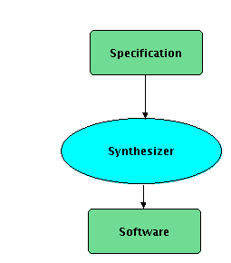
Synthesis
auxiliary information
(structure of expected
program)

Slide 47
Programming Activity
requirements
Consider three related activities:
Development within an IDE (Eclipse, Visual Studio, emacs, vim)
Compilation and static checking (optimizing compiler for the language, static analyzer, contract checker)
Execution on a (virtual) machine
More compute power available for each of these
→ use it to improve programmer productivity
def f(x : Int) = {
y = 2 * x + 1
}
iload_0
iconst_1
iadd
42

Slide 48
Synthesis at All Levels
requirements
Opportunities for implicit programming in
Development within an IDE
isynth tool
Compilation
Comfusy and RegSy tools
Execution
Scala^Z3 and UDITA tools
I next examine these tools, from last to first, focusing on Compilation
def f(x : Int) = {
choose y st ...
}
iload_0
iconst_1
call Z3
42

Slide 49
isynth - Interactive Synthesis of Code Snippets
def map[A,B](f:A => B, l:List[A]): List[B] = { ... }
def stringConcat(lst : List[String]): String = { ... }
...
def printInts(intList:List[Int], prn: Int => String): String = 
Returned value:
stringConcat(map[Int, String](prn, intList))
Is there a term of given type in given environment?
Monorphic: decidable. Polymorphic: undecidable
with: Tihomir Gvero, Ruzica Piskac

Slide 50
isynth - Interactive Synthesis of Code Snippets
supports method combinations, type polymorphism, user preferences
based on first-order resolution – combines forward and backward reasoning
ranking of returned solutions is obtained through a system of weights
Notes:
We must ask Fabien for better URLs.

Slide 51
Synthesis at All Levels
requirements
Opportunities for implicit programming in
Development within an IDE
isynth tool
Compilation
Comfusy and RegSy tools
Execution
Scala^Z3 and UDITA tools
√
def f(x : Int) = {
choose y st ...
}
iload_0
iconst_1
call Z3
42

Slide 52
An example
def secondsToTime(totalSeconds: Int) : (Int, Int, Int) =
choose((h: Int, m: Int, s: Int) ⇒ (
h * 3600 + m * 60 + s == totalSeconds
&& h ≥ 0
&& m ≥ 0 && m < 60
&& s ≥ 0 && s < 60 ))
3787 seconds
1 hour, 3 mins. and 7 secs.
def secondsToTime(totalSeconds: Int) : (Int, Int, Int) =
val t1 = totalSeconds div 3600
val t2 = totalSeconds + ((-3600) * t1)
val t3 = min(t2 div 60, 59)
val t4 = totalSeconds + ((-3600) * t1) + (-60 * t3)
(t1, t3, t4)
Notes:
An actual example that works in our system.

Slide 53
Possible starting point: quantifier elimination
A specification statement of the form
r = choose(x ⇒ F( a, x ))
“let r be x such that F(a, x) holds”
Corresponds to constructively solving the quantifier elimination problem where a is a parameter
∃ x . F( a, x )

Slide 54
choose((x, y) ⇒ 5 * x + 7 * y == a && x ≤ y)
Corresponding quantifier elimination problem:
∃ x ∃ y . 5x + 7y = a ∧ x ≤ y
Use extended Euclid’s algorithm to find particular solution to 5x + 7y = a:
(5,7 are mutually prime, else we get divisibility pre.)
x = 3a
y = -2a
Express general solution of equations for x, y using a new variable z:
x = -7z + 3a
y = 5z - 2a
Rewrite inequations x ≤ y in terms of z:
5a ≤ 12z
z ≥ ceil(5a/12)
Obtain synthesized program:
val z = ceil(5*a/12)
val x = -7*z + 3*a
val y = 5*z + -2*a
z = ceil(5*31/12) = 13
x = -7*13 + 3*31 = 2
y = 5*13 – 2*31 = 3
For a = 31:

Slide 55
choose((x, y) ⇒ 5 * x + 7 * y == a && x ≤ y && x ≥ 0)
Express general solution of equations for x, y using a new variable z:
x = -7z + 3a
y = 5z - 2a
Rewrite inequations x ≤ y in terms of z:
z ≥ ceil(5a/12)
Rewrite x ≥ 0:
z ≤ floor(3a/7)
Precondition on a:
ceil(5a/12) ≤ floor(3a/7)
(exact precondition)
Obtain synthesized program:
assert(ceil(5*a/12) ≤ floor(3*a/7))
val z = ceil(5*a/12)
val x = -7*z + 3*a
val y = 5*z + -2*a
With more inequalities
we may generate a for loop

Slide 56
Synthesis for sets
def splitBalanced[T](s: Set[T]) : (Set[T], Set[T]) =
choose((a: Set[T], b: Set[T]) ⇒ (
a union b == s && a intersect b == empty
&& a.size – b.size ≤ 1
&& b.size – a.size ≤ 1
))
def splitBalanced[T](s: Set[T]) : (Set[T], Set[T]) =
val k = ((s.size + 1)/2).floor
val t1 = k
val t2 = s.size – k
val s1 = take(t1, s)
val s2 = take(t2, s minus s1)
(s1, s2)
s
b
a

Slide 57
Synthesis for non-linear arithmetic
def decomposeOffset(offset: Int, dimension: Int) : (Int, Int) =
choose((x: Int, y: Int) ⇒ (
offset == x + dimension * y && 0 ≤ x && x < dimension
))
The predicate becomes linear at run-time
Synthesized program must do case analysis on the sign of the input variables
Some coefficients are computed at run-time

Slide 58
Compile-time warnings
def secondsToTime(totalSeconds: Int) : (Int, Int, Int) =
choose((h: Int, m: Int, s: Int) ⇒ (
h * 3600 + m * 60 + s == totalSeconds
&& h ≥ 0 && h < 24
&& m ≥ 0 && m < 60
&& s ≥ 0 && s < 60
))
Warning: Synthesis predicate is not satisfiable for variable assignment:
totalSeconds = 86400

Slide 59
Compile-time warnings
def secondsToTime(totalSeconds: Int) : (Int, Int, Int) =
choose((h: Int, m: Int, s: Int) ⇒ (
h * 3600 + m * 60 + s == totalSeconds
&& h ≥ 0
&& m ≥ 0 && m ≤ 60
&& s ≥ 0 && s < 60
))
Warning: Synthesis predicate has multiple solutions for variable assignment:
totalSeconds = 60
Solution 1: h = 0, m = 0, s = 60
Solution 2: h = 0, m = 1, s = 0

Slide 60
Implicit Programming at All Levels
requirements
Opportunities for implicit programming in
Development within an IDE
isynth tool
Compilation
Comfusy and RegSy tools
Execution
Scala^Z3 and UDITA tools
I next examine these tools, from last to first, focusing on Compilation
def f(x : Int) = {
choose y st ...
}
iload_0
iconst_1
call Z3
42

Slide 61
Scala^Z3 Invoking Constraint Solver at Run-Time
Java Virtual Machine
- functional and imperative code
- custom ‘decision procedure’ plugins
Z3 SMT Solver
Q: implicit constraint
A: model
Q: queries containing
extension symbols
A: custom theory consequences
with: Philippe Suter, Ali Sinan Köksal, Robin Steiger

Slide 62
Executing choose using Z3
def secondsToTime(totalSeconds: Int) : (Int, Int, Int) =
choose((h: Var[Int], m: Var[Int], s: Var[Int]) ⇒ (
h * 3600 + m * 60 + s == totalSeconds
&& 0 <= h
&& 0 <= m && m < 60
&& 0 <= s && s < 60 ))
will be constant at run-time
syntax tree constructor
3787 seconds
1 hour, 3 mins. and 7 secs.
It works, certainly for constraints within Z3’s supported theories
Implemented as a library (jar + z3.so / dll) – no compiler extensions
Notes:
An actual example that works in our system.

Slide 63
Programming in Scala^Z3
find triples of integers x, y, z such that x > 0, y > x,
2x + 3y <= 40, x · z = 3y², and y is prime
model enumeration (currently: negate previous)
val results = for(
(x,y) ← findAll((x: Var[Int], y: Var[Int]) ) => x > 0 && y > x && x * 2 + y * 3 <= 40);
if isPrime(y);
z ← findAll((z: Var[Int]) ) => x * z === 3 * y * y))
yield (x, y, z)
user’s Scala function
λ
Scala’s existing mechanism for composing iterations (reduces to standard higher order functions such as flatMap-s)
Use Scala syntax to construct Z3 syntax trees
a type system prevents certain ill-typed Z3 trees
Obtain models as Scala values
Can also write own plugin decision procedures in Scala

Slide 64
Other Forms of Synthesis
Automata-Theoretic Synthesis
reactive synthesis
regular synthesis over unbounded domains
Synthesis of Synchronization Constructs
Quantitative Synthesis
Synthesis from examples:
Sumit Gulwani: Automating String Processing in Spreadsheets using Input-Output Examples

Slide 65
Recommended Reading
Recent Research Highlights from the Communications of the ACM
A Few Billion Lines of Code Later: Using Static Analysis to Find Bugs in the Real World
Retrospective: An Axiomatic Basis for Computer Programming
Model Checking: Algorithmic Verification and Debugging
Software Model Checking Takes Off
Formal Verification of a Realistic Compiler
seL4: Formal Verification of an Operating-System Kernel

