Slide 1
Synthesis, Analysis, and Verification Lecture 09a
Abstract Interpretation
Lectures:
Viktor Kuncak

Slide 2
Abstract Interpretation
Way to infer properties of e.g. computations
Consider assignment: z = x+y
Interpreter:
Abstract interpreter:

Slide 3
Adding and Multiplying Intervals

Slide 4
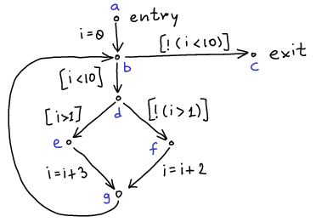
Programs as Control-Flow Graphs
i = 0;
while (i < 10) {
if (i > 1)
i = i + 3;
else
i = i + 2;
}

Slide 5
Suppose
program state given only by the value of i
initially, it is possible that i has any value
Task: for each point, find set S of possible states

Slide 6
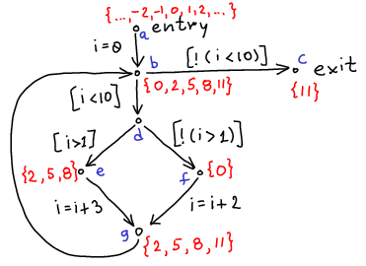
i = 0;
while (i < 10) {
if (i > 1)
i = i + 3;
else
i = i + 2;
}

Slide 7
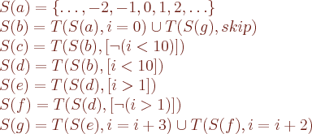
Sets are Given by Equations

Slide 8
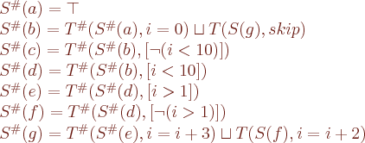
Sets are Given by Equations

Slide 9
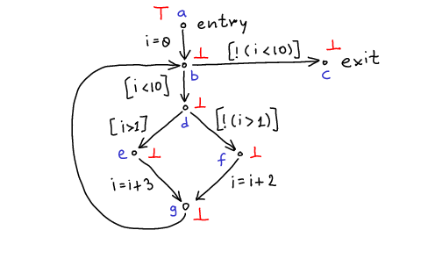

Slide 11
Approximation of Sets by Supersets

Slide 12
Partially Ordered Families of Sets

Slide 13
Does every element in this order have least upper bound?
Dually, does it have greatest lower bound?

