Slide 1
Synthesis, Analysis, and Verification Lecture 08
WS1S: Automata-Based Decision Procedure
Tree Automata and WSkS
Lectures:
Viktor Kuncak

Slide 2
Weak Monadic Second-Order Logic of One Successor

Slide 14
WS1S As Extension of Presburger Arithmetic
Finite set of natural numbers S can represent bits in binary representation
We can interpret sets as numbers
What do we gain?

Slide 15
WS1S as PA + Bitwise Operators
Non-negative integer constants and variables
Boolean operators
Linear arithmetic operator
Bitwise operators
Quantifiers over numbers and bit positions

Slide 16
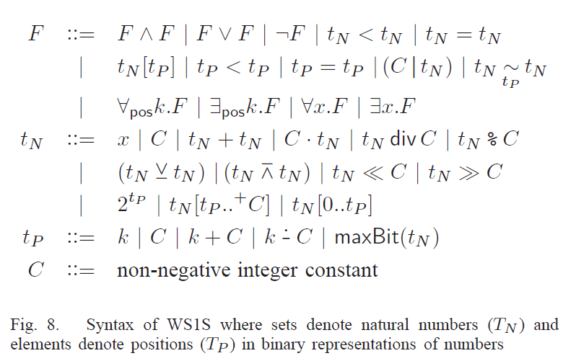
WS1S as PA + Bitwise Operators

Slide 17
Infinite Binary Tree in WS2S

