Slide 1
This Week
Lecture on relational semantics
Exercises on logic and relations
Labs on using Isabelle to do proofs

Slide 2
Synthesis, Analysis, and Verification Lecture 02a
Relational Semantics
Lectures:
Viktor Kuncak

Slide 3
More Relations and Functions

Slide 4
Function Updates

Slide 5
A Simple Property

Slide 6
Transitive Closure

Slide 7
proof

Slide 8
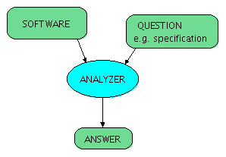
Analysis and Verification
auxiliary information
(hints, proof steps)

Slide 9
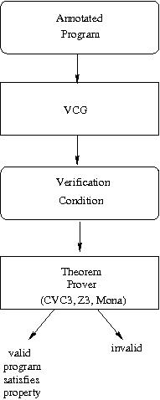
Verification-Condition Generation
Steps in Verification
generate formulas implying program correctness
attempt to prove formulas
if formula is valid, program is correct
if formula has a counterexample, it indicates one of these:
error in the program
error in the property
error in auxiliary statements (e.g. loop invariants)
Terminology
generated formulas: verification conditions
generation process: verification-condition generation
program that generates formulas: verification-condition generator (VCG)

Slide 10
Validity and Satisfiability
F is valid ⬄ ¬F is unsatisfiable
F is invalid ⬄ ¬F is satisfiable
F is invalid ⬄ not the case that F is valid
F is unsatisfiable ⬄ not the case that F is satisfiable

Slide 11
Verification-Condition Generation
Steps in Verification
generate formulas implying program correctness
attempt to prove formulas
if formula is valid, program is correct
if formula has a counterexample, it indicates one of these:
error in the program
error in the property
error in auxiliary statements (e.g. loop invariants)
Terminology
generated formulas: verification conditions
generation process: verification-condition generation
program that generates formulas: verification-condition generator (VCG)

Slide 12
Simple Programming Language
x = T
if (F) c1 else c2
c1 ; c2
while (F) c1
c ::= x=T | (if (F) c else c) | c ; c | (while (F) c)
T ::= K | V | (T + T) | (T - T) | (K * T) | (T / K) | (T % K)
F ::= (T==T) | (T < T) | (T > T) | (~F) | (F && F) | (F || F)
V ::= x | y | z | ...
K ::= 0 | 1 | 2 | ...

Slide 13
Simple Program and its Syntax Tree
while (x > 1) {
if (x % 2 = 0)
x = x / 2
else
x = 3 * x + 1
}

Slide 14
Remark: Turing-Completeness
This language is Turing-complete
it subsumes counter machines, which are known to be Turing-complete
every possible program (Turing machine) can be encoded into computation on integers (computed integers can become very large)
the problem of taking a program and checking whether it terminates is undecidable
Rice's theorem: all properties of programs that are expressed in terms of the results that the programs compute (and not in terms of the structure of programs) are undecidable
In real programming languages we have bounded integers, but we have other sources of unboundedness, e.g.
bignums
example: sizes of linked lists and other containers
program syntax trees for an interpreter or compiler (would like to handle programs of any size!)

Slide 15
Relational Semantics

Slide 16
Examples

Slide 17
Why Relations
The meaning is, in general, an arbitrary relation. Therefore:
For certain states there will be no results. In particular, if a computation starting at a state does not terminate
For certain states there will be multiple results. This means command execution starting in state will sometimes compute one and sometimes other result. Verification of such program must account for both possibilities.
Multiple results are important for modeling e.g. concurrency, as well as approximating behavior that we do not know (e.g. what the operating system or environment will do, or what the result of complex computation is)

Slide 18
Guarded Command Language
assume(F) - stop execution if F does not hold pretend execution never happened
s1 [] s2 - do either s1 or s2
s* - execute s zero, once, or more times

Slide 19
Guarded Commands and Relations - Idea
x = T {(x,T) | true }
gets more complex for more variables
assume(F) Δ_{S} S is set of values for which F is true (satisfying assignments of F)
s* r*
s₁ [] s₂ r₁ U r₂

Slide 20
Assignment for More Variables
var x,y
… y = x + 1

Slide 21
‘if’ condition using assume and []
if (F) s1 else s2
(assume(F); s1) [] (assume(¬F); s2)

Slide 22
Example: y is absolute value of x
if (x>0) y = x else y = -x
(assume(x>0); y=x) [] (assume(¬(x>0)); y=-x)

Slide 23
(calculating absolute value)

Slide 24
guards
F → c

Slide 25
‘while’ using assume and *
(assume(F); s)* [] assume(¬F)
while (F) s

