Slide 1
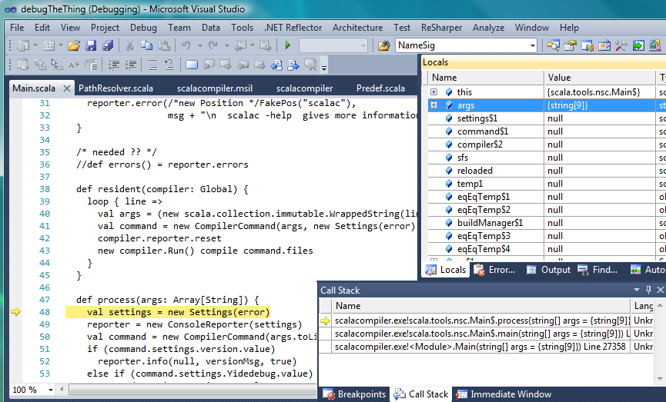
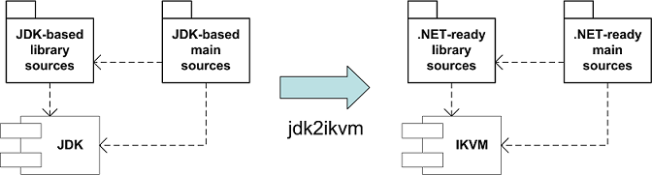
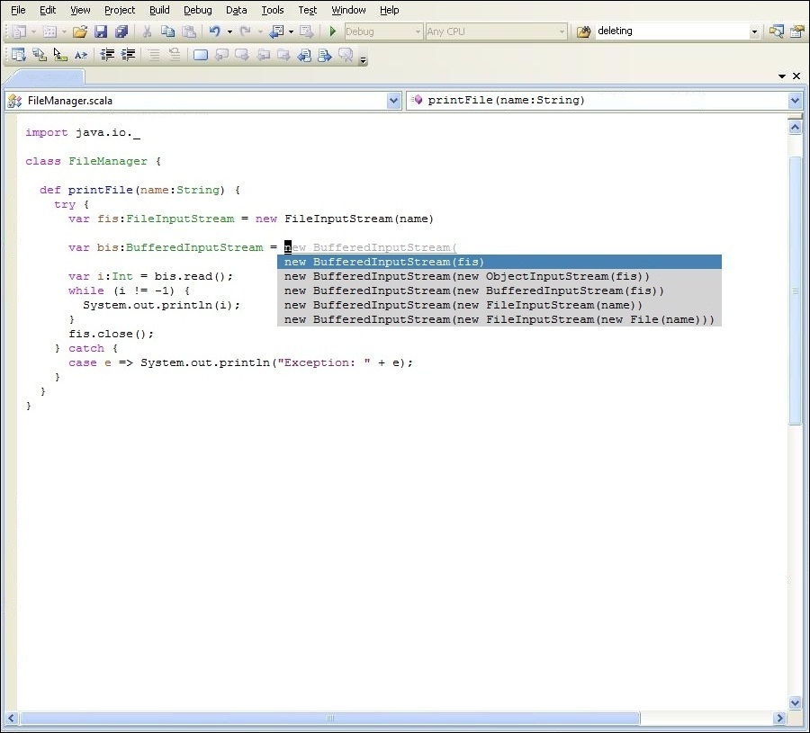
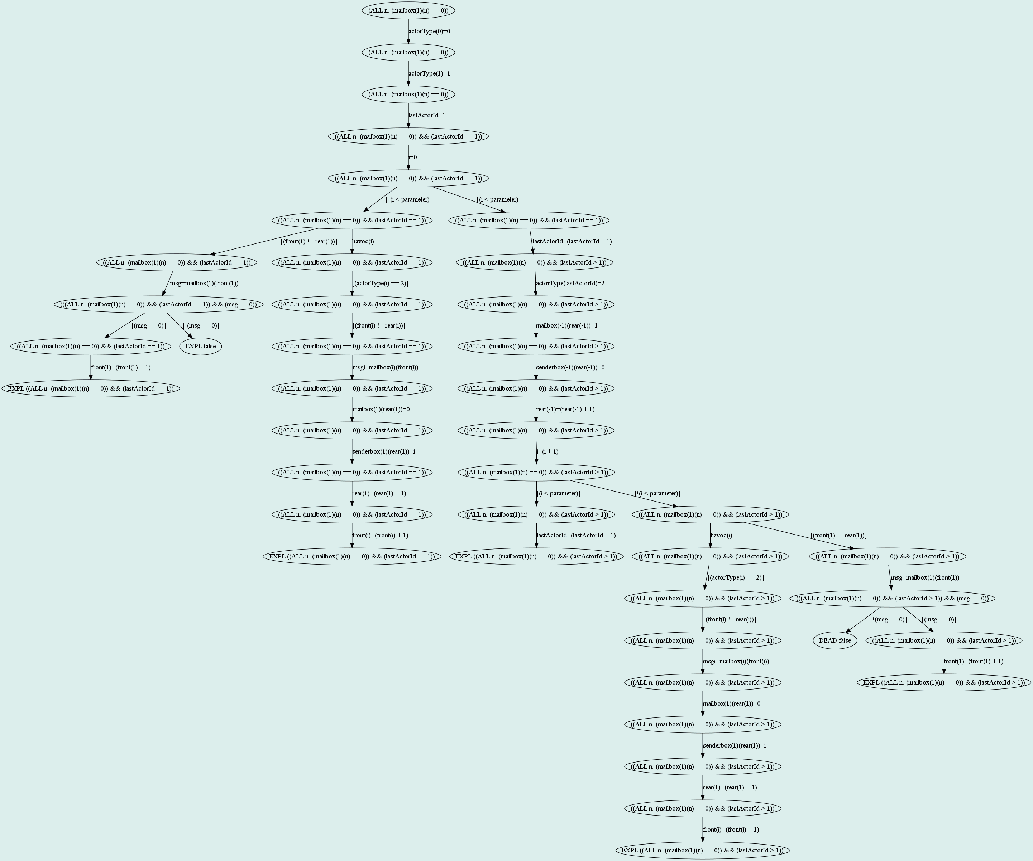
August 2008
M. Garcia,T. Gvero,H. Hojjat,V. Kuncak,M. Odersky,R. Piskac, L.Rytz
ProgLab.NET:
A Workbench for Ensuring Software Quality and Reliability
The Scala compiler has a modular architecture: frontend and backend are replaceable components
Scala.NET instantiates that architecture for .NET
    desktop & server, mobile, game console
Programs using only Scala SDK libraries compile as-is on JVM and .NET
Additionally, a migration tool ports JDK-based Scala sources to .NET
http://lamp.epfl.ch/~magarcia/ScalaNET/
Eldarica: Predicate Abstraction for Concurrent Programs
InSynth: Interactive Synthesis of Code
Huge state space in concurrent programs
- unknown number of processes
- unbounded variables
Solution: Abstract the program using a set of ‘important’ features
(critical messages, shared variables,…)
Context
(Reachability Tree for a client-server program)
Desired Type
Establish the correctness using global invariant
# messages can be exponential
Find predicates to calculate the performance of the system
(# of message passed, # of created actors)
Reduce the unnecessary messages as soon as it does not affect the correctness
Easier Programming
Easier to reuse API libraries
Synthesis
Technique
Uses type information
Resolution algorithm with weights
Learning
Uses source code corpus to learn weights
Supports
generic types
higher-order functions
improve the quality of generated snippets

