Slide 1
Code Generation through Passing Jump Targets

Slide 2
Feedback
Theoretical
Record lectures?
Cover more material

Slide 3
Code Compiled with javac
static int k = 0;
static boolean action(int si, boolean ob, int sm, int pr) {
if (sm + 2*pr > 10 &&
!(si <= 5 && ob)) {
k++; return true;
} else {
return false;
} }
Compared to our current translation:
if 'sm+2*pr > 10' false, immediately ireturns
if 'si > 5' is true, immediately goes to 'then' part
no intermediate result for if condition - do branches directly
negation sign eliminated and pushed through
only one iconst_0 and one iconst_1
0: iload_2
1: iconst_2
2: iload_3
3: imul
4: iadd
5: bipush 10
7: if_icmple 29
10: iload_0
11: iconst_5
12: if_icmpgt 19
15: iload_1
16: ifne 29
19: getstatic #2; //Field k
22: iconst_1
23: iadd
24: putstatic #2; //Field k
27: iconst_1
28: ireturn
29: iconst_0
30: ireturn

Slide 4
Translate This While Loop using Rules that Explicitly Put Booleans on Stack
static void count(int from, int to, int step) {
int counter = from;
while (counter < to) {
counter = counter + step;
}
}
nbegin: iload #counter
iload #to
if_icmplt ntrue
iconst_0
goto nafter
ntrue: iconst_1
nafter: ifeq nexit
iload #counter
iload #step
iadd
istore #counter
goto nbegin
nexit:

Slide 5
Towards More Efficient Translation

Slide 6
Macro ‘branch’ instruction
Introduce an imaginary big instruction
branch(c,nTrue,nFalse)
Here
c is a potentially complex Java boolean expression, that is the main reason why branch is not a real instruction
nTrue is label to jump to when c evaluates to true
nFalse is label to jump to when c evaluates to false
no “fall through” – always jumps (symmetrical)
We show how to:
use branch to compile if, while, etc.
expand branch recursively into concrete bytecodes

Slide 7
Using branch in Compilation
[ if (c) t else e ] =
[ while (c) s ] =
branch(c,nTrue,nFalse)
test: branch(c,body,exit)
body: [ s ]
goto test
exit:
nTrue: [ t ]
goto nAfter
nFalse: [ e ]
nAfter:

Slide 8
Decomposing branch
branch(!c,nThen,nElse) =
branch(c1 && c2,nThen,nElse) =
branch(c1 || c2,nThen,nElse) =
branch(true,nThen,nElse) =
branch(false,nThen,nElse) =
boolean var b with slot N
branch(b,nThen,nElse) =
goto nThen
branch(c,nElse,nThen)
goto nElse
branch(c1,nNext,nElse)
nNext: branch(c2,nThen,nElse)
branch(c1,nThen,nNext)
nNext: branch(c2,nThen,nElse)
iload_N
ifeq nElse
goto nThen

Slide 9
Compiling Relations
branch(e1 R e2,nThen,nElse) =
[ e1 ]
[ e2 ]
if_icmpR nThen
goto nElse
R can be <,>,==,!=,<=,>=,...

Slide 10
Putting boolean variable on the stack
Consider storing x = c
where x,c are boolean and c has &&, ||
How to put result of branch on stack to allow istore?
[ b = c ] =
branch(c,nThen,nElse)
nThen: iconst_1
goto nAfter
nElse: iconst_0
nAfter: istore #b

Slide 11
Compare Two Translations of This While Loop
while (counter < to) {
counter = counter + step;
}
new one:
test: iload #counter
iload #to
if_icmplt body
goto exit
body: iload #counter
iload #step
iadd
istore #counter
goto test
exit:
old one:
nbegin: iload #counter
iload #to
if_icmplt ntrue
iconst_0
goto nafter
ntrue: iconst_1
nafter: ifeq nexit
iload #counter
iload #step
iadd
istore #counter
goto nbegin
nexit:

Slide 12
Complex Boolean Expression: Example
Generate code for this:
if ((x < y)&& !((y < z) && ok))
return
else y = y + 1
Compare to the old translation.
branch(x<y,n1,else)
n1: branch(y<z,n2,then)
n2: branch(ok,else,then)
then: return
goto after
else: iload #y
iconst_1 iadd
istore #y
after:

Slide 13
Implementing branch
Option 1: emit code using branch, then rewrite
Option 2: branch is a just a function in the compiler that expands into instructions
branch(c,nTrue,nFalse)
def compileBranch(c:Expression, nTrue : Label, nFalse : Label) : List[Bytecode] =
{ … }
The function takes two destination labels.

Slide 14
More Complex Control Flow

Slide 15
Destination Parameters in Compilation
To compilation functions […] pass a label to which instructions should jump after they finish.
No fall-through
[ x = e ] after = // new parameter 'after'
[ e ]
istore #x
goto after // at the end jump to it
[ s1 ; s2 ] after =
[ s1 ] freshL
freshL: [ s2 ] after
we could have any junk in here because ([s1] freshL) ends in a jump

Slide 16
Translation of if, while, return with one 'after' parameter
[ if (c) t else e ] after =
branch(c,nTrue,nFalse)
nTrue: [ t ] after
nFalse: [ e ] after
[ return exp ] after =
[ exp ] ireturn
[ while (c) s ] after =
test: branch(c,body,after)
body: [ s ] test

Slide 17
Generated Code for Example
[ if (x < y) return; else y = 2; ] after =
iload #x
iload #y
if_icmp_lt nTrue
goto nFalse
nTrue: return
nFalse: iconst_2
istore #y
goto after
Note: no goto after return because
translation of 'if' does not generate goto as it did before, since it passes it to the translation of the body
translation of 'return' knows it can ignore the 'after' parameter

Slide 18
break statement
A common way to exit from a loop is to use a 'break' statement e.g.
while (true) {
code1
if (cond) break
cond2
}
Consider a language that has expressions, assignments, the {…} blocks, 'if' statements, while, and a 'break' statement. The 'break' statement exits the innermost loop and can appear inside arbitrarily complex blocks and if conditions. How would translation scheme for such construct look like?

Slide 19
Two Destination Parameters
[ s1 ; s2 ] after brk =
[ s1 ] freshL brk
freshL: [ s2 ] after brk
[ x = e ] after brk =
[ e ]
istore #x
goto after
[ return exp ] after brk =
[ exp ] ireturn
[ break ] after brk =
goto brk
[ while (c) s ] after brk =
test: branch(c,body,after) body: [ s ] test after
this is where the second parameter gets bound to the exit of the loop

Slide 20
if with two parameters
[ if (c) t else e ] after brk =
branch(c,nTrue,nFalse)
nTrue: [ t ] after brk
nFalse: [ e ] after brk

Slide 21
break and continue statements? Three parameters!
[ break ] after brk cont =
goto brk
[ continue ] after brk cont =
goto cont
[ while (c) s ] after brk cont =
test: branch(c,body,after) body: [ s ] test after test

Slide 22
Some High-Level Instructions for JVM

Slide 23
Method Calls
Invoking methods (arguments pushed onto stack)
invokestatic
invokevirtual
Returning value from methods:
ireturn – take integer from stack and return it
areturn – take reference from stack and return it
return – return from a method returning ‘void’

Slide 24
invokestatic
If the method is not native, the nargs argument values are popped from the operand stack. A new frame is created on the Java Virtual Machine stack for the method being invoked. The nargs argument values are consecutively made the values of local variables of the new frame, with arg1 in local variable 0 (or, if arg1 is of type long or double, in local variables 0 and 1) and so on. Any argument value that is of a floating-point type undergoes value set conversion (§2.8.3) prior to being stored in a local variable. The new frame is then made current, and the Java Virtual Machine pc is set to the opcode of the first instruction of the method to be invoked. Execution continues with the first instruction of the method.
If the method is native and the platform-dependent code that implements it has not yet been bound (§5.6) into the Java Virtual Machine, that is done. The nargs argument values are popped from the operand stack and are passed as parameters to the code that implements the method. Any argument value that is of a floating-point type undergoes value set conversion (§2.8.3) prior to being passed as a parameter. The parameters are passed and the code is invoked in an implementation-dependent manner. When the platform-dependent code returns, the following take place:
If the native method is synchronized, the monitor associated with the resolved Class object is updated and possibly exited as if by execution of a monitorexit instruction (§monitorexit) in the current thread.
If the native method returns a value, the return value of the platform-dependent code is converted in an implementation-dependent way to the return type of the native method and pushed onto the operand stack.
invokestatic
indexbyte1
indexbyte2
..., [arg1, [arg2 ...]] → ...
The unsigned indexbyte1 and indexbyte2 are used to construct an index into the run-time constant pool of the current class (§2.6), where the value of the index is (indexbyte1 << 8) | indexbyte2. The run-time constant pool item at that index must be a symbolic reference to a method (§5.1), which gives the name and descriptor (§4.3.3) of the method as well as a symbolic reference to the class in which the method is to be found. The named method is resolved (§5.4.3.3). The resolved method must not be an instance initialization method (§2.9) or the class or interface initialization method (§2.9). It must be static, and therefore cannot be abstract.
On successful resolution of the method, the class that declared the resolved method is initialized (§5.5) if that class has not already been initialized.
The operand stack must contain nargs argument values, where the number, type, and order of the values must be consistent with the descriptor of the resolved method.
If the method is synchronized, the monitor associated with the resolved Class object is entered or reentered as if by execution of a monitorenter instruction (§monitorenter) in the current thread.

Slide 25
invokevirtual
Otherwise, if C has a superclass, this same lookup procedure is performed recursively using the direct superclass of C; the method to be invoked is the result of the recursive invocation of this lookup procedure.
Otherwise, an AbstractMethodError is raised.
The objectref must be followed on the operand stack by nargs argument values, where the number, type, and order of the values must be consistent with the descriptor of the selected instance method.
If the method is synchronized, the monitor associated with objectref is entered or reentered as if by execution of a monitorenter instruction (§monitorenter) in the current thread.
If the method is not native, the nargs argument values and objectref are popped from the operand stack. A new frame is created on the Java Virtual Machine stack for the method being invoked. The objectref and the argument values are consecutively made the values of local variables of the new frame, with objectref in local variable 0, arg1 in local variable 1 (or, if arg1 is of type long or double, in local variables 1 and 2), and so on. Any argument value that is of a floating-point type undergoes value set conversion (§2.8.3) prior to being stored in a local variable. The new frame is then made current, and the Java Virtual Machine pc is set to the opcode of the first instruction of the method to be invoked. Execution continues with the first instruction of the method.
...
invokevirtual
indexbyte1
indexbyte2
..., objectref, [arg1, [arg2 ...]] →...
Description
The unsigned indexbyte1 and indexbyte2 are used to construct an index into the run-time constant pool of the current class (§2.6), where the value of the index is (indexbyte1 << 8) | indexbyte2. The run-time constant pool item at that index must be a symbolic reference to a method (§5.1), which gives the name and descriptor (§4.3.3) of the method as well as a symbolic reference to the class in which the method is to be found. The named method is resolved (§5.4.3.3). The resolved method must not be an instance initialization method (§2.9) or the class or interface initialization method (§2.9). Finally, if the resolved method is protected (§4.6), and it is a member of a superclass of the current class, and the method is not declared in the same run-time package (§5.3) as the current class, then the class of objectref must be either the current class or a subclass of the current class.
If the resolved method is not signature polymorphic (§2.9), then the invokevirtual instruction proceeds as follows.
Let C be the class of objectref. The actual method to be invoked is selected by the following lookup procedure:
If C contains a declaration for an instance method m that overrides (§5.4.5) the resolved method, then m is the method to be invoked, and the lookup procedure terminates.

Slide 26
Translating Method Calls: Example
[ x = objExpr.myMethodName(e1,e2) ] =
[ objExpr ] [ e1 ]
[ e2 ]
invokevirtual #13
istore #x
constant pool area:
0: "hello, world"
1:
...
13: className.myMethodName/(II)I
...

Slide 27
Rule for Method Call Translation
[ objExpr.myMethodName(e1,...,en) ] =
[ objExpr ] [ e1 ]
...
[ en ]
invokevirtual #constantPoolAddr

Slide 28
Objects and References
ifnull label - consume top-of-stack reference and jump if it is null
ifnonnull label - consume top-of-stack reference, jump if not null
new #className - create fresh object of class pointed to by the offset #className in the constant pool (does not invoke any constructors)
getfield #field – consume object reference from stack, then dereference the field of that object given by (field,class) stored in the #field pointer in the constant pool and put the value of the field on the stack
putfield #field - consume an object reference obj and a value v from the stack and store v it in the #field of obj “If the field descriptor type is boolean, byte, char, short, or int, then the value must be an int.”
obj.field
obj.field= v

Slide 29
Array Manipulation
a = reference - “address” arrays
i = int arrays (and some other int-like value types)
Selected array manipulation operations:
newarray, anewarray, multianewarray – allocate an array object and put a reference to it on the stack
aaload, iaload – take: a reference to array and index from stack load the value from array and push it onto the stack
aastore, iastore – take: a reference to array, an index, a value from stack, store the value into the array index
arraylength – retrieve length of the array
Java arrays store the size of the array and its time, which enables run-time checking of array bounds and object types.

Slide 30
There are Floating Point Operations…
fadd
faload (for floating point arrays)
fastore (for floating point arrays)
fcmp<op>
fconst_<f>
fdiv
fload
fload_<n>
fmul
fneg
frem
freturn
fstore
fstore_<n>
fsub
When needed,
READ THE JVM Spec ☺

Slide 31
i=0
while (i < 10) {
a[i] = 7*i+3 i = i + 1 }
source code simplified Java-like
language
Covered!
Your
Compiler
i = 0 LF
w h i l e
i = 0 while ( i
< 10 )
assign
i 0
while
<
lexer
parser
i
10
assign
+
code gen
a[i]
3
type check
*
7
i
characters
words
trees
21: iload_2
22: iconst_2
23: iload_1
24: imul
25: iadd
26: iconst_1
27: iadd
28: istore_2
Java Virtual Machine (JVM) Bytecode

Slide 32
OPTIONAL MATERIAL: Abstract Interpretation (Cousot, Cousot 1977) also known as Data-Flow Analysis (Kildall 1973)

Slide 33
Example: Constant propagation Here is why it is useful
int a, b, step, i;
boolean c;
a = 0;
b = a + 10;
step = -1;
if (step > 0) {
i = a;
} else {
i = b;
}
c = true;
while (c) {
print(i);
i = i + step; // can emit decrement
if (step > 0) {
c = (i < b);
} else {
c = (i > a); // can emit better instruction here
} // insert here (a = a + step), redo analysis
}

Slide 34
Goal of Data-Flow Analysis
Automatically compute information about the program
Use it to report errors to user (like type errors)
Use it to optimize the program
Works on control-flow graphs: (like flow-charts)
x = 1 while (x < 10) { x = x + 2 }

Slide 35
Interpretation and Abstract Interpratation
Control-Flow graph is similar to AST
We can
interpret control flow graph
generate machine code from it (e.g. LLVM, gcc)
abstractly interpret it: do not push values, but approximately compute supersets of possible values (e.g. intervals, types, etc.)

Slide 36
Compute Range of x at Each Point

Slide 37
What we see in the sequel
How to compile abstract syntax trees into control-flow graphs
Lattices, as structures that describe abstractly sets of program states (facts)
Transfer functions that describe how to update facts
Basic idea of fixed-point iteration

Slide 38
Generating Control-Flow Graphs
Start with graph that has one entry and one exit node and label is entire program
Recursively decompose the program to have more edges with simpler labels
When labels cannot be decomposed further, we are done

Slide 39
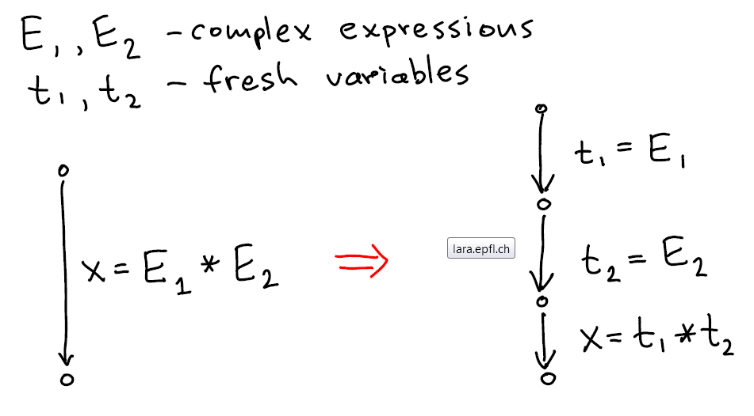
Flattening Expressions for simplicity and ordering of side effects

Slide 40
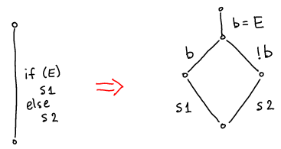
If-Then-Else
Better translation uses the "branch" instruction approach: have two destinations

Slide 41
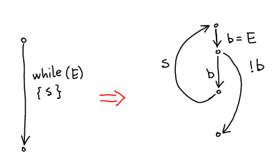
While
Better translation uses the "branch" instruction

Slide 42
Example 1: Convert to CFG
while (i < 10) {
println(j);
i = i + 1;
j = j +2*i + 1;
}

Slide 43
Example 2: Convert to CFG
int i = n;
while (i > 1) {
println(i);
if (i % 2 == 0) {
i = i / 2;
} else {
i = 3*i + 1;
}
}

Slide 44
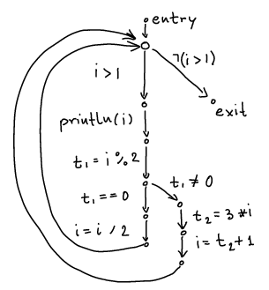
Example 2 Result
int i = n;
while (i > 1) {
println(i);
if (i % 2 == 0) {
i = i / 2;
} else {
i = 3*i + 1;
}
}

Slide 45
Translation Functions
[ s₁ ; s₂ ] v_{source} v_{target} =
[ s₁ ] v_{source} v_{fresh}
[ s₂ ] v_{fresh} v_{target}
insert (v_{s},stmt,v_{t})=
cfg = cfg + (v_{s},stmt, v_{t})
[ x=y+z ] v_{s} v_{t} = insert(v_{s},x=y+z, v_{t})
when y,z are constants or variables
[ branch(x<y) ] v_{source} v_{true} v_{false} =
insert(v_{source},[x<y],v_{true});
insert(v_{source},[!(x<y)],v_{false})

Slide 46
Analysis Domain (D) Lattices

Slide 47
Lattice
Partial order: binary relation ≤ (subset of some D²) which is
reflexive: x ≤ x
anti-symmetric: x≤y /\ y≤x -> x=y
transitive: x≤y /\ y≤z -> x≤z
Lattice is a partial order in which every two-element set has least among its upper bounds and greatest among its lower bounds
Lemma: if (D, ≤) is lattice and D is finite, then lub and glb exist for every finite set

Slide 48
Graphs and Partial Orders
If the domain is finite, then partial order can be represented by directed graphs
if x ≤ y then draw edge from x to y
For partial order, no need to draw x ≤ z if x ≤ y and y ≤ z. So we only draw non-transitive edges
Also, because always x ≤ x , we do not draw those self loops
Note that the resulting graph is acyclic: if we had a cycle, the elements must to be equal

Slide 49
Domain of Intervals [a,b] where a,b∈{-M,-127,0,127,M-1}

Slide 50
Defining Abstract Interpretation
Abstract Domain D describing which information to compute – this is often a lattice
inferred types for each variable: x:T1, y:T2
interval for each variable x:[a,b], y:[a’,b’]
Transfer Functions, [[st]] for each statement st, how this statement affects the facts
Example:

Slide 51
For now, we consider arbitrary integer bounds for intervals
Really ‘Int’ should be BigInt, as in e.g. Haskell
Often we must analyze machine integers
need to correctly represent (and/or warn about) overflows and underflows
fundamentally same approach as for unbounded integers
For efficiency, many analysis do not consider arbitrary intervals, but only a subset of them
We consider as the domain
empty set (denoted ⊥ , pronounced “bottom”)
all intervals [a,b] where a,b are integers and a ≤ b, or where we allow a= -∞ and/or b = ∞
set of all integers [-∞ ,∞] is denoted T , pronounced “top”

Slide 52
Find Transfer Function: Plus
Suppose we have only two integer variables: x,y
If
and we execute x= x+y
then
So we can let
a’= a+c b’ = b+d c’=c d’ = d

Slide 53
Find Transfer Function: Minus
Suppose we have only two integer variables: x,y
If
and we execute y= x-y
then
So we can let
a’= a b’ = b c’= a - d d’ = b - c

Slide 54
Transfer Functions for Tests
Tests e.g. [x>1] come from translating if,while into CFG
if (x > 1) { y = 1 / x } else { y = 42 }

Slide 55
Joining Data-Flow Facts
if (x > 0) { y = x + 100
} else { y = -x – 50
}
join

Slide 56
Handling Loops: Iterate Until Stabilizes
x = 1 while (x < 10) { x = x + 2 }

Slide 57
Analysis Algorithm
var facts : Map[Node,Domain] = Map.withDefault(empty) facts(entry) = initialValues
while (there was change) pick edge (v1,statmt,v2) from CFG such that facts(v1) has changed facts(v2)=facts(v2) join transferFun(statmt, facts(v1)) }
Order does not matter for the end result, as long as we do not permanently neglect any edge whose source was changed.

Slide 58
Work List Version
var facts : Map[Node,Domain] = Map.withDefault(empty) var worklist : Queue[Node] = empty
def assign(v1:Node,d:Domain) = if (facts(v1)!=d) { facts(v1)=d for (stmt,v2) <- outEdges(v1) { worklist.add(v2) } } assign(entry, initialValues)
while (!worklist.isEmpty) { var v2 = worklist.getAndRemoveFirst update = facts(v2) for (v1,stmt) <- inEdges(v2) { update = update join transferFun(facts(v1),stmt) } assign(v2, update) }

Slide 59
Exercise: Run range analysis, prove that error is unreachable
int M = 16; int[M] a;
x := 0;
while (x < 10) {
x := x + 3;
}
if (x >= 0) {
if (x <= 15)
a[x]=7;
else
error;
} else {
error; }
checks array accesses

Slide 60
Range analysis results
int M = 16; int[M] a;
x := 0;
while (x < 10) {
x := x + 3;
}
if (x >= 0) {
if (x <= 15)
a[x]=7;
else
error;
} else {
error; }
checks array accesses

Slide 61
Simplified Conditions
int M = 16; int[M] a;
x := 0;
while (x < 10) {
x := x + 3;
}
if (x >= 0) {
if (x <= 15)
a[x]=7;
else
error;
} else {
error; }
checks array accesses

Slide 62
Remove Trivial Edges, Unreachable Nodes
int M = 16; int[M] a;
x := 0;
while (x < 10) {
x := x + 3;
}
if (x >= 0) {
if (x <= 15)
a[x]=7;
else
error;
} else {
error; }
checks array accesses
Benefits:
- faster execution (no checks)
- program cannot crash with error

