Slide 1
I = 0
while (i < 10) {
i = i + 1 }
source code
Compiler
(scalac, gcc)
i
d3
=
0
LF
w
id3
=
0
while
(
id3
<
10
)
assign
i 0
while
<
lexer
parser
i
10
assign
+
i
i
1
characters
words
(tokens)
trees
Type Checking

Slide 2
Evaluating an Expression
scala prompt:
  >def min1(x : Int, y : Int) : Int = { if (x < y) x else y+1 }
  min1: (x: Int,y: Int)Int
  >min1(10,5)
  res1: Int = 6
How can we think about this evaluation?
  x → 10
  y → 5
  if (x < y) x else y+1

Slide 3
Computing types using the evaluation tree
scala prompt:
  >def min1(x : Int, y : Int) : Int = { if (x < y) x else y+1 }
  min1: (x: Int,y: Int)Int
  >min1(10,5)
  res1: Int = 6
How can we think about this evaluation?
  x : Int → 10
  y : Int → 5
  if (x < y) x else y+1

Slide 4
We can compute types without values
scala prompt:
  >def min1(x : Int, y : Int) : Int = { if (x < y) x else y+1 }
  min1: (x: Int,y: Int)Int
  >min1(10,5)
  res1: Int = 6
How can we think about this evaluation?
  x : Int
  y : Int
  if (x < y) x else y+1

Slide 5

We do not like trees upside-down

Slide 6
Leaves are Up
type rules move
from leaves to root

Slide 7

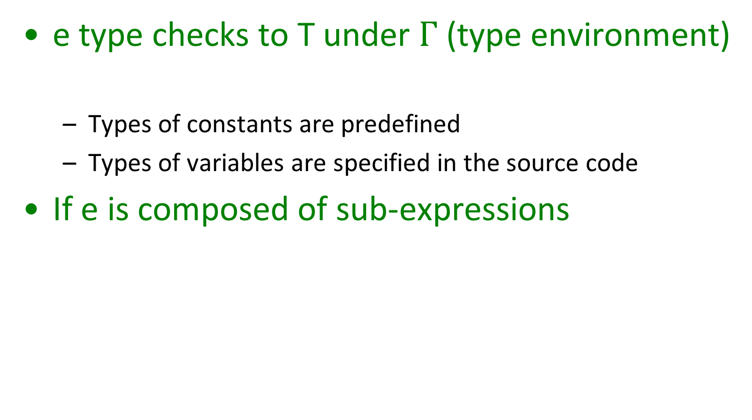
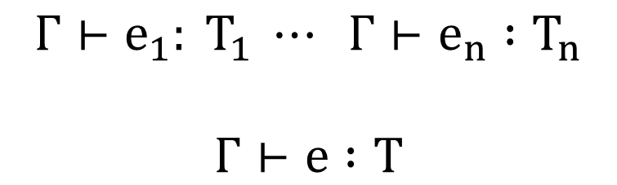
Type Judgements and Type Rules
e type checks to T under $Γ$ (type environment)
  Types of constants are predefined
  Types of variables are specified in the source code
If e is composed of sub-expressions
$$Γ⊢e : T$$
$$Γ⊢e_{1}: T_{1} ⋯ Γ⊢e_{n} :T_{n}$$
$$Γ⊢e :T$$

Slide 8

Type Judgements and Type Rules
$$Γ⊢e : T$$
if the (free) variables of e have types given by the type
environment gamma, then e (correctly) type checks
and has type T
$$Γ⊢e_{1}: T_{1} ⋯ Γ⊢e_{n} :T_{n}$$
$$Γ⊢e :T$$
If e₁ type checks in gamma and has type T₁ and ...
and e_{n} type checks in gamma and has type T_{n}
then e type checks in gamma and has type T
type rule

Slide 9
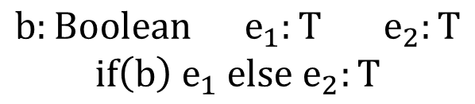
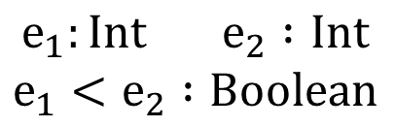
Type Rules as Local Tree Constraints
x : Int
y : Int
Type Rules
$$e_{1}:Int e_{2} :Int$$
$$e_{1}<e_{2} :Boolean$$
for every type T, if
b has type Boolean, and ...
then
$$b:Boolean{ e}_{1}:T e_{2}:T$$
$$if\left(b\right) e_{1} else e_{2}:T$$

Slide 10
Type Rules with Environment
x : Int
y : Int
Type Rules

Slide 11
Type Checker Implementation Sketch
def typeCheck(Γ : Map[ID, Type], e : ExprTree) : TypeTree = {
e match {
case Var(id) => { ?? }
case If(c,e1,e2) => { ?? }
...
}}
case Var(id) => { Γ(id) match
case Some(t) => t
case None => error(UnknownIdentifier(id,id.pos))
}

Slide 12
Type Checker Implementation Sketch
case If(c,e1,e2) => {
  val tc = typeCheck(Γ,c)
  if (tc != BooleanType) error(IfExpectsBooleanCondition(e.pos))
  val t1 = typeCheck(Γ, e1); val t2 = typeCheck(Γ, e2)
  if (t1 != t2) error(IfBranchesShouldHaveSameType(e.pos))
  t1
  }

Slide 13
Derivation Using Type Rules
x : Int
y : Int

Slide 14
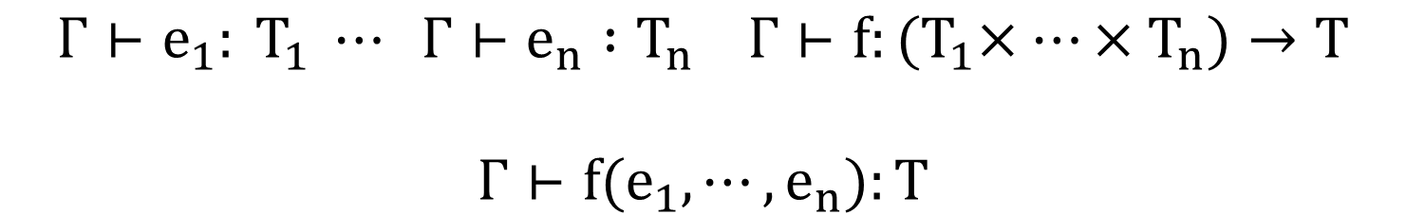
Type Rule for Function Application
$$Γ⊢e_{1}: T_{1} ⋯ Γ⊢e_{n} :T_{n} Γ⊢f:{(T}_{1}×⋯×T_{n})→T$$
$$Γ⊢f(e_{1}, ⋯, e_{n}):T$$

Slide 15
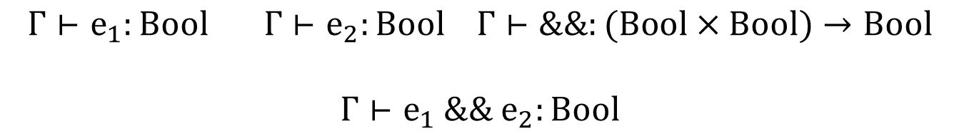
Type Rule for Function Application [Cont.]
We can treat operators as variables that have function type
We can replace many previous rules with application rule:
(
)
$$Γ⊢e_{1}:Bool Γ⊢e_{2}:Bool Γ⊢\&\&:(Bool×Bool)→Bool$$
$$Γ⊢e_{1} \&\& e_{2}:Bool$$

Slide 16
Computing the Environment of a Class
object World {
var data : Int
var name : String
def m(x : Int, y : Int) : Boolean { ... }
def n(x : Int) : Int {
if (x > 0) p(x – 1) else 3
}
def p(r : Int) : Int = {
var k = r + 2
m(k, n(k))
}
}
We can type check each function m,n,p in this global environment

Slide 17
Extending the Environment
class World {
var data : Int
var name : String
def m(x : Int, y : Int) : Boolean { ... }
def n(x : Int) : Int {
if (x > 0) p(x – 1) else 3
}
def p(r : Int) : Int = {
var k:Int = r + 2
m(k, n(k))
}
}

Slide 18

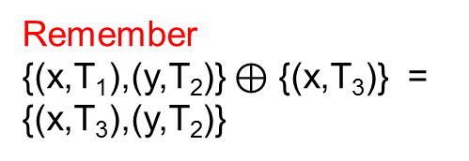

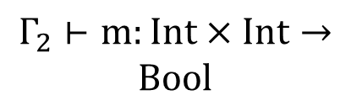

Type Checking Expression in a Body
class World {
var data : Int
var name : String
def m(x : Int, y : Int) : Boolean { ... }
def n(x : Int) : Int {
if (x > 0) p(x – 1) else 3
}
def p(r : Int) : Boolean = {
var k:Int = r + 2
m(k, n(k))
}
}
Remember
{(x,T₁),(y,T₂)} $⊕$ {(x,T₃)} = {(x,T₃),(y,T₂)}
$Γ_{2}⊢n:Int→Int Γ_{2}⊢k:Int$
$$Γ_{2}⊢n(k):Int$$
$$Γ_{2}⊢k:Int$$
$$Γ_{2}⊢m:Int×Int→$$
$$Bool$$
$$Γ_{2}⊢m\left(k,n\left(k\right)\right):Bool$$

Slide 19

Type Rule for Method Definitions
$$def m\left(x_{1}:T_{1},⋯,x_{n}:T_{n}\right):T=e$$
Type Rule for Assignments
Type Rules for Block: { var x₁:T₁ ... var x_{n}:T_{n}; s₁; ... s_{m}; e }

Slide 20
Blocks with Declarations in the Middle
just
expression
empty
declaration is first
statement is first

Slide 21
Rule for While Statement

Slide 22
Rule for a Method Call

Slide 23

Example to Type Check
Γ₀ = {
(z, Boolean),
(u, Int),
(f, Boolean → Int) }
object World {
var z : Boolean
var u : Int
def f(y : Boolean) : Int {
z = y
if (u > 0) {
u = u – 1
var z : Int
z = f(!y) + 3
z+z
} else { 0 }
}
}
Γ₁ = Γ₀ ⊕ {(y, Boolean)}
Exercise:
$???$
$$Γ⊢if\left(u>0\right)\left\{ body \right\} else \{ 0 \}:Int$$

Slide 24
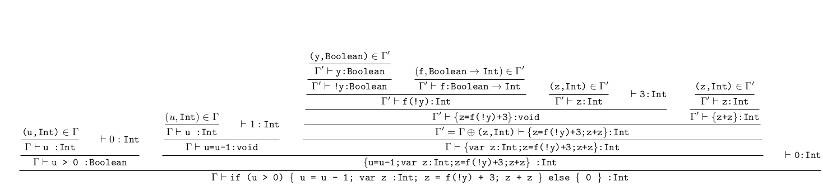
Solution

Slide 25
Overloading of Operators
Int x Int → Int
Not a problem for type checking from leaves to root
String x String → String

