Slide 1
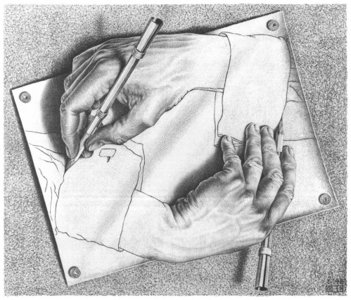
Computer Language Processing (Compiler Construction)
Drawing Hands M.C. Escher, 1948
http://lara.epfl.ch/cc
Staff:
Viktor Kuncak – Lectures
Etienne Kneuss – Labs
Ravichandhran Kandhadai Madhavan – Exercises

Slide 2
Computer Language Processing
Language can be
Natural language (French, English, …)
computer language (Java, Scala, C, SQL, …)
Mathematical language: a set of strings
Can represent both of the above
We can process the language: do something with strings in the language
manually: mathematical proof, literary criticism
using computers: algorithms that work on strings
Computer language processing in this course: processing computer languages using computers

Slide 3
Compilers
A typical compiler processes a general-purpose, Turing-complete, language and translates it into the form where it can be efficiently executed
gcc and clang: map C into machine instructions
Java compiler: Java source code into bytecodes (.class files)
Just-in-time (JIT) compiler inside the Java Virtual Machine (JVM): translate .class files into machine instructions (while running the program)
This is the focus of this class and the class project.

Slide 4
Example: javac
4: iload_1
5: bipush 10
7: if_icmpge 32
10: getstatic #2; //System.out
13: iload_2
14: invokevirtual #3; //println
17: iload_1
18: iconst_1
19: iadd
20: istore_1
21: iload_2
22: iconst_2
23: iload_1
24: imul
25: iadd
26: iconst_1
27: iadd
28: istore_2
29: goto 4
32: return
- from Java to Bytecode
…
while (i < 10) {
System.out.println(j);
i = i + 1;
j = j + 2*i+1;
}
javac Test.java
→ Test.class
javap –c Test
You will build a compiler that generates such code
…

Slide 5
Example: gcc
- from C to Intel x86
jmp .L2 .L3: movl -8(%ebp), %eax
movl %eax, 4(%esp)
movl $.LC0, (%esp)
call printf
addl $1, -12(%ebp)
movl -12(%ebp), %eax
addl %eax, %eax
addl -8(%ebp), %eax
addl $1, %eax
movl %eax, -8(%ebp)
.L2:
cmpl $9, -12(%ebp)
jle .L3
#include <stdio.h> int main(void) { int i = 0;
int j = 0;
while (i < 10) {
printf("%d\n", j);
i = i + 1;
j = j + 2*i+1;
}
}
gcc test.c –S
→ test.s

Slide 6
Compiler
i=0
while (i < 10) {
a[i] = 7*i+3 i = i + 1 }
source code (e.g. Scala, Java,C) easy to write
Construction
data-flow graphs
Compiler
(scalac, gcc)
i = 0 LF
w h i l e
i = 0 while ( i
< 10 )
optimizer
assign
i 0
while
<
lexer
parser
i
10
assign
+
a[i]
3
type check
*
7
i
code gen
characters
words
trees
mov R1,#0 mov R2,#40 mov R3,#3 jmp +12
mov (a+R1),R3
add R1, R1, #4 add R3, R3, #7
cmp R1, R2 blt -16
machine code
(e.g. x86, ARM, JVM) efficient to execute

Slide 7
Compilers are Important
Source code (e.g. Scala, Java, C, C++, Python) – designed to be easy for programmers to use
should correspond to way programmers think
help them be productive: avoid errors, write at a higher level, use abstractions, interfaces
Target code (e.g. x86, arm, JVM, .NET) – designed to efficiently run on hardware / VM
fast, low-power, compact, low-level
Compilers bridge these two worlds, they are essential for building complex software

Slide 8
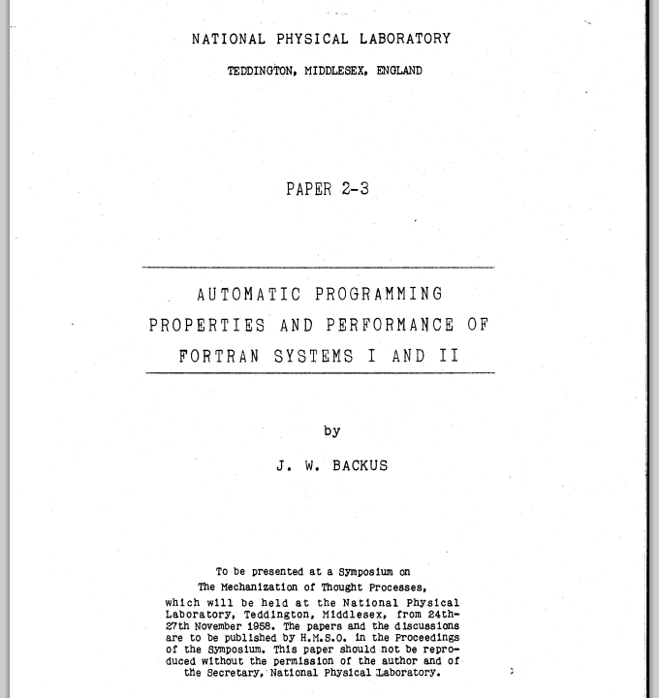
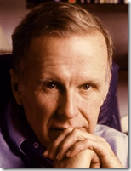
A pioneering compiler: FORTRAN
(FORmula TRANslator)
Backus-Naur
Form - BNF
Turing Award
1977

Slide 9
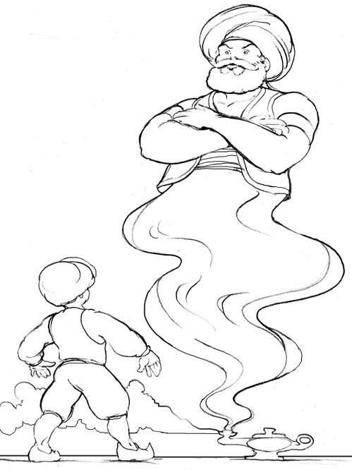
Challenges for Future
Can target code commands include not only execution of commands on standard microprocessors processors, but also automatic design of new hardware devices, and control of physical devices?
Can compilers bridge the gap between
wishes and commands, and help humans make the right decisions?
Can source code programs be wishes:
specification languages, math,
natural language phrases, diagrams,
other forms of communication closer to engineers and users?

Slide 10
Some of Topics You Learn in Course
Develop a compiler for a Java-like language
Write a compiler from start to end
Generates Java Virtual Machine (JVM) code
(We provide you code stubs, libraries in Scala)
Compiler generators – using and making them
Analyze complex text
Automata, regular expressions, grammars, parsing
Automatically detecting errors in code
name resolution, type checking, data-flow analysis
Machine-like code generation

Slide 11
Potential Uses of Knowledge Gained
understand how compilers work, use them better
gain experience with building complex software
build compiler for your next great language
extend language with a new construct you need
adapt existing compiler to new target platform (e.g. embedded CPU or graphics processor)
regular expression handling in editors, grep
build an XML parsing library
process complex input box in an application (e.g. expression evaluator)
parse simple natural language fragments

Slide 12
Schedule and Activities (6 credits)
All activities take place in INM 202
Mondays 10:15-12:00,
Wednesday 8:15-10:00 and continuing to:
Wednesday 10:15-12:00
Lectures, Labs, Exercises
At home
Continue with programming the compiler
Practice solving problems to prepare for quizzes
If you need more help, email us:
we will arrange additional meetings

Slide 13
How We Compute Your Grade
The grade is based on a weighted average of:
50% : project (submit, explain if requested)
submit through our wonderful online system
do them in groups of 2, exceptionally 1 or 3
25% : quiz for the first part of the course
25% : quiz for the second part of the course
will be on the last Wednesday of classes

Slide 14
Collaboration and Its Boundaries
For clarification questions, discuss them in the mailing list, which we monitor
Work in groups of 2 for project
everyone should know every part of code
we may ask you to explain specific parts of code
Do not copy lab solutions from other groups!
we use code plagiarism detection tools
we will check if you fully understand your code
Do the quizzes individually
You wouldn’t steal a handbag.
You wouldn’t steal a car.
You wouldn’t steal a compiler!

Slide 15
i=0
while (i < 10) {
a[i] = 7*i+3 i = i + 1 }
Your
Compiler
source code simplified Java-like
language
Construction
Your
Compiler
i = 0 LF
w h i l e
i = 0 while ( i
< 10 )
assign
i 0
while
<
lexer
parser
i
10
assign
+
code gen
a[i]
3
type check
*
7
i
characters
words
trees
21: iload_2
22: iconst_2
23: iload_1
24: imul
25: iadd
26: iconst_1
27: iadd
28: istore_2
Each two weeks you will add next phase
- keep same groups
- it is essential to not get behind schedule
- final addition to compiler is your choice!
JVM
Code

Slide 16
EPFL Course Dependencies
Theoretical Computer Science (CS-251)
If have not taken it, check the book “Introduction to the Theory of Computation” by Michael Sipser
Knowledge of the Scala language (see web)
Helpful general background
Discrete structures (CS-150), Algorithms (CS-250)
This course provides background for MSc:
Advanced Compilers
Synthesis Analysis & Verification
Foundations of Software

Slide 17
Course Materials
Official Textbook:
Andrew W. Appel, Jens Palsberg: Modern Compiler Implementation in Java (2nd Edition). Cambridge University Press, 2002 We do not strictly follow it–understand, not copy
program in Scala instead of Java
use pattern matching instead of visitors
hand-written parsers in the project (instead of using a parser generator)
Lectures in course wiki: http://lara.epfl.ch/w/cc

Slide 18
Additional Materials
Compilers: Principles, Techniques, and Tools (2nd Edition) by Alfred V. Aho, Monica S. Lam, Ravi Sethi, Jeffrey D. Ullman
comprehensive
Compiler Construction by Niklaus Wirth
concise, has main ideas
“Niklaus Emil Wirth (born February 15, 1934) is a Swiss computer scientist, best known for designing several programming languages, including Pascal, and for pioneering several classic topics in software engineering. In 1984 he won the Turing Award for developing a sequence of innovative computer languages.”
Additional recent books (2011-2012):
Aarne Ranta: Implementing Programming Languages
H.Seidl, R.Wilhelm, S.Haack: Compiler Design (3 vols, Springer)

Slide 19
Describing the Syntax of Languages

Slide 20
Syntax (from Wikipedia)
...In linguistics, syntax (from Ancient Greek σύνταξις "arrangement" from σύν - syn, "together", and τάξις - táxis, "an ordering") is the study of the principles and rules for constructing phrases and sentences in natural languages.
...In computer science, the syntax of a programming language is the set of rules that define the combinations of symbols that are considered to be correctly structured programs in that language.

Slide 21
Describing Syntax: Why
Goal: document precisely (a superset of) meaningful programs (for users, implementors)
Programs outside the superset: meaningless
We say programs inside make syntactic sense
(They may still be ‘wrong’ in a deeper sense)
Describing syntactically valid programs
There exist arbitrarily long valid programs, we cannot list all of them explicitly!
Informal English descriptions are imprecise, cannot use them as language reference

Slide 22
Describing Syntax: How
Use theory of formal languages (from TCS)
regular expressions & finite automata
context-free grammars
We can use such precise descriptions to
document what each compiler should support
manually derive compiler phases (lexer, parser)
automatically construct these phases using compiler generating tools
We illustrate this through an example

Slide 23
While Language – Idea
Small language used to illustrate key concepts
Simpler than the language for which you implement your compiler
‘while’ and ‘if’ are the control statements
no procedures, no exceptions
the only variables are of ‘int’ type
no variable declarations, they are initially zero
no objects, pointers, arrays

Slide 24
While Language – Example Programs
while (i < 100) {
j = i + 1;
while (j < 100) {
println(“ “,i);
println(“,”,j);
j = j + 1;
}
i = i + 1;
}
x = 13; while (x > 1) { println("x=", x); if (x % 2 == 0) { x = x / 2; } else { x = 3 * x + 1; } }
Does the program terminate for every initial value of x?
(Collatz conjecture - open)
Nested loop
Even though it is simple, while is Turing-complete.

Slide 25
Reasons for Unbounded Program Length
nesting of
expressions
while (i < 100) {
j = i + 5*(j + 2*(k + 7*(j+k) + i));
while (293847329 > j) {
while (k < 100) {
someName42a = someName42a + k;
k = k + i + j;
println(“Nice number”, k)
}
}
}
constants of any length
nesting of
statements
variable names of any length
String constants of any length
(words - tokens)

Slide 26
Tokens (Words) of the While Language
Ident ::= letter (letter | digit)*
integerConst ::= digit digit*
stringConst ::= “ AnySymbolExceptQuote* “
keywords if else while println
special symbols ( ) && < == + - * / % ! - { } ; ,
letter ::= a | b | c | … | z | A | B | C | … | Z digit ::= 0 | 1 | … | 8 | 9
regular
expressions

Slide 27
Double Floating Point Constants
Different rules in different languages
1) digit digit* [ . ] [ digit digit* ]
2) digit digit* [ . digit digit * ]
3) digit* . digit digit*
4) digit digit* . digit digit*

Slide 28
Identifiers
while (i < 100) {
j = i + 5*(j + 2*(k + 7*(j+k) + i));
while (293847329 > j) {
while (k < 100) {
someName42a = someName42a + k;
k = k + i + j;
println(“Nice number”, k)
}
}
}
letter (letter | digit)*

Slide 29
Id3 = 0
while (id3 < 10) {
println(“”,id3); id3 = id3 + 1 }
Compiler
source code
Construction
i d3
=
0 LF
w
id3 = 0 while ( id3
< 10 )
assign
i 0
while
<
lexer
parser
i
10
assign
+
a[i]
3
*
7
i
characters
words
(tokens)
trees
Lexer is specified using regular expressions.
Groups characters into tokens and classifies them into token classes.

Slide 30
More Reasons for Unbounded Length
nesting of
expressions
while (i < 100) {
j = i + 5*(j + 2*(k + 7*(j+k) + i));
while (293847329847 > j) {
while (k < 100) {
someName42a = someName42a + k;
k = k + i + j;
println(“Nice number”, k)
}
}
}
constants of any length
nesting of
statements
variable names of any length
String constants of any length
(words - tokens)
(sentences)

Slide 31
Sentences of the While Language
We describe sentences using context-free grammar (Backus-Naur form). Terminal symbols are tokens (words)
program ::= statmt*
statmt ::= println( stringConst , ident )
| ident = expr
| if ( expr ) statmt (else statmt)?
| while ( expr ) statmt | { statmt* }
expr ::= intLiteral | ident
| expr (&& | < | == | + | - | * | / | % ) expr | ! expr | - expr
nesting of
statements
nesting of
expressions

Slide 32
While Language without Nested Loops
statmt ::= println( stringConst , ident )
| ident = expr
| if ( expr ) statmt (else statmt)?
| while ( expr ) statmtww | { statmt* }
statmtww ::= println( stringConst , ident )
| ident = expr
| if ( expr ) statmtww (else statmtww)?
| { statmtww* }

Slide 33
Id3 = 0
while (id3 < 10) {
println(“”,id3); id3 = id3 + 1 }
Compiler
source code
Construction
i d3
=
0 LF
w
id3 = 0 while ( id3
< 10 )
assign
i 0
while
<
lexer
parser
i
10
assign
+
a[i]
3
*
7
i
characters
words
(tokens)
trees
regular expressions
for tokens
context-free grammar

Slide 34
Abstract Syntax - Trees
To get abstract syntax (trees, cases classes), start from context-free grammar for tokens, then
remove punctuation characters
interpret rules as tree descriptions, not string descriptions
statmt ::= println( stringConst , ident ) PRINT(String,ident)
| ident = expr ASSIGN(ident,expr)
| if ( expr ) statmt (else statmt)? IF(expr,stmt,Option[statmt])
| while ( expr ) statmt WHILE(expr,statmt) | { statmt* } BLOCK(List[statmt])
concrete syntax
abstract syntax
abstract class statmt case class PRINT(id:ident) extends statmt case class ASSIGN(id:ident, e:expr) extends statmt case class IF(e:expr, s1:statmt, s2:Option[statmt]) extends statmt ...
Scala trees for this abstract syntax

Slide 35
ocaml vs Haskell vs Scala
ocaml:
type tree = Leaf | Node of tree * int * tree
Haskell:
data Tree = Leaf | Branch Tree Int Tree
Scala:
abstract class Tree case object Leaf extends Tree case class Node(left:Tree,x:Int,right:Tree) extends Tree

Slide 36
Example of Parsing
res = 14 + arg * 3
Lexer:
res = 14 + arg * 3
Parser:
:=
ASSIGN(res, PLUS(CONST(14),
TIMES(VAR(arg),CONST(3))))
res
+
14
*
arg
3
Code generator then “prints” this tree into instructions.

Slide 37
Interpreters

Slide 38
What is an interpreter?
Interpreter is a simpler way to implement a language
Usually it is easier to build than a compiler
It can be used as one way to define the meaning of programs: programs should compute whatever the interpreter returns
Your first lab: build an interpreter
the front end (lexer and parser) will be given to you as a class file

Slide 39
i=0
while (i < 10) {
a[i] = 7*i+3 i = i + 1 }
Interpreter
source code simplified Java-like
language
Construction
(first lab)
program inputs
Your
Compiler
i = 0 LF
w h i l e
i = 0 while ( i
< 10 )
assign
i 0
interpreter
while
<
lexer
parser
i
10
assign
+
a[i]
3
*
7
i
characters
words
trees
Differences with the compiler
does not generate code
waits for program input, evaluates program tree, computes the result
JVM
Code
result of executing the program

Slide 40
Reminder about Formal Languages

Slide 41
Languages Formally
A word is a finite, possibly empty, sequence of elements from some set Σ
Σ – alphabet, Σ* - set of all words over Σ
For lexer: characters; for parser: token classes
uv denotes concatenation of words u and v
By a language we mean a subset of Σ*
union, intersection, complement wrt. Σ*
L₁ L₂ = { u₁ u₂ | u₁ in L₁ , u₂ in L₂ } L⁰ = {ε} L^{k+1} = L L^{k} L* = U_{k} L^{k} (Kleene star)

Slide 42
Are there finitely many tokens?
There are finitely many token classes
identifier
string
{
}
(
... (many, but finitely many)
There is unbounded number of instances of token classes identifier and string When we discuss grammars, we work with token classes.

Slide 43
Examples of Languages
Σ = {a,b}
Σ* = {ε, a, b, aa, ab, ba, bb, aaa, aab, aba, ... }
Examples of two languages, subsets of Σ* :
L₁ = {a, bb, ab} (finite language, three words)
L₂ = {ab, abab, ababab, ... } = { (ab)^{n} | n ≥ 0 } (infinite language)

Slide 44
Examples of Operations
L = {a,ab}
L L = { aa, aab, aba, abab }
L* = { a, ab, aa, aab, aba, abab, aaa, ... }
(is bb inside L* ?)
= { w | immediately before each b there is a }

