Slide 1
Abstract Interpretation (Cousot, Cousot 1977) also known as Data-Flow Analysis (Kildall 1973)

Slide 2
Why Constant Propagation
int a, b, step, i;
boolean c;
a = 0;
b = a + 10;
step = -1;
if (step > 0) {
i = a;
} else {
i = b;
}
c = true;
while (c) {
print(i);
i = i + step; // can emit decrement
if (step > 0) {
c = (i < b);
} else {
c = (i > a); // can emit better instruction here
} // insert here (a = a + step), redo analysis
}

Slide 3
Goal of Data-Flow Analysis
Automatically compute information about the program
Use it to report errors to user (like type errors)
Use it to optimize the program
Works on control-flow graphs: (like flow-charts)
x = 1 while (x < 10) { x = x + 2 }

Slide 4
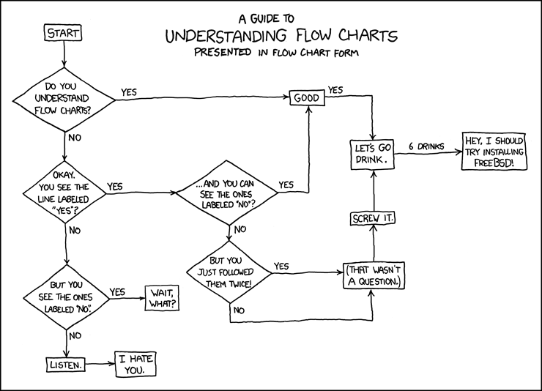
Control-Flow Graphs: Like Flow Charts
http://imgs.xkcd.com/comics/flow_charts.png

Slide 5
Control-Flow Graph: (V,E)
Set of nodes, V
Set of edges, which have statements on them (v₁,st,v₂) ∈ E means there is edge from v₁ to v₂ labeled with statement st.
x = 1 while (x < 10) { x = x + 2 }
V = {v₀,v₁,v₂,v₃} E = {(v₀,x=1,v₁), (v₁,[x<10],v₂), (v₂,x=x+2,v₁), (v₁,[!(x<10)],v₃)}

Slide 6
Interpretation and Abstract Interpratation
Control-Flow graph is similar to AST
We can
interpret control flow graph
generate machine code from it (e.g. LLVM, gcc)
abstractly interpret it: do not push values, but approximately compute supersets of possible values (e.g. intervals, types, etc.)

Slide 7
Compute Range of x at Each Point

Slide 8
What we see in the sequel
How to compile abstract syntax trees into control-flow graphs
Lattices, as structures that describe abstractly sets of program states (facts)
Transfer functions that describe how to update facts
Basic idea of fixed-point iteration

Slide 9
Generating Control-Flow Graphs
Start with graph that has one entry and one exit node and label is entire program
Recursively decompose the program to have more edges with simpler labels
When labels cannot be decomposed further, we are done

Slide 10
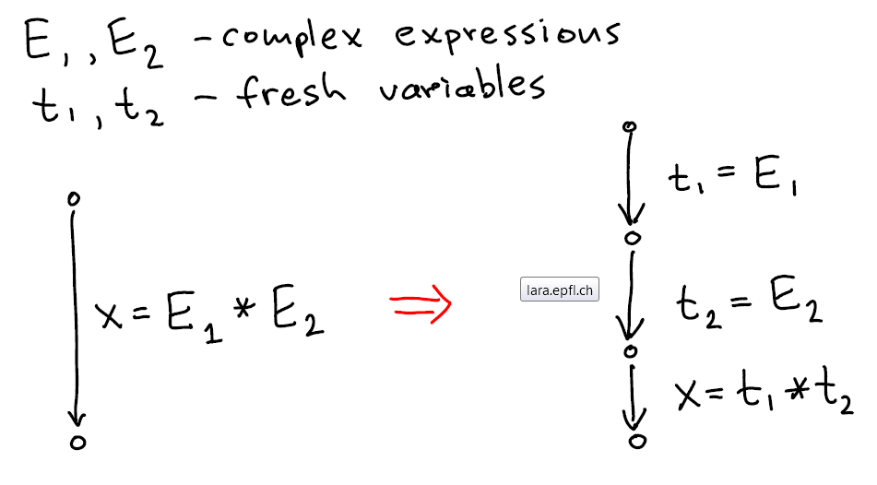
Flattening Expressions for simplicity and ordering of side effects

Slide 11
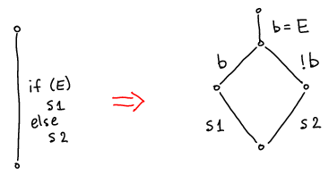
If-Then-Else
Better translation uses the "branch" instruction approach: have two destinations

Slide 12
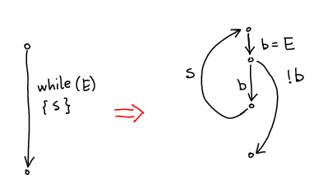
While
Better translation uses the "branch" instruction

Slide 13
Example 1: Convert to CFG
while (i < 10) {
println(j);
i = i + 1;
j = j +2*i + 1;
}

Slide 14
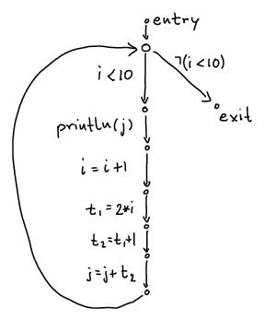
Example 1 Result
while (i < 10) {
println(j);
i = i + 1;
j = j +2*i + 1;
}

Slide 15
Example 2: Convert to CFG
int i = n;
while (i > 1) {
println(i);
if (i % 2 == 0) {
i = i / 2;
} else {
i = 3*i + 1;
}
}

Slide 16
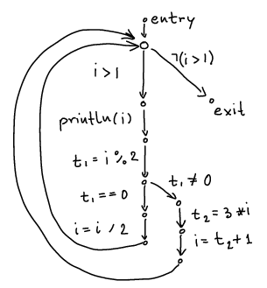
Example 2 Result
int i = n;
while (i > 1) {
println(i);
if (i % 2 == 0) {
i = i / 2;
} else {
i = 3*i + 1;
}
}

Slide 17
Translation Functions
[ s₁ ; s₂ ] v_{source} v_{target} =
[ s₁ ] v_{source} v_{fresh}
[ s₂ ] v_{fresh} v_{target}
insert (v_{s},stmt,v_{t})=
cfg = cfg + (v_{s},stmt, v_{t})
[ x=y+z ] v_{s} v_{t} = insert(v_{s},x=y+z, v_{t})
when y,z are constants or variables
[ branch(x<y) ] v_{source} v_{true} v_{false} =
insert(v_{source},[x<y],v_{true});
insert(v_{source},[!(x<y)],v_{false})

Slide 18
Analysis Domain (D) Lattices

Slide 19
Abstract Intepretation Generalizes Type Inference
Type Inference
Abstract Interpretation
computes types
type rules
can be used to compute types of expression from subtypes
types fixed for a variable
computes facts from a domain
types
intervals
formulas
set of initialized variables
set of live variables
transfer functions
compute facts for one program point from facts at previous program points
facts change as the values of vars change (flow-sensitivity)

Slide 20
scalac computes types. Try in REPL:
class C
class D extends C
class E extends C
val p = false
val d = new D()
val e = new E()
val z = if (p) d else e
val u = if (p) (d,e) else (d,d)
val v = if (p) (d,e) else (e,d)
val f1 = if (p) ((d1:D) => 5) else ((e1:E) => 5)
val f2 = if (p) ((d1:D) => d) else ((e1:E) => e)

Slide 21
Finds "Best Type" for Expression
class C
class D extends C
class E extends C
val p = false
val d = new D() // d:D
val e = new E() // e:E
val z = if (p) d else e // z:C
val u = if (p) (d,e) else (d,d) // u:(D,C)
val v = if (p) (d,e) else (e,d) // v:(C,C)
val f1 = if (p) ((d1:D) => 5) else ((e1:E) => 5) // f1: ((D with E) => Int)
val f2 = if (p) ((d1:D) => d) else ((e1:E) => e) // f2: ((D with E) => C)

Slide 22
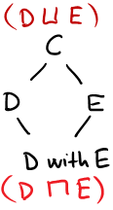
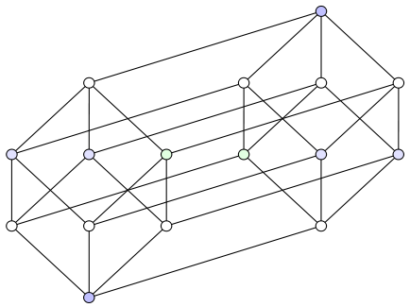
Subtyping Relation in this Example
product of two graphs:
CC
CD
DC
CE
EC
DD
ED
DE
FC
EE
class C
class D extends C
class E extends C
CF
DF
FD
EF
FE
FF
each relation can be visualized in 2D
two relations: naturally shown in 4D (hypercube)
we usually draw larger elements higher

Slide 23
Least Upper Bound (lub, join)
A,B,C are all upper bounds on both D and E
(they are above each of then in the picture,
they are supertypes of D and supertypes of E).
Among these upper bounds, C is the least one
(the most specific one).
We therefore say C is the least upper bound,
In any partial order ≤, if S is a set of elements (e.g. S={D,E}) then:
U is upper bound on S iff x ≤ U for every x in S.
U₀ is the least upper bound (lub) of S, written U₀ = S , or U₀=lub(S) iff:
U₀ is upper bound and
if U is any upper bound on S, then U₀ ≤ U

Slide 24
Greatest Lower Bound (glb, meet)
In the presence of traits or interfaces, there are multiple types that are subtypes of both D and E. The type (D with E) is the largest of them.
In any partial order ≤, if S is a set of elements (e.g. S={D,E}) then:
L is lower bound on S iff L ≤ x for every x in S.
L₀ is the greatest lower bound (glb) of S, written L₀ = S, or L₀=glb(S), iff:
m₀ is upper bound and
if m is any upper bound on S, then m₀ ≤ m

Slide 25
Computing lub and glb for tuple and function types

Slide 26
Lattice
Partial order: binary relation ≤ (subset of some D²) which is
reflexive: x ≤ x
anti-symmetric: x≤y /\ y≤x -> x=y
transitive: x≤y /\ y≤z -> x≤z
Lattice is a partial order in which every two-element set has lub and glb
Lemma: if (D, ≤) is lattice and D is finite, then lub and glb exist for every finite set

Slide 27
Idea of Why Lemma Holds
lub(x₁,lub(x₂,...,lub(x_{n-1},x_{n}))) is lub({x₁,...x_{n}})
glb(x₁,glb(x₂,...,glb(x_{n-1},x_{n}))) is glb({x₁,...x_{n}})
lub of all elements in D is maximum of D
by definition, glb({}) is the maximum of D
glb of all elements in D is minimum of D
by definition, lub({}) is the minimum of D

Slide 28
Graphs and Partial Orders
If the domain is finite, then partial order can be represented by directed graphs
if x ≤ y then draw edge from x to y
For partial order, no need to draw x ≤ z if x ≤ y and y ≤ z. So we only draw non-transitive edges
Also, because always x ≤ x , we do not draw those self loops
Note that the resulting graph is acyclic: if we had a cycle, the elements must to be equal

Slide 29
Defining Abstract Interpretation
Abstract Domain D describing which information to compute – this is often a lattice
inferred types for each variable: x:T1, y:T2
interval for each variable x:[a,b], y:[a’,b’]
Transfer Functions, [[st]] for each statement st, how this statement affects the facts
Example:

Slide 30
Domain of Intervals [a,b] where a,b∈{-M,-127,0,127,M-1}

Slide 31
For now, we consider arbitrary integer bounds for intervals
Really ‘Int’ should be BigInt, as in Haskell, Go
Often we must analyze machine integers
need to correctly represent (and/or warn about) overflows and underflows
fundamentally same approach as for unbounded integers
For efficiency, many analysis do not consider arbitrary intervals, but only a subset of them
For now, we consider as the domain
empty set (denoted ⊥ , pronounced “bottom”)
all intervals [a,b] where a,b are integers and a ≤ b, or where we allow a= -∞ and/or b = ∞
set of all integers [-∞ ,∞] is denoted T , pronounced “top”

Slide 32
Find Transfer Function: Plus
Suppose we have only two integer variables: x,y
If
and we execute x= x+y
then
So we can let
a’= a+c b’ = b+d c’=c d’ = d

Slide 33
Find Transfer Function: Minus
Suppose we have only two integer variables: x,y
If
and we execute y= x-y
then
So we can let
a’= a b’ = b c’= a - d d’ = b - c

Slide 34
Further transfer functions
x=y*z (assigning product)
x=y (copy)

Slide 35
Transfer Functions for Tests
Tests e.g. [x>1] come from translating if,while into CFG
if (x > 1) { y = 1 / x } else { y = 42 }

Slide 36
Joining Data-Flow Facts
if (x > 0) { y = x + 100
} else { y = -x – 50
}
join

Slide 37
Handling Loops: Iterate Until Stabilizes
x = 1 while (x < 10) { x = x + 2 }

Slide 38
Analysis Algorithm
var facts : Map[Node,Domain] = Map.withDefault(empty) facts(entry) = initialValues
while (there was change) pick edge (v1,statmt,v2) from CFG such that facts(v1) has changed facts(v2)=facts(v2) join transferFun(statmt, facts(v1)) }
Order does not matter for the end result, as long as we do not permanently neglect any edge whose source was changed.

Slide 39
Work List Version
var facts : Map[Node,Domain] = Map.withDefault(empty) var worklist : Queue[Node] = empty
def assign(v1:Node,d:Domain) = if (facts(v1)!=d) { facts(v1)=d for (stmt,v2) <- outEdges(v1) { worklist.add(v2) } } assign(entry, initialValues)
while (!worklist.isEmpty) { var v2 = worklist.getAndRemoveFirst update = facts(v2) for (v1,stmt) <- inEdges(v2) { update = update join transferFun(facts(v1),stmt) } assign(v2, update) }

Slide 40
Exercise: Run range analysis, prove that error is unreachable
int M = 16; int[M] a;
x := 0;
while (x < 10) {
x := x + 3;
}
if (x >= 0) {
if (x <= 15)
a[x]=7;
else
error;
} else {
error; }
checks array accesses

Slide 41
Range analysis results
int M = 16; int[M] a;
x := 0;
while (x < 10) {
x := x + 3;
}
if (x >= 0) {
if (x <= 15)
a[x]=7;
else
error;
} else {
error; }
checks array accesses

Slide 42
Simplified Conditions
int M = 16; int[M] a;
x := 0;
while (x < 10) {
x := x + 3;
}
if (x >= 0) {
if (x <= 15)
a[x]=7;
else
error;
} else {
error; }
checks array accesses

Slide 43
Remove Trivial Edges, Unreachable Nodes
int M = 16; int[M] a;
x := 0;
while (x < 10) {
x := x + 3;
}
if (x >= 0) {
if (x <= 15)
a[x]=7;
else
error;
} else {
error; }
checks array accesses
Benefits:
- faster execution (no checks)
- program cannot crash with error

Slide 44
Exercise: Apply Range Analysis and Simplify
int a, b, step, i;
boolean c;
a = 0;
b = a + 10;
step = -1;
if (step > 0) {
i = a;
} else {
i = b;
}
c = true;
while (c) {
process(i);
i = i + step;
if (step > 0) {
c = (i < b);
} else {
c = (i > a);
}
}
For booleans, use this lattice: D_{b} = { {}, {false}, {true}, {false,true} } with ordering given by set subset relation.

