Slide 1
Code Generation Introduction

Slide 2
i=0
while (i < 10) {
a[i] = 7*i+3 i = i + 1 }
source code (e.g. Scala, Java,C) easy to write
idea
data-flow graphs
Compiler
(scalac, gcc)
i = 0 LF
w h i l e
i = 0 while ( i
< 10 )
optimizer
assign
i 0
while
<
lexer
parser
i
10
assign
+
a[i]
3
type check
*
7
i
code gen
characters
words
trees
mov R1,#0 mov R2,#40 mov R3,#3 jmp +12
mov (a+R1),R3
add R1, R1, #4 add R3, R3, #7
cmp R1, R2 blt -16
machine code
(e.g. x86, arm, JVM) efficient to execute

Slide 3
Example: gcc
jmp .L2 .L3: movl -8(%ebp), %eax
movl %eax, 4(%esp)
movl $.LC0, (%esp)
call printf
addl $1, -12(%ebp)
movl -12(%ebp), %eax
addl %eax, %eax
addl -8(%ebp), %eax
addl $1, %eax
movl %eax, -8(%ebp)
.L2:
cmpl $9, -12(%ebp)
jle .L3
#include <stdio.h> int main() { int i = 0;
int j = 0;
while (i < 10) {
printf("%d\n", j);
i = i + 1;
j = j + 2*i+1;
}
}
gcc test.c -S

Slide 4
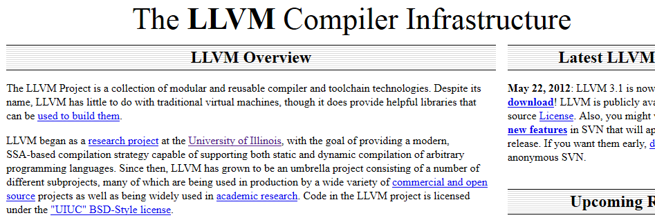
LLVM: Another Interesting C Compiler

Slide 5
i=0
while (i < 10) {
a[i] = 7*i+3 i = i + 1 }
source code simplified Java-like
language
Your Project
Your
Compiler
i = 0 LF
w h i l e
i = 0 while ( i
< 10 )
assign
i 0
while
<
lexer
parser
i
10
assign
+
code gen
a[i]
3
type check
*
7
i
characters
words
trees
21: iload_2
22: iconst_2
23: iload_1
24: imul
25: iadd
26: iconst_1
27: iadd
28: istore_2
Java Virtual Machine (JVM) Bytecode

Slide 6
javac example
4: iload_1
5: bipush 10
7: if_icmpge 32
10: getstatic #2; //System.out
13: iload_2
14: invokevirtual #3; //println
17: iload_1
18: iconst_1
19: iadd
20: istore_1
21: iload_2
22: iconst_2
23: iload_1
24: imul
25: iadd
26: iconst_1
27: iadd
28: istore_2
29: goto 4
32: return
while (i < 10) {
System.out.println(j);
i = i + 1;
j = j + 2*i+1;
}
javac Test.java
javap –c Test
Phase after type checking:
emits such bytecode instructions
Guess what each JVM instruction for the highlighted expression does.

Slide 7
Stack Machine: High-Level Machine Code
instruction sequence:
program counter
...
21: iload_2
22: iconst_2
23: iload_1
24: imul
25: iadd
26: iconst_1
27: iadd
28: istore_2
29: goto 4
...
top of stack
local variable memory (slots):
0
1
2
stack
3
8
Let us step through

Slide 8
Operands are consumed from stack and put back onto stack
instruction sequence:
...
21: iload_2
22: iconst_2
23: iload_1
24: imul
25: iadd
26: iconst_1
27: iadd
28: istore_2
29: goto 4
...
top of stack
8
memory:
0
1
2
stack
3
8

Slide 9
Operands are consumed from stack and put back onto stack
instruction sequence:
...
21: iload_2
22: iconst_2
23: iload_1
24: imul
25: iadd
26: iconst_1
27: iadd
28: istore_2
29: goto 4
...
top of stack
2
8
memory:
0
1
2
stack
3
8

Slide 10
Operands are consumed from stack and put back onto stack
instruction sequence:
...
21: iload_2
22: iconst_2
23: iload_1
24: imul
25: iadd
26: iconst_1
27: iadd
28: istore_2
29: goto 4
...
top of stack
3
2
8
memory:
0
1
2
stack
3
8

Slide 11
Operands are consumed from stack and put back onto stack
instruction sequence:
...
21: iload_2
22: iconst_2
23: iload_1
24: imul
25: iadd
26: iconst_1
27: iadd
28: istore_2
29: goto 4
...
top of stack
6
8
memory:
0
1
2
stack
3
8

Slide 12
Operands are consumed from stack and put back onto stack
instruction sequence:
...
21: iload_2
22: iconst_2
23: iload_1
24: imul
25: iadd
26: iconst_1
27: iadd
28: istore_2
29: goto 4
...
top of stack
14
memory:
0
1
2
stack
3
8

Slide 13
Operands are consumed from stack and put back onto stack
instruction sequence:
...
21: iload_2
22: iconst_2
23: iload_1
24: imul
25: iadd
26: iconst_1
27: iadd
28: istore_2
29: goto 4
...
top of stack
1
14
memory:
0
1
2
stack
3
8

Slide 14
Operands are consumed from stack and put back onto stack
instruction sequence:
...
21: iload_2
22: iconst_2
23: iload_1
24: imul
25: iadd
26: iconst_1
27: iadd
28: istore_2
29: goto 4
...
top of stack
15
memory:
0
1
2
stack
3
8

Slide 15
Operands are consumed from stack and put back onto stack
instruction sequence:
...
21: iload_2
22: iconst_2
23: iload_1
24: imul
25: iadd
26: iconst_1
27: iadd
28: istore_2
29: goto 4
...
top of stack
memory:
0
1
2
stack
3
15

Slide 16
Instructions in JVM
Separate for each type, including
integer types (iadd, imul, iload, istore, bipush)
reference types (aload, astore)
Why are they separate?
Memory safety!
Each reference points to a valid allocated object
Conditionals and jumps
Further high-level operations
array operations
object method and field access

Slide 17
Stack Machine Simulator
var code : Array[Instruction]
var pc : Int // program counter
var local : Array[Int] // for local variables
var operand : Array[Int] // operand stack
var top : Int
top
6
8
while (true) step
def step = code(pc) match { case Iadd() =>
operand(top - 1) = operand(top - 1) + operand(top)
top = top - 1 // two consumed, one produced
case Imul() =>
operand(top - 1) = operand(top - 1) * operand(top)
top = top - 1 // two consumed, one produced
stack

Slide 18
Stack Machine Simulator: Moving Data
case Bipush(c) => operand(top + 1) = c // put given constant 'c' onto stack top = top + 1
case Iload(n) => operand(top + 1) = local(n) // from memory onto stack
top = top + 1
case Istore(n) => local(n) = operand(top) // from stack into memory top = top - 1 // consumed } if (notJump(code(n)))
pc = pc + 1 // by default go to next instructions

Slide 19
Actual Java Virtual Machine
JVM Instruction Description from JavaTech book
Official documentation: http://docs.oracle.com/javase/specs/
http://docs.oracle.com/javase/specs/jvms/se7/html/index.html
Use: javac -g *.java to compile
javap -c -l ClassName to explore

Slide 20
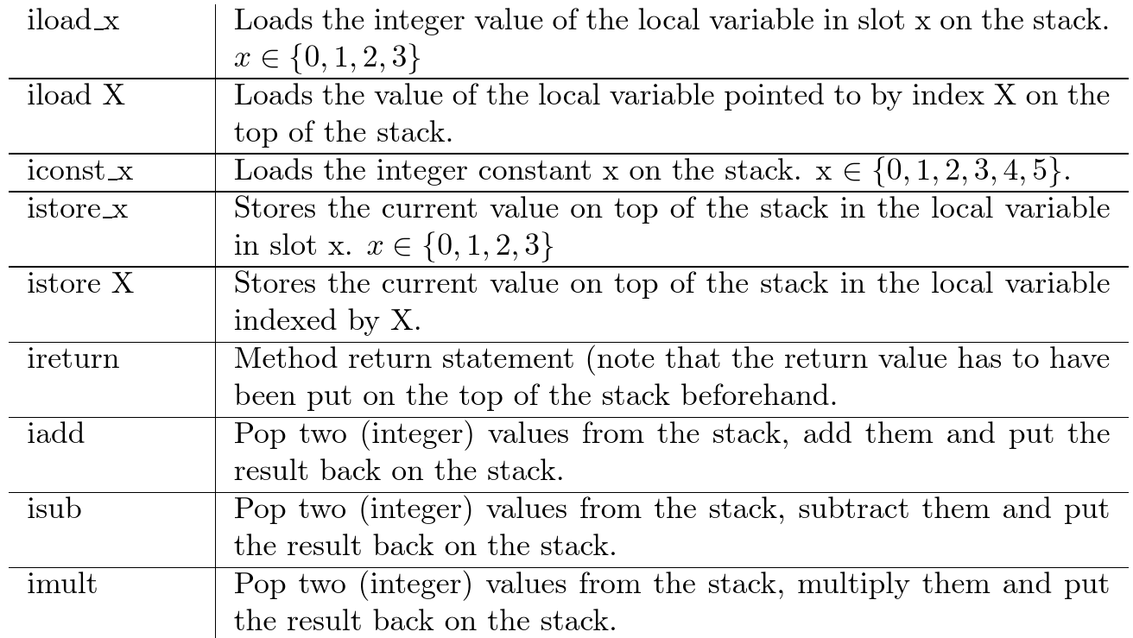
Selected Instructions
bipush X
Like iconst, but for arbitrarily large X

Slide 21
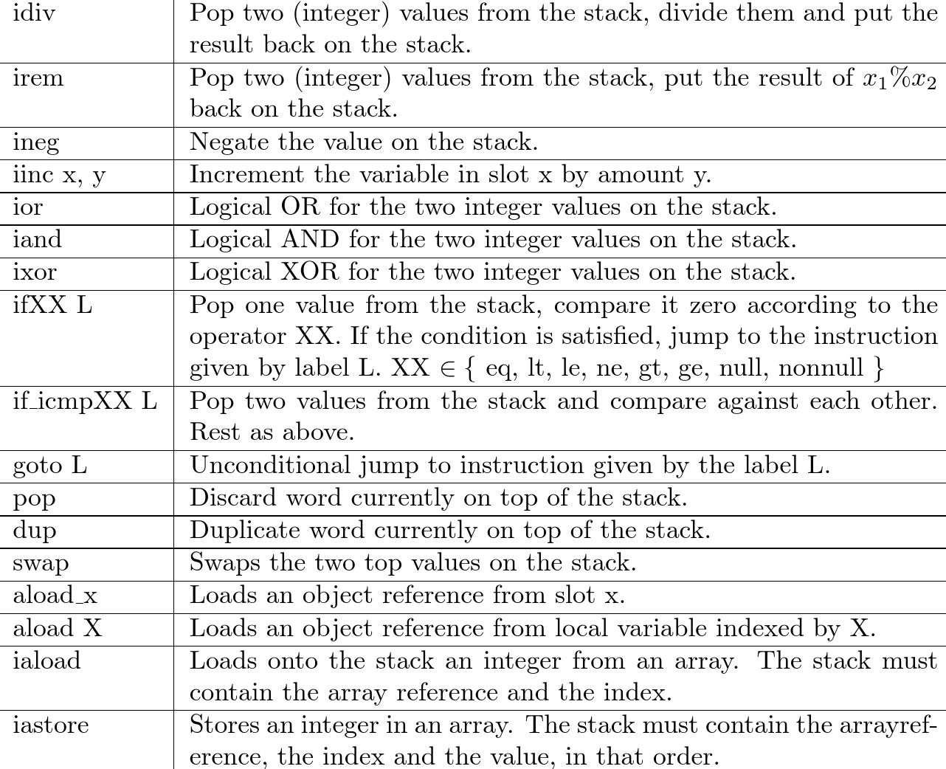

Slide 22
Example: Twice
class Expr1 { public static int twice(int x) {
return x*2; } }
javac -g Expr1.java; javap -c -l Expr1
public static int twice(int);
Code:
0: iload_0 // load int from var 0 to top of stack
1: iconst_2 // push 2 on top of stack
2: imul // replace two topmost elements with their product
3: ireturn // return top of stack
}

Slide 23
Example: Area
class Expr2 {
public static int cubeArea(int a, int b, int c) {
return (a*b + b*c + a*c) * 2;
}
}
public static int cubeArea(int, int, int);
Code:
0: iload_0
1: iload_1
2: imul
3: iload_1
4: iload_2
5: imul
6: iadd
7: iload_0
8: iload_2
9: imul
10: iadd
11: iconst_2
12: imul
13: ireturn
}
javac -g Expr2.java; javap -c -l Expr2
LocalVariableTable:
Start Length Slot Name Signature
0 14 0 a I
0 14 1 b I
0 14 2 c I

Slide 24
What Instructions Operate on
operands that are part of instruction itself, following their op code (unique number for instruction - iconst)
operand stack - used for computation (iadd)
memory managed by the garbage collector (loading and storing fields)
constant pool - used to store ‘big’ values instead of in instruction stream
e.g. string constants, method and field names
mess!

Slide 25
CAFEBABE
Library to make bytecode generation easy and fun!
https://github.com/psuter/cafebabe/wiki
Named after magic code appearing in .class files when displayed in hexadecimal:
More on that in the labs!

Slide 26
Towards Compiling Expressions: Prefix, Infix, and Postfix Notation

Slide 27
Overview of Prefix, Infix, Postfix
Let f be a binary operation, e₁ e₂ two expressions
We can denote application f(e₁,e₂) as follows
in prefix notation f e₁ e₂
in infix notation e₁ f e₂
in postfix notation e₁ e₂ f
Suppose that each operator (like f) has a known number of arguments. For nested expressions
infix requires parentheses in general
prefix and postfix do not require any parantheses!

Slide 28
Expressions in Different Notation
For infix, assume * binds stronger than +
There is no need for priorities or parens in the other notations
arg.list +(x,y) +(*(x,y),z) +(x,*(y,z)) *(x,+(y,z))
prefix + x y + * x y z + x * y z * x + y z
infix x + y x*y + z x + y*z x*(y + z)
postfix x y + x y * z + x y z * + x y z + *
Infix is the only problematic notation and leads to ambiguity
Why is it used in math? Amgiuity reminds us of algebraic laws:
x + y looks same from left and from right (commutative)
x + y + z parse trees mathematically equivalent (associative)

Slide 29
Convert into Prefix and Postfix
prefix
infix ( ( x + y ) + z ) + u x + (y + (z + u ))
postfix
draw the trees:
Terminology:
prefix = Polish notation (attributed to Jan Lukasiewicz from Poland)
postfix = Reverse Polish notation (RPN)
Is the sequence of characters in postfix opposite to one in prefix if we have binary operations?
What if we have only unary operations?

Slide 30
Compare Notation and Trees
arg.list +(x,y) +(*(x,y),z) +(x,*(y,z)) *(x,+(y,z))
prefix + x y + * x y z + x * y z * x + y z
infix x + y x*y + z x + y*z x*(y + z)
postfix x y + x y * z + x y z * + x y z + *
draw ASTs for each expression
How would you pretty print AST into a given form?

Slide 31
Simple Expressions and Tokens
sealed abstract class Expr
case class Var(varID: String) extends Expr
case class Plus(lhs: Expr, rhs: Expr) extends Expr
case class Times(lhs: Expr, rhs: Expr) extends Expr
sealed abstract class Token
case class ID(str : String) extends Token
case class Add extends Token
case class Mul extends Token
case class O extends Token // (
case class C extends Token // )

Slide 32
Printing Trees into Lists of Tokens
def prefix(e : Expr) : List[Token] = e match {
case Var(id) => List(ID(id))
case Plus(e1,e2) => List(Add()) ::: prefix(e1) ::: prefix(e2)
case Times(e1,e2) => List(Mul()) ::: prefix(e1) ::: prefix(e2)
}
def infix(e : Expr) : List[Token] = e match { // should emit parantheses!
case Var(id) => List(ID(id))
case Plus(e1,e2) => List(O())::: infix(e1) ::: List(Add()) ::: infix(e2) :::List(C())
case Times(e1,e2) => List(O())::: infix(e1) ::: List(Mul()) ::: infix(e2) :::List(C())
}
def postfix(e : Expr) : List[Token] = e match {
case Var(id) => List(ID(id))
case Plus(e1,e2) => postfix(e1) ::: postfix(e2) ::: List(Add())
case Times(e1,e2) => postfix(e1) ::: postfix(e2) ::: List(Mul())
}

Slide 33
LISP: Language with Prefix Notation
1958 – pioneering language
Syntax was meant to be abstract syntax
Treats all operators as user-defined ones, so syntax does not assume the number of arguments is known
use parantheses in prefix notation: f(x,y) as (f x y)
(defun factorial (n)
(if (<= n 1)
1
(* n (factorial (- n 1)))))

Slide 34
PostScript: Language using Postfix
.ps are ASCII files given to PostScript-compliant printers
Each file is a program whose execution prints the desired pages
http://en.wikipedia.org/wiki/PostScript%20programming%20language
PostScript language tutorial and cookbook
Adobe Systems Incorporated
Reading, MA : Addison Wesley, 1985
ISBN 0-201-10179-3 (pbk.)

Slide 35
A PostScript Program
/inch {72 mul} def
/wedge
{ newpath
0 0 moveto
1 0 translate
15 rotate
0 15 sin translate
0 0 15 sin -90 90 arc
closepath
} def
gsave
3.75 inch 7.25 inch translate
1 inch 1 inch scale
wedge 0.02 setlinewidth stroke
grestore
gsave
4.25 inch 4.25 inch translate
1.75 inch 1.75 inch scale
0.02 setlinewidth
1 1 12
{ 12 div setgray
gsave
wedge
gsave fill grestore
0 setgray stroke
grestore
30 rotate
} for
grestore
showpage

Slide 36
If we send it to printer (or run GhostView viewer gv) we get
4.25 inch 4.25 inch translate
1.75 inch 1.75 inch scale
0.02 setlinewidth
1 1 12
{ 12 div setgray
gsave
wedge
gsave fill grestore
0 setgray stroke
grestore
30 rotate
} for
grestore
showpage

Slide 37
Why postfix? Can evaluate it using stack
def postEval(env : Map[String,Int], pexpr : Array[Token]) : Int = { // no recursion!
var stack : Array[Int] = new Array[Int](512)
var top : Int = 0; var pos : Int = 0
while (pos < pexpr.length) {
pexpr(pos) match {
case ID(v) => top = top + 1
stack(top) = env(v)
case Add() => stack(top - 1) = stack(top - 1) + stack(top)
top = top - 1
case Mul() => stack(top - 1) = stack(top - 1) * stack(top)
top = top - 1
}
pos = pos + 1
}
stack(top) }
x -> 3, y -> 4, z -> 5
infix: x*(y+z)
postfix: x y z + *
Run ‘postfix’ for this env

Slide 38
Evaluating Infix Needs Recursion
The recursive interpreter:
def infixEval(env : Map[String,Int], expr : Expr) : Int = expr match {
case Var(id) => env(id)
case Plus(e1,e2) => infix(env,e1) + infix(env,e2)
case Times(e1,e2) => infix(env,e1) * infix(env,e2)
}
Maximal stack depth in interpreter = expression height

Slide 39
Compiling Expressions
Evaluating postfix expressions is like running a stack-based virtual machine on compiled code
Compiling expressions for stack machine is like translating expressions into postfix form

Slide 40
Expression, Tree, Postfix, Code
*
infix: x*(y+z)
postfix: x y z + *
bytecode:
iload 1 x
iload 2 y
iload 3 z
iadd +
imul *
+
x
y
z

Slide 41
Show Tree, Postfix, Code
infix: (x*y + y*z + x*z)*2 tree:
postfix: bytecode:

Slide 42
“Printing” Trees into Bytecodes
To evaluate e₁*e₂ interpreter
evaluates e₁
evaluates e₂
combines the result using *
Compiler for e₁*e₂ emits:
code for e₁ that leaves result on the stack, followed by
code for e₂ that leaves result on the stack, followed by
arithmetic instruction that takes values from the stack and leaves the result on the stack
def compile(e : Expr) : List[Bytecode] = e match { // ~ postfix printer
case Var(id) => List(ILoad(slotFor(id)))
case Plus(e1,e2) => compile(e1) ::: compile(e2) ::: List(IAdd())
case Times(e1,e2) => compile(e1) ::: compile(e2) ::: List(IMul())
}

Slide 43
Local Variables
For int: instructions iload and istore from JVM Spec.
Assigning indices (called slots) to local variables using function slotOf : VarSymbol → {0,1,2,3,…}
How to compute the indices?
assign them in the order in which they appear in the tree
def compile(e : Expr) : List[Bytecode] = e match {
case Var(id) => List(ILoad(slotFor(id)))
…
}
def compileStmt(s : Statmt) : List[Bytecpde] = s match {
case Assign(id,e) => compile(e) ::: List(IStore(slotFor(id)))
… }

Slide 44
Global Variables and Fields
Static Variables
Consult JVM Spec and see
getstatic
putstatic
as well as the section on Runtime Constant Pool.
Instance Variables (Fields)
To access these we use
getfield
putfield
In lower-level machines x.f is evaluated as mem[x + offset(f)]
With inheritance, offset(f) must be consistent despite the fact that we do not know exactly what the run-time class of x will be
this can be very tricky to implement efficiently with multiple inheritance
general approach: do a run-time test on the dynamic type of an object to decide how to interpret field or method access

Slide 45
Factorial Example
public int fact(int);
Code:
0: iload_1
1: iconst_1
2: if_icmpge 10
5: iconst_1
6: istore_2
7: goto 20
10: iload_1
11: aload_0
12: iload_1
13: iconst_1
14: isub
15: invokevirtual #2; //Met. fact:(I)I
18: imul
19: istore_2
20: iload_2
21: ireturn
class Factorial {
public int fact(int num){
int num_aux;
if (num < 1)
num_aux = 1 ;
else
num_aux=
num*(this.fact(num-1));
return num_aux;
}
}
aload_0 refers to receiver object (0th argument), since ‘fact’ is not static

Slide 46
Correctness
If we execute the compiled code, the result is the same as running the interpreter.
exec(env,compile(expr)) == interpret(env,expr)
interpret : Env x Expr -> Int compile : Expr -> List[Bytecode] exec : Env x List[Bytecode] -> Int Assume 'env' in both cases maps var names to values.
With much more work, can prove correctness of entire compiler:
CompCert - A C Compiler whose Correctness has been Formally Verified

Slide 47
exec(env,compile(expr)) == interpret(env,expr)
Attempted proof by induction:
exec(env,compile(Times(e1,e2))) == exec(env,compile(e1) ::: compile(e2) ::: List(`*`)) ==
We need to know something about behavior of intermediate executions.
exec : Env x List[Bytecode] -> Int
run : Env x List[Bytecode] x List[Int] -> List[Int] // stack as argument and result
exec(env,bcodes) == run(env,bcodes,List()).head

Slide 48
run(env,bcodes,stack) = newStack
Executing sequence of instructions
run : Env x List[Bytecode] x List[Int] -> List[Int]
Stack grows to the right, top of the stack is last element
Byte codes are consumed from left
Definition of run is such that
run (env,`*` :: L, S ::: List(x1, x2)) == run(env,L, S:::List(x1*x2))
run (env,`+` :: L, S ::: List(x1, x2)) == run(env,L, S:::List(x1+x2))
run(env,ILoad(n) :: L, S) == run(env,L, S:::List(env(n)))
By induction one shows:
run (env,L1 ::: L2,S) == run(env,L2, run(env,L1,S))
execute instructions L1, then execute L2 on the result

Slide 49
New correctness condition
exec : Env x List[Bytecode] -> Int run : Env x List[Bytecode] x List[Int] -> List[Int]
Old condition:
exec(env,compile(expr)) == interpret(env,expr)
New condition:
run(env,compile(expr),S) == S:::List(interpret(env,expr))
for short (T - table), [x] denotes List(x)
run(T,C(e),S) == S:::[I(T,e)]

Slide 50
Proof of one case: run(T,C(e),S) == S:::[I(T,e)]
run(T,C(Times(e1,e2)),S) == run(T,C(e1):::C(e2):::[`*`],S) == run(T,[`*`], run(T,e2, run(T,e1,S) )) == run(T,[`*`], run(T,e2, S:::[I(T,e1)]) ) == run(T,[`*`], S:::[I(T,e1),I(T,e2)]) == S:::[I(T,e1) * I(T,e2)] == S:::[I(T,Times(e1,e2)]

