Slide 1
Id3 = 0
while (id3 < 10) {
println(“”,id3); id3 = id3 + 1 }
source code
Compiler
(scalac, gcc)
i d3
=
0 LF
w
id3 = 0 while ( id3
< 10 )
assign
var id3: Int
while
<
lexer
parser
id3
10
assign
+
a[i]
3
*
7
i
characters
words
(tokens)
trees
Name Analysis:
making sense of trees;
converting them into graphs:
connect uses and declarations

Slide 2
Errors Detected So Far
File input: file does not exist
Lexer: unknown token, string not closed before end of file, …
Parser: syntax error - unexpected token, cannot parse given non-terminal
Name analyzer: unknown variable, …
Type analyzer: applying function to argument of wrong type, …
Data-flow analyzer: variable read before being written, …

Slide 3
Showing Good Errors with Syntax Trees
Suppose we have undeclared variable ‘i’ in a program of 100K lines
What error message would you like compiler to give?
An ocurrence of variable ‘i’ not declared
An ocurrence of variable ‘i’ in procedure P not declared
Variable ‘i’ undeclared at line 514, position 12 ⬅
How to emit this error message if we only have a syntax trees?
Abstract syntax tree nodes store positions in file where they begin!
For identifier nodes: allows reporting variable uses
Variable 'i' in line 11, column 5 undeclared
For other nodes, supports useful for type errors, e.g. could report for (x + y) * (!ok)
Type error in line 13,
expression in line 13, column 11-15, has type bool, but int is expected
Constructing trees with positions:
obtain position from lexer when parsing beginning of tree node
save this position in the constructed tree
can also save end positions
What is important is to save information for leaves
information for other nodes can be approximated using information in leaves

Slide 4
Example: find program result, symbols, scopes
class Example {
boolean x;
int y;
int z;
int compute(int x, int y) {
int z = 3;
return x + y + z;
}
public void main() {
int res;
x = true;
y = 10;
z = 17;
res = compute(z, z+1);
System.out.println(res);
}
}
Scope of a variable = part of the program where it is visible
Draw an arrow from occurrence of each identifier to the point of its declaration.
For each declaration of identifier, identify where the identifier can be referred to (its scope).
Name analysis:
computes those arrows
= maps, partial functions (math)
= environments (PL theory)
= symbol table (implementation)
report some simple semantic errors
We usually introduce symbols for things denoted by identifiers. Symbol tables map identifiers to symbols.

Slide 5
Name Analysis: Problems it Detects
a class is defined more than once: class A { ...} class B { ... } class A { ... }
a variable is defined more than once: int x; int y; int x;
a class member is overriden without override keyword: class A { int x; ... } class B extends A { int x; ... }
a method is overloaded (forbidden in Tool): class A { def f(B x) {} def f(C x) {} ... }
a method argument is shadowed by a local variable declaration (forbidden in Java, Tool): def (x:Int) { var x : Int; ...}
two method arguments have the same name: def (x:Int,y:Int,x:Int) { ... }
a class name is used as a symbol (as parent class or type, for instance) but is not declared: class A extends Objekt {}
an identifier is used as a variable but is not declared: def(amount:Int) { total = total + ammount }
the inheritance graph has a cycle: class A extends B {} class B extends C {} class C extends A
To make it efficient and clean to check for such errors, we associate mapping from each identifier to the symbol that the identifier represents.
We use Map data structures to maintain this mapping
The rules that specify how declarations are used to construct such maps are given by scoping rules of the programming language.

Slide 6
Usual static scoping: What is the result?
class World {
int sum;
int value;
void add() {
sum = sum + value; value = 0;
}
Identifier refers to the symbol that was declared closest to the place in program text (thus "static").
We will assume static scoping unless otherwise specified.
void main() {
sum = 0;
value = 10;
add();
if (sum % 3 == 1) {
int value;
value = 1;
add();
print("inner value = ", value);
print("sum = ", sum); }
print("outer value = ", value);
}
}
1
10
0

Slide 7
Renaming Statically Scoped Program
class World {
int sum;
int value;
void add(int foo) {
sum = sum + value; value = 0;
}
Identifier refers to the symbol that was declared closest to the place in program text (thus "static").
We will assume static scoping unless otherwise specified.
Property of static scoping:
Given the entire program, we can rename variables to avoid any shadowing (make all vars unique!)
void main() {
sum = 0;
value = 10;
add();
if (sum % 3 == 1) {
int value1;
value1 = 1;
add(); // cannot change value1
print("inner value = ", value1);
print("sum = ", sum); }
print("outer value = ", value);
}
}
1
10
0

Slide 8
Dynamic scoping: What is the result?
class World {
int sum;
int value;
void add() {
sum = sum + value; value = 0;
}
Symbol refers to the variable that was most recently declared within program execution.
Views variable declarations as executable statements that establish which symbol is considered to be the ‘current one’.
(Used in old LISP interpreters.)
Translation to normal code: access through a dynamic environment.
void main() {
sum = 0;
value = 10;
add();
if (sum % 3 == 1) {
int value;
value = 1;
add();
print("inner value = ", value);
print("sum = ", sum); }
print("outer value = ", value);
}
}
0
11
0

Slide 9
Dynamic scoping translated using global map, working like stack
class World {
int sum;
int value;
void add() {
sum = sum + value; value = 0;
}
class World {
pushNewDeclaration('sum);
pushNewDeclaration('value);
void add(int foo) {
update('sum, lookup('sum) + lookup('value)); update('value, 0);
}
void main() {
sum = 0;
value = 10;
add();
if (sum % 3 == 1) {
int value;
value = 1;
add();
print("inner value = ", value);
print("sum = ", sum); }
print("outer value = ", value);
}
}
void main() {
update('sum, 0);
update('value,10);
add();
if (lookup('sum) % 3 == 1) {
pushNewDeclaration('value);
update('value, 1);
add();
print("inner value = ", lookup('value));
print("sum = ", lookup('sum)); popDeclaration('value) }
print("outer value = ", lookup('value));
}
}
0
11
0
Object-oriented programming has scope for each object, so we have a nice controlled alternative to dynamic scoping (objects give names to scopes).

Slide 10
class World {
int sum; int value;
// value → int, sum → int
void add(int foo) {
// foo → int, value → int, sum → int
string z;
// z → string, foo → int, value → int, sum → int
sum = sum + value; value = 0;
}
How the symbol map
changes in case of
static scoping
// value → int, sum → int
void main(string bar) {
// bar → string, value → int, sum → int
int y;
// y → int, bar → string, value → int, sum → int
sum = 0;
value = 10;
add();
// y → int, bar → string, value → int, sum → int
if (sum % 3 == 1) {
string value;
// value → string, y → int, bar → string, sum → int
value = 1;
add();
print("inner value = ", value);
print("sum = ", sum); }
// y → int, bar → string, value → int, sum → int
print("outer value = ", value);
} }
Outer declaration int value is shadowed by inner declaration string value
Map becomes bigger as we enter more scopes, later becomes smaller again
Imperatively: need to make maps bigger, later smaller again.
Functionally: immutable maps, keep old versions.

Slide 11
Formalism for Name Analysis

Slide 13
Checking that each variable is declared
“e uses only variables declared in Γ”

Slide 14
Rules for Checking Variable Use

Slide 15
Local Block Declarations Change Γ

Slide 16
Method Parameters are Similar
Γ s
Γ T m (T₁ x₁ ,..., T_{n} x_{n}) { s }
class World {
int sum;
int value;
void add(int foo) {
sum = sum + foo;
}
}

Slide 17
Symbol Table (Γ) Contents
Map identifiers to the symbol with relevant information about the identifier
All information is derived from syntax tree - symbol table is for efficiency
in old one-pass compilers there was only symbol table, no syntax tree
in modern compiler: we could always go through entire tree, but symbol table can give faster and easier access to the part of syntax tree, or some additional information
Goal: efficiently supporting phases of compiler
In the name analysis phase:
finding which identifier refers to which definition
we store definitions
What kinds of things can we define? What do we need to know for each ID?
variables (globals, fields, parameters, locals):
need to know types, positions - for error messages
later: memory layout. To compile x.f = y into memcopy(addr_y, addr_x+6, 4)
e.g. 3rd field in an object should be stored at offset e.g. +6 from the address of the object
the size of data stored in x.f is 4 bytes
sometimes more information explicit: whether variable local or global
methods, functions, classes: recursively have with their own symbol tables

Slide 18
Different Points, Different Γ
class World {
int sum;
void add(int foo) {
sum = sum + foo;
} void sub(int bar) { sum = sum - bar; } int count;
}

Slide 19
Imperative Way: Push and Pop
class World {
int sum;
void add(int foo) {
sum = sum + foo;
} void sub(int bar) { sum = sum - bar; } int count;
}
change table, record change
revert changes from table
change table, record change
revert changes from table

Slide 20
Imperative Symbol Table
Hash table, mutable Map[ID,Symbol]
Example:
hash function into array
array has linked list storing (ID,Symbol) pairs
Undo stack: to enable entering and leaving scope
Entering new scope (function,block):
add beginning-of-scope marker to undo stack
Adding nested declaration (ID,sym)
lookup old value symOld, push old value to undo stack
insert (ID,sym) into table
Leaving the scope
go through undo stack until the marker, restore old values

Slide 21
Functional: Keep Old Version
class World {
int sum;
void add(int foo) {
sum = sum + foo;
} void sub(int bar) { sum = sum - bar; } int count;
}
create new Γ₁, keep old Γ₀
create new Γ₂, keep old Γ₀

Slide 22
Functional Symbol Table Implemented
Typical: Immutable Balanced Search Trees
Updating returns new map, keeping old one
lookup and update both log(n)
update creates new path (copy log(n) nodes, share rest!)
memory usage acceptable
Simplified. In practice, BST[A], store Int key and value A
sealed abstract class BST case class Empty() extends BST case class Node(left: BST, value: Int, right: BST) extends BST

Slide 23
Lookup
def contains(key: Int, t : BST): Boolean = t match { case Empty() => false case Node(left,v,right) => { if (key == v) true else if (key < v) contains(key, left) else contains(key, right) } }
Running time bounded by tree height.
contains(6,t) ?

Slide 24
Insertion
def add(x : Int, t : BST) : Node = t match { case Empty() => Node(Empty(),x,Empty()) case t @ Node(left,v,right) => { if (x < v) Node(add(x, left), v, right) else if (x==v) t else Node(left, v, add(x, right)) } }
Both add(x,t) and t remain accessible.
Running time and newly allocated nodes bounded by tree height.

Slide 25
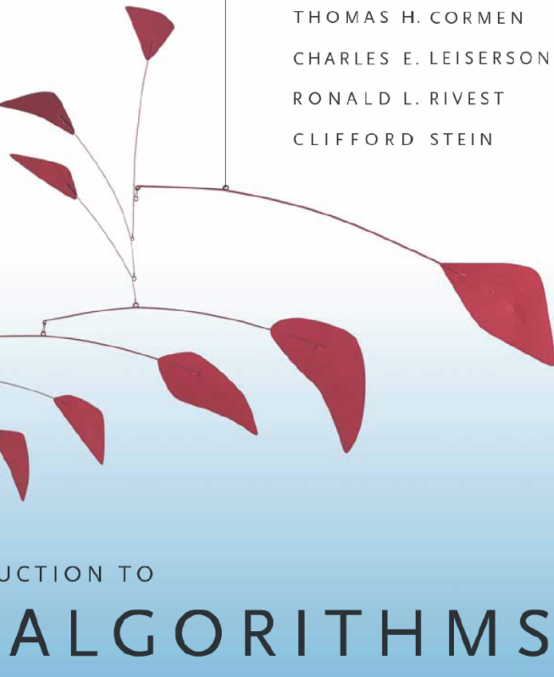
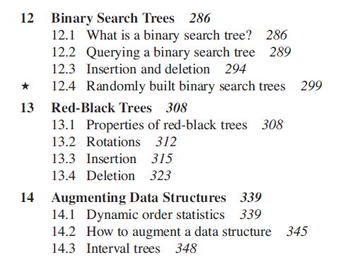
Balanced Trees: Red-Black Trees

Slide 26
Balanced Tree: Red Black Tree
Goals:
ensure that tree height remains at most log(size) add(1,add(2,add(3,...add(n,Empty())...))) ~ linked list
preserve efficiency of individual operations: rebalancing arbitrary tree: could cost O(n) work
Solution: maintain mostly balanced trees: height still O(log size)
sealed abstract class Color case class Red() extends Color case class Black() extends Color
sealed abstract class Tree case class Empty() extends Tree case class Node(c: Color,left: Tree,value: Int, right: Tree) extends Tree

Slide 27
balanced tree
constraints
From 4. and 5.: tree height is O(size).
Analysis is similar for mutable and immutable trees.
for immutable trees: see book by Chris Okasaki

Slide 28
Balancing
def balance(c: Color, a: Tree, x: Int, b: Tree): Tree = (c,a,x,b) match { case (Black(),Node(Red(),Node(Red(),a,xV,b),yV,c),zV,d) => Node(Red(),Node(Black(),a,xV,b),yV,Node(Black(),c,zV,d))
case (Black(),Node(Red(),a,xV,Node(Red(),b,yV,c)),zV,d) => Node(Red(),Node(Black(),a,xV,b),yV,Node(Black(),c,zV,d))
case (Black(),a,xV,Node(Red(),Node(Red(),b,yV,c),zV,d)) => Node(Red(),Node(Black(),a,xV,b),yV,Node(Black(),c,zV,d)) case (Black(),a,xV,Node(Red(),b,yV,Node(Red(),c,zV,d))) => Node(Red(),Node(Black(),a,xV,b),yV,Node(Black(),c,zV,d)) case (c,a,xV,b) => Node(c,a,xV,b) }

Slide 29
Insertion
def add(x: Int, t: Tree): Tree = { def ins(t: Tree): Tree = t match { case Empty() => Node(Red(),Empty(),x,Empty()) case Node(c,a,y,b) => if (x < y) balance(c, ins(a), y, b) else if (x == y) Node(c,a,y,b) else balance(c,a,y,ins(b)) } makeBlack(ins(t)) }
def makeBlack(n: Tree): Tree = n match { case Node(Red(),l,v,r) => Node(Black(),l,v,r) case _ => n }
Modern object-oriented languages (=Scala) support abstraction and functional data structures.
Just use Map from Scala.

Slide 30
Id3 = 0
while (id3 < 10) {
println(“”,id3); id3 = id3 + 1 }
source code
Compiler
(scalac, gcc)
i d3
=
0 LF
w
id3 = 0 while ( id3
< 10 )
assign
i 0
while
<
lexer
parser
i
10
assign
+
a[i]
3
*
7
i
characters
words
(tokens)
trees
Type Checking

Slide 31
Evaluating an Expression
scala prompt:
>def min1(x : Int, y : Int) : Int = { if (x < y) x else y+1 } min1: (x: Int,y: Int)Int >min1(10,5) res1: Int = 6
How can we think about this evaluation?
x → 10 y → 5 if (x < y) x else y+1

Slide 32
Each Value has a Type
scala prompt:
>def min1(x : Int, y : Int) : Int = { if (x < y) x else y+1 } min1: (x: Int,y: Int)Int >min1(10,5) res1: Int = 6
How can we think about this evaluation?
x : Int → 10 y : Int → 5 if (x < y) x else y+1

Slide 33
We can compute types without values
scala prompt:
>def min1(x : Int, y : Int) : Int = { if (x < y) x else y+1 } min1: (x: Int,y: Int)Int >min1(10,5) res1: Int = 6
How can we think about this evaluation?
x : Int y : Int if (x < y) x else y+1

Slide 34
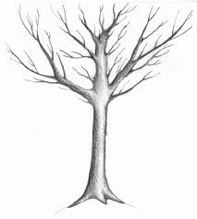
We do not like trees upside-down

Slide 35
Leaves are Up
type rules move
from leaves to root

Slide 37
Type Rules as Local Tree Constraints
x : Int y : Int
Type Rules
for every type T, if
b has type Boolean, and ...
then

Slide 38
Type Rules with Environment
x : Int y : Int
Type Rules

Slide 39
if the free variables of e have types given by gamma, then e (correctly) type checks and has type T
If e₁ type checks in gamma and has type T₁ and ... and e_{n} type checks in gamma and has type T_{n}
then e type checks in gamma and has type T

