Slide 1
Abstract Interpretation (Cousot, Cousot 1977) also known as Data-Flow Analysis

Slide 2
Goal of Data-Flow Analysis
Automatically compute information about the program
Use it to report errors to user (like type errors)
Use it to optimize the program
Works on control-flow graphs: (like flow-charts)
x = 1 while (x < 10) { x = x + 2 }

Slide 3
Constant Propagation
int a, b, step, i;
boolean c;
a = 0;
b = a + 10;
step = -1;
if (step > 0) {
i = a;
} else {
i = b;
}
c = true;
while (c) {
print(i);
i = i + step; // can emit decrement
if (step > 0) {
c = (i < b);
} else {
c = (i > a); // can emit better instruction here
} // insert here (a = a + step), redo analysis
}

Slide 4
Control-Flow Graph: (V,E)
Set of nodes, V
Set of edges, which have statements on them (v₁,st,v₂) in E means there is edge from v₁ to v₂ labeled with statement st.
x = 1 while (x < 10) { x = x + 2 }
V = {v₀,v₁,v₂,v₃} E = {(v₀,x=1,v₁), (v₁,[x<10],v₂), (v₂,x=x+2,v₁), (v₁,[!(x<10)],v₃)}

Slide 5
Interpretation and Abstract Interpratation
Control-Flow graph is similar to AST
We can
interpret control flow graph
generate machine code from it (e.g. LLVM, gcc)
abstractly interpret it: do not push values, but approximately compute supersets of possible values (e.g. intervals, types, etc.)

Slide 6
Compute Range of x at Each Point

Slide 7
What we see today
How to compile abstract syntax trees into control-flow graphs
Lattices, as structures that describe abstractly sets of program states (facts)
Transfer functions that describe how to update facts (started) Next time:
Iterative analysis algorithm
Convergence

Slide 8
Generating Control-Flow Graphs
Start with graph that has one entry and one exit node and label is entire program
Recursively decompose the program to have more edges with simpler labels
When labels cannot be decomposed further, we are done

Slide 9
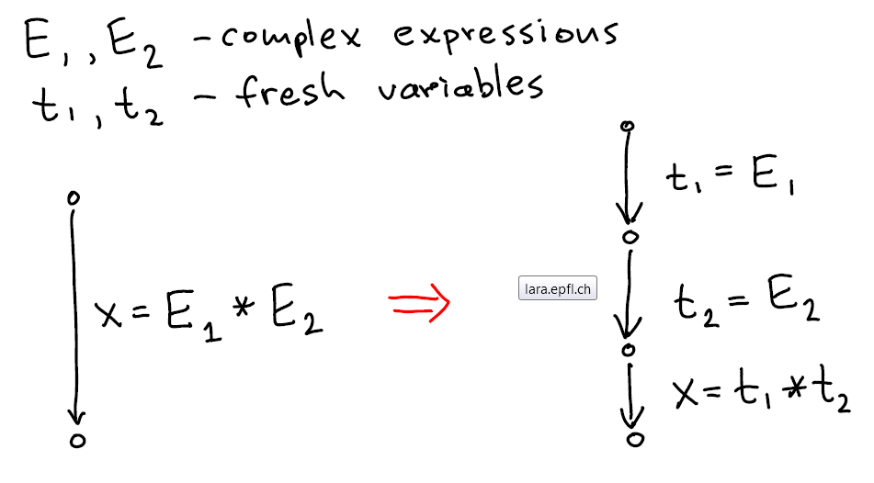
Flattening Expressions

Slide 10
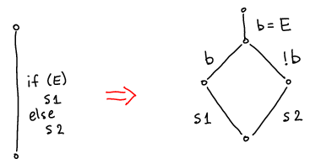
If-Then-Else
Better translation uses the "branch" instruction approach: have two destinations

Slide 11
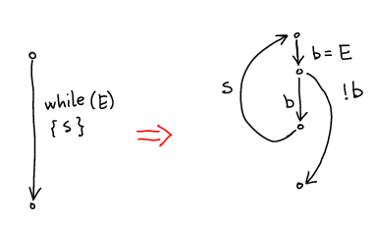
While
Better translation uses the "branch" instruction

Slide 12
Example 1: Convert to CFG
while (i < 10) {
println(j);
i = i + 1;
j = j +2*i + 1;
}

Slide 13
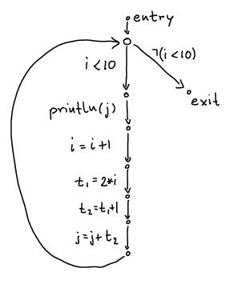
Example 1 Result
while (i < 10) {
println(j);
i = i + 1;
j = j +2*i + 1;
}

Slide 14
Example 2: Convert to CFG
int i = n;
while (i > 1) {
println(i);
if (i % 2 == 0) {
i = i / 2;
} else {
i = 3*i + 1;
}
}

Slide 15
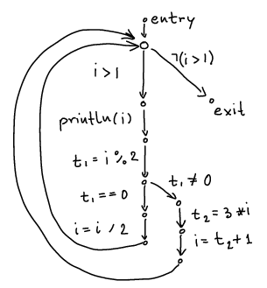
Example 2 Result
int i = n;
while (i > 1) {
println(i);
if (i % 2 == 0) {
i = i / 2;
} else {
i = 3*i + 1;
}
}

Slide 16
Analysis Domains

Slide 17
Abstract Intepretation Generalizes Type Inference
Type Inference
Abstract Interpretation
computes types
type rules
can be used to compute types of expression from subtypes
types fixed for a variable
computes facts from a domain
types
intervals
formulas
set of initialized variables
set of live variables
transfer functions
compute facts for one program point from facts at previous program points
facts change as the values of vars change (flow-sensitivity)

Slide 18
scalac computes types. Try in REPL:
class C
class D extends C
class E extends C
val p = false
val d = new D()
val e = new E()
val z = if (p) d else e
val u = if (p) (d,e) else (d,d)
val v = if (p) (d,e) else (e,d)
val f1 = if (p) ((d1:D) => 5) else ((e1:E) => 5)
val f2 = if (p) ((d1:D) => d) else ((e1:E) => e)

Slide 19
Finds "Best Type" for Expression
class C
class D extends C
class E extends C
val p = false
val d = new D() // d:D
val e = new E() // e:E
val z = if (p) d else e // z:C
val u = if (p) (d,e) else (d,d) // u:(D,C)
val v = if (p) (d,e) else (e,d) // v:(C,C)
val f1 = if (p) ((d1:D) => 5) else ((e1:E) => 5) // f1: ((D with E) => Int)
val f2 = if (p) ((d1:D) => d) else ((e1:E) => e) // f2: ((D with E) => C)

Slide 20
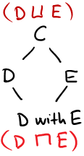
Subtyping Relation in this Example
product of two graphs:
...

Slide 21
Subtyping Relation in this Example

Slide 22
Least Upper Bound (lub, join)
A,B,C are all upper bounds on both D and E
(they are above each of then in the picture,
they are supertypes of D and supertypes of E).
Among these upper bounds, C is the least one
(the most specific one).
We therefore say C is the least upper bound,
In any partial order ≤, if S is a set of elements (e.g. S={D,E}) then:
U is upper bound on S iff x ≤ U for every x in S.
U₀ is the least upper bound (lub) of S, written U₀ = S , or U₀=lub(S) iff:
U₀ is upper bound and
if U is any upper bound on S, then U₀ ≤ U

Slide 23
Greatest Lower Bound (glb, meet)
In the presence of traits or interfaces, there are multiple types that are subtypes of both D and E. The type (D with E) is the largest of them.
In any partial order ≤, if S is a set of elements (e.g. S={D,E}) then:
L is lower bound on S iff L ≤ x for every x in S.
L₀ is the greatest upper bound (glb) of S, written L₀ = S, or L₀=glb(S), iff:
m₀ is upper bound and
if m is any upper bound on S, then m₀ ≤ m

Slide 24
Computing lub and glb for tuple and function types

Slide 25
Lattice
Partial order: binary relation ≤ (subset of some D²) which is
reflexive: x ≤ x
anti-symmetric: x≤y /\ y≤x -> x=y
transitive: x≤y /\ y≤z -> x≤z
Lattice is a partial order in which every two-element set has lub and glb
Lemma: if (D, ≤) is lattice and D is finite, then lub and glb exist for every finite set

Slide 26
Idea of Why Lemma Holds
lub(x₁,lub(x₂,...,lub(x_{n-1},x_{n}))) is lub({x₁,...x_{n}})
glb(x₁,glb(x₂,...,glb(x_{n-1},x_{n}))) is glb({x₁,...x_{n}})
lub of all elements in D is maximum of D
by definition, glb({}) is the maximum of D
glb of all elements in D is minimum of D
by definition, lub({}) is the minimum of D

Slide 27
Graphs and Partial Orders
If the domain is finite, then partial order can be represented by directed graphs
if x ≤ y then draw edge from x to y
For partial order, no need to draw x ≤ z if x ≤ y and y ≤ z. So we only draw non-transitive edges
Also, because always x ≤ x , we do not draw those self loops
Note that the resulting graph is acyclic: if we had a cycle, the elements must to be equal

Slide 28
Defining Abstract Interpretation
Abstract Domain D (elements are data-flow facts), describing which information to compute, e.g.
inferred types for each variable: x:C, y:D
interval for each variable x:[a,b], y:[a’,b’]
Transfer Functions, [[st]] for each statement st, how this statement affects the facts
Example:

Slide 29
Domain of Intervals [a,b] where a,b∈{-M,-127,0,127,M-1}

Slide 30
Find Transfer Function: Plus
Suppose we have only two integer variables: x,y
If
and we execute x= x+y
then
So we can let
a’= a+c b’ = b+d c’=c d’ = d

Slide 31
Find Transfer Function: Minus
Suppose we have only two integer variables: x,y
If
and we execute y= x-y
then
So we can let
a’= a b’ = b c’= a - d d’ = b - c

