Slide 1
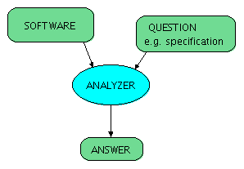
Program Analysis
Goal:
Automatically computes potentially useful information about the program.
Can come
from compiler or user
auxiliary information
(hints, proof steps, types)
efficiency
use it to help
correctness

Slide 2
Uses of Program Analysis
Compute information about the program and use it for:
efficiency (codegen): Program transformation
  Use the information in compiler to transform the program, make it more efficient (“optimization”)
correctness: Program verification
  Provide feedback to developer about possible errors in the program

Slide 3
Example Transformations
Common sub-expression elimination using available expression analysis
  avoid re-computing (automatically or manually generated) identical expressions
Constant propagation
  use constants instead of variables if variable value known
Copy propagation
  use another variable with the same name
Dead code elimination
  remove unnecessary code
Automatically generate code for parallel machines

Slide 4
Examples of Verification Questions
Example questions in analysis and verification (with sample links to tools or papers):
Will the program crash?
Does it compute the correct result?
Does it leak private information?
How long does it take to run?
How much power does it consume?
Will it turn off automated cruise control?

Slide 5
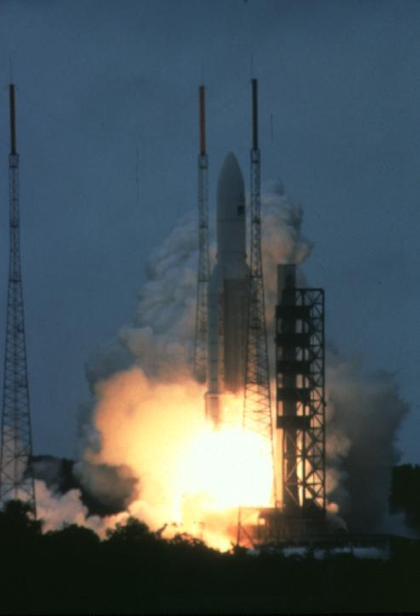
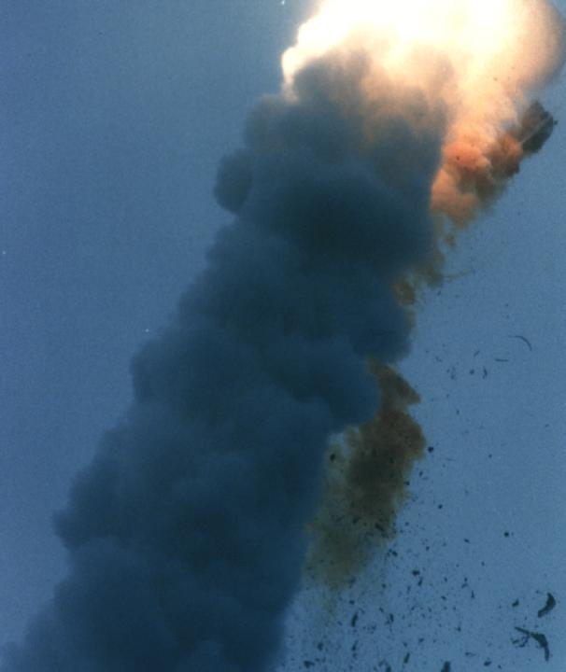
French Guyana, June 4, 1996
t = 0 sec
t = 40 sec
$800 million software failure
Space Missions

Slide 6
Arithmetic Overflow
According to a presentation by Jean-Jacques Levy (who was part of the team who
searched for the source of the problem), the source code in Ada that caused the problem
was as follows:
L_M_BV_32 := TBD.T_ENTIER_32S ((1.0/C_M_LSB_BV) * G_M_INFO_DERIVE(T_ALG.E_BV));
if L_M_BV_32 > 32767 then
P_M_DERIVE(T_ALG.E_BV) := 16#7FFF#;
elsif L_M_BV_32 < -32768 then
P_M_DERIVE(T_ALG.E_BV) := 16#8000#;
else
P_M_DERIVE(T_ALG.E_BV) := UC_16S_EN_16NS(TDB.T_ENTIER_16S(L_M_BV_32));
end if;
P_M_DERIVE(T_ALG.E_BH) :=
UC_16S_EN_16NS (TDB.T_ENTIER_16S ((1.0/C_M_LSB_BH)*G_M_INFO_DERIVE(T_ALG.E_BH)));
http://en.wikipedia.org/wiki/Ariane_5_Flight_501

Slide 7
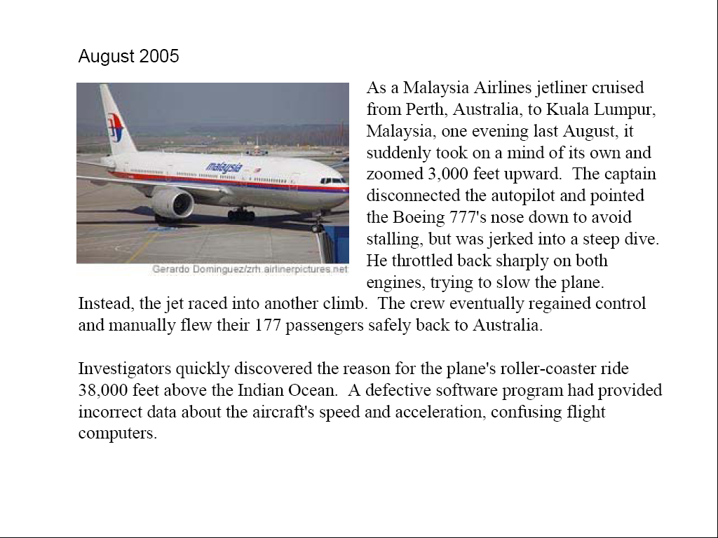
Air Transport

Slide 8
ASTREE Analyzer
“In Nov. 2003, ASTRÉE was able to prove completely automatically the absence of any RTE in the primary flight control software of the Airbus A340 fly-by-wire system, a program of 132,000 lines of C analyzed in 1h20 on a 2.8 GHz 32-bit PC using 300 Mb of memory (and 50mn on a 64-bit AMD Athlon™ 64 using 580 Mb of memory).”
http://www.astree.ens.fr/

Slide 9
AbsInt
7 April 2005. AbsInt contributes to guaranteeing the safety of the A380, the world's largest passenger aircraft. The Analyzer is able to verify the proper response time of the control software of all components by computing the worst-case execution time (WCET) of all tasks in the flight control software. This analysis is performed on the ground as a critical part of the safety certification of the aircraft.

Slide 10
Coverity Prevent
SAN FRANCISCO - January 8, 2008 - Coverity®, Inc., the leader in improving software quality and security, today announced that as a result of its contract with US Department of Homeland Security (DHS), potential security and quality defects in 11 popular open source software projects were identified and fixed. The 11 projects are Amanda, NTP, OpenPAM, OpenVPN, Overdose, Perl, PHP, Postfix, Python, Samba, and TCL.

Slide 11
Microsoft’s Static Driver Verifier
Static Driver Verifier (SDV) is a thorough, compile-time, static verification tool designed for kernel-mode drivers. SDV finds serious errors that are unlikely to be encountered even in thorough testing. SDV systematically analyzes the source code of Windows drivers that are written in the C language. SDV uses a set of interface rules and a model of the operating system to determine whether the driver interacts properly with the Windows operating system. SDV can verify device drivers (function drivers, filter drivers, and bus drivers) that use the Windows Driver Model (WDM), Kernel-Mode Driver Framework (KMDF), or NDIS miniport model. SDV is designed to be used throughout the development cycle. You should run SDV as soon as the basic structure of a driver is in place, and continue to run it as you make changes to the driver. Development teams at Microsoft use SDV to improve the quality of the WDM, KMDF, and NDIS miniport drivers that ship with the operating system and the sample drivers that ship with the Windows Driver Kit (WDK). SDV is included in the Windows Driver Kit (WDK) and supports all x86-based and x64-based build environments.

Slide 12
Further Reading on Verification
Recent Research Highlights from the Communications of the ACM
  A Few Billion Lines of Code Later: Using Static Analysis to Find Bugs in the Real World
  Retrospective: An Axiomatic Basis for Computer Programming
  Model Checking: Algorithmic Verification and Debugging
  Software Model Checking Takes Off
  Formal Verification of a Realistic Compiler
  seL4: Formal Verification of an Operating-System Kernel

Slide 13
Type Inference

Slide 14
Example Analysis: Type Inference
Avoid the need for some type declarations, but still know the type
More generally, infer types that programmer is not willing to write (e.g. more precise ones)
We show a simple example: inferring types that can be simple values or functions
  we assume no subtyping in this part

Slide 15
Subset of Scala
Int, Boolean (unless otherwise specified)
arithmetic operations (+, -, …), Int x Int => Int
relations relate Int and give Boolean
boolean operators
functions
if-then-else statements

Slide 16
Example
object Main {
val a = 2 * 3
val b = a < 2
val c = sumOfSquares(a)
val d = if(b) c(3) else square(a)
}
def square(x) = x * x
def sumOfSquares(x) = {
(y) => square(x) + square(y)
}
Can it type-check?

Slide 17
The idea
Find assignment
{TA -> Int, TB -> Boolean …}
object Main {
val a: TA = 2 * 3
val b: TB = a < 2
val c: TC = sumOfSquares(a)
val d: TD = if(b) c(3) else square(a)
}
def square(x: TE): TF = x * x
def sumOfSquares(x: TG): TH = {
(y: TI) => square(x) + square(y)
}

Slide 18
Hindley-Milner algorithm, intuitively
Record type constraints
  val a: A = 3
  val b: B = a
Solve type constraints
  obvious in the case above: {A= Int, B = Int}
  in general use unification algorithm
Return assignment to type variables or failure
  constraints:
  { A = Int, A = B}

Slide 19
Recording type constraints
T1 = Boolean
T2 = T3 = T4
T1 = T2 = T3 = Int

Slide 20
Type constraints in example
2: Int, 3: Int
object Main {
val a: TA = 2 * 3
val b: TB = a < 2
val c: TC = sumOfSquares(a: TA)
val d: TD =
if(b) c(3): S1 else square(a): S2
}
def square(x: TE): TF = x * x
def sumOfSquares(x: TG): TH = {
(y: TI) => (square(x) + square(y)): S3
}
TA = Int
TB = Boolean
TC = TH
TA = TG
S1 = S2
TD = S2
TD = S1
TA = TE
TF = Int
TE = TF
TE = TG
TI = TE
TH = TI -> S3
S3 = Int
S3 = TF

Slide 21
Rules for Solving Equations

Slide 22
Unification
Finds a solution (substitution) to a set of equational constraints.
works for any constraint set of equalities between (type) constructors
finds the most general solution
Definition
A set of equations is in solved form if it is of the form
{x1 = t1, … x_{n} = t_{n}} iff variables x_{i} do not appear in terms t_{i}, that is {x1, …, x_{n}} ∩ (FV(t1) ∪… FV(t_{n})) = ∅
In what follows,
x denotes a type variable (like TA, TB before)
t, t_{i}, s_{i} denote terms, that may contain type variables

Slide 23
Unification Algorithm
We obtain a solved form in finite time using the non-deterministic algorithm that applies the following rules as long as no clash is reported and as long as the equations are not in solved form.
Orient: Select t = x, t ≠ x and replace it with x = t.
Delete: Select x = x, remove it.
Eliminate: Select x = t where x does not occur in t,
substitute x with t in all remaining equations.
Occurs Check: Select x = t, where x occurs in t, report clash.
Decomposition: Select f(t1, …, t_{n}) = f(s1, …, s_{n}),
replace with t1 = s1, …, t_{n} = s_{n}.
Decomposition Clash: f(t1,…,t_{n}) = g(s1,…,s_{n}), f ≠ g, report clash.
e.g. (T₁ x T₂) = (S₁ -> S₂) is f(T₁,T₂) = g(S₁,S₂)
f and g can denote x, ->, as well as constructor of polymorphic containers:
Map[A, B] = Map[C, D] will be replaced by A = B and C = D

Slide 24
Example 2
Construct and Solve Constraints
def twice(f) = (x) => f(f(x))
def succ(x) = x + 1
twice(succ)(5)

Slide 25
Example 3:
  def length(s : String) : Int = {...}
  def foo(s: String) = length(s)
  def bar(x, y) = foo(x) + y

Slide 26
Most General Solution
What is the general solution for
def f(x) = x
def g(a) = f( f( a))
Example solution: a:Int, f,g : Int -> Int
Are there others? How do all solutions look like?

Slide 27
Instantiating Type Variables
def f(x) = x
def test() = if (f(true)) f(3) else f(4)
Generate and solve constraints.
Is result different if we clone f for each invocation?

Slide 28
Generalization Rule
If after inferring top-level function definitions certain variables remain unconstrained, then generalize these variables
When applying a function with generalized variables, rename variables into fresh ones
def f(x) = x
def test() = if (f(true)) f(3) else f(4)

Slide 29
Example Use
def CONS[T](x:T, lst:List[T]):List[T]={...}
def listInt() : List[Int] = {...}
def listBool() : List[Bool] = {...}
def baz(a, b) = CONS(a(b), b)
def test(f,g) =
(baz(f,listInt), baz(g,listBool))

Slide 30
Data-Flow Analysis

Slide 31
Goal of Data-Flow Analysis
Automatically compute information about the program
Use it to report errors to user (like type errors)
Use it to optimize the program
Works on control-flow graphs:
x = 1
while (x < 10) {
x = x + 2
}

Slide 32
How We Define It
Abstract Domain D (Data-Flow Facts):
which information to compute?
  Example: interval for each variable x:[a,b], y:[a’,b’]
Transfer Functions [[st]] for each statement st,
how this statement affects the facts
  Example:

Slide 33
Find Transfer Function: Plus
Suppose we have only two integer variables: x,y
If
and we execute x= x+y
then
So we can let
a’= a+c b’ = b+d
c’=c d’ = d

Slide 34
Find Transfer Function: Minus
Suppose we have only two integer variables: x,y
If
and we execute y= x-y
then
So we can let
a’= a b’ = b
c’= a - d d’ = b - c

Slide 35
Transfer Functions for Tests
if (x > 1) {
y = 1 / x
} else {
y = 42
}

Slide 36
Merging Data-Flow Facts
if (x > 0) {
y = x + 100
} else {
y = -x – 50
}
join

Slide 37
Handling Loops: Iterate Until Stabilizes
Compiler learned
some facts! ☺
x = 1
while (x < 10) {
x = x + 2
}

Slide 38
Data-Flow Analysis Algorithm
var facts : Map[Vertex,Domain] = Map.withDefault(empty)
facts(entry) = initialValues // change
while (there was change)
pick edge (v1,statmt,v2) from CFG
such that facts(v1) was changed
facts(v2)=facts(v2) join [[statmt]](facts(v1))
}
Order does not matter for the
end result, as long as we do not
permanently neglect any edge
whose source was changed.

Slide 39
Handling Loops: Iterate Until Stabilizes
Compiler learns
some facts, but only after long time
x = 1
while (x < n) {
x = x + 2
}
n = 100000

Slide 40
Handling Loops: Iterate Until Stabilizes
For unknown program inputs it may be practically impossible to know how long it takes
var x : BigInt = 1
while (x < n) {
x = x + 2
}
var n : BigInt = readInput()
Solutions
- smaller domain, e.g. only certain intervals
[a,b] where a,b in {-∞,-127,-1,0,1,127,∞}
- widening techniques (make it less precise on demand)

Slide 41
Size of analysis domain
Interval analysis:
D₁ = { [a,b] | a ≤ b, a,b∈{-M,-127,-1,0,1,127,M-1}} U {⊥}
Constant propagation:
D₂ = { [a,a] | a∈{-M,-(M-1),…,-2,-1,0,1,2,3,…,M-1}} U {⊥}
suppose M is 2⁶³
|D₁| =
|D₂| =

Slide 42
How many steps does the analysis take to finish (converge)?
Interval analysis:
D₁ = { [a,b] | a ≤ b, a,b∈{-M,-127,-1,0,1,127,M-1}} U {⊥}
Constant propagation:
D₂ = { [a,a] | a∈{-M,-(M-1),…,-2,-1,0,1,2,3,…,M-1}} U {⊥}
suppose M is 2⁶³
With D₁ takes at most steps.
With D₂ takes at most steps.

Slide 43
Termination Given by Length of Chains
Interval analysis:
D₁ = { [a,b] | a ≤ b, a,b∈{-M,-127,-1,0,1,127,M-1}} U {⊥}
Constant propagation:
D₂ = { [a,a] | a∈{-M,…,-2,-1,0,1,2,3,…,M-1}} U {⊥} U {T}
suppose M is 2⁶³
Domain is a lattice. Maximal chain length = lattice height

Slide 44
Lattice for intervals [a,b] where a,b∈{-M,-127,0,127,M-1}

