Slide 1
Symbol Table (Γ) Contents
Map identifiers to the symbol with relevant information about the identifier
All information is derived from syntax tree - symbol table is for efficiency
in old one-pass compilers there was only symbol table, no syntax tree
in modern compiler: we could always go through entire tree, but symbol table can give faster and easier access to the part of syntax tree, or some additional information
Goal: efficiently supporting phases of compiler
In the name analysis phase:
finding which identifier refers to which definition
we store definitions
What kinds of things can we define? What do we need to know for each ID?
variables (globals, fields, parameters, locals):
need to know types, positions - for error messages
later: memory layout. To compile x.f = y into memcopy(addr_y, addr_x+6, 4)
e.g. 3rd field in an object should be stored at offset e.g. +6 from the address of the object
the size of data stored in x.f is 4 bytes
sometimes more information explicit: whether variable local or global
methods, functions, classes: recursively have with their own symbol tables

Slide 2
Different Points, Different Γ
class World {
int sum;
void add(int foo) {
sum = sum + foo;
} void sub(int bar) { sum = sum - bar; } int count;
}

Slide 3
Imperative Way: Push and Pop
class World {
int sum;
void add(int foo) {
sum = sum + foo;
} void sub(int bar) { sum = sum - bar; } int count;
}
change table, record change
revert changes from table
change table, record change
revert changes from table

Slide 4
Imperative Symbol Table
Hash table, mutable Map[ID,Symbol]
Example:
hash function into array
array has linked list storing (ID,Symbol) pairs
Undo stack: to enable entering and leaving scope
Entering new scope (function,block):
add beginning-of-scope marker to undo stack
Adding nested declaration (ID,sym)
lookup old value symOld, push old value to undo stack
insert (ID,sym) into table
Leaving the scope
go through undo stack until the marker, restore old values

Slide 5
Functional: Keep Old Version
class World {
int sum;
void add(int foo) {
sum = sum + foo;
} void sub(int bar) { sum = sum - bar; } int count;
}
create new Γ₁, keep old Γ₀
create new Γ₁, keep old Γ₀

Slide 6
Functional Symbol Table Implemented
Typical: Immutable Balanced Search Trees
Updating returns new map, keeping old one
lookup and update both log(n)
update creates new path (copy log(n) nodes, share rest!)
memory usage acceptable
Simplified. In practice, BST[A], store Int key and value A
sealed abstract class BST case class Empty() extends BST case class Node(left: BST, value: Int, right: BST) extends BST

Slide 7
Lookup
def contains(key: Int, t : BST): Boolean = t match { case Empty() => false case Node(left,v,right) => { if (key == v) true else if (key < v) contains(key, left) else contains(key, right) } }
Running time bounded by tree height.
contains(6,t) ?

Slide 8
Insertion
def add(x : Int, t : BST) : Node = t match { case Empty() => Node(Empty(),x,Empty()) case t @ Node(left,v,right) => { if (x < v) Node(add(x, left), v, right) else if (x==v) t else Node(left, v, add(x, right)) } }
Both add(x,t) and t remain accessible.
Running time and newly allocated nodes bounded by tree height.

Slide 9
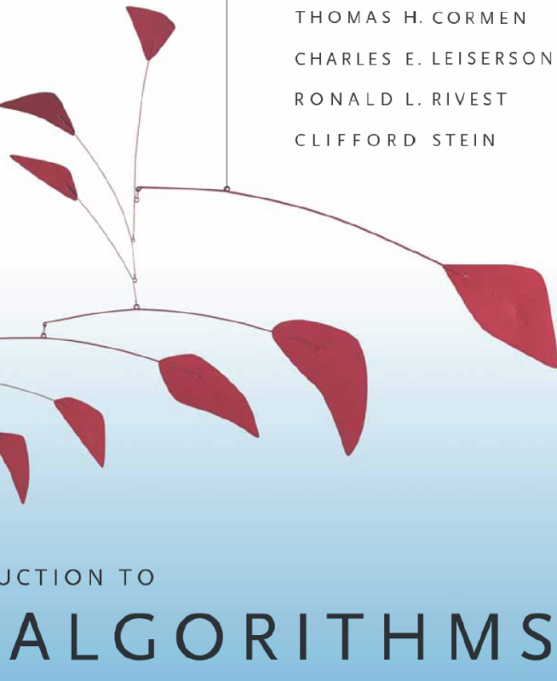
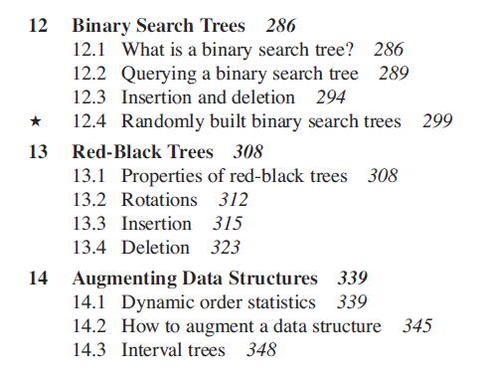
Balanced Trees: Red-Black Trees

Slide 10
Balanced Tree: Red Black Tree
Goals:
ensure that tree height remains at most log(size) add(1,add(2,add(3,...add(n,Empty())...))) ~ linked list
preserve efficiency of individual operations: rebalancing arbitrary tree: could cost O(n) work
Solution: maintain mostly balanced trees: height still O(log size)
sealed abstract class Color case class Red() extends Color case class Black() extends Color
sealed abstract class Tree case class Empty() extends Tree case class Node(c: Color,left: Tree,value: Int, right: Tree) extends Tree

Slide 11
balanced tree
constraints
From 4. and 5.: tree height is O(size).
Analysis is similar for mutable and immutable trees.
for immutable trees: see book by Chris Okasaki

Slide 12
Balancing
def balance(c: Color, a: Tree, x: Int, b: Tree): Tree = (c,a,x,b) match { case (Black(),Node(Red(),Node(Red(),a,xV,b),yV,c),zV,d) => Node(Red(),Node(Black(),a,xV,b),yV,Node(Black(),c,zV,d))
case (Black(),Node(Red(),a,xV,Node(Red(),b,yV,c)),zV,d) => Node(Red(),Node(Black(),a,xV,b),yV,Node(Black(),c,zV,d))
case (Black(),a,xV,Node(Red(),Node(Red(),b,yV,c),zV,d)) => Node(Red(),Node(Black(),a,xV,b),yV,Node(Black(),c,zV,d)) case (Black(),a,xV,Node(Red(),b,yV,Node(Red(),c,zV,d))) => Node(Red(),Node(Black(),a,xV,b),yV,Node(Black(),c,zV,d)) case (c,a,xV,b) => Node(c,a,xV,b) }

Slide 13
Insertion
def add(x: Int, t: Tree): Tree = { def ins(t: Tree): Tree = t match { case Empty() => Node(Red(),Empty(),x,Empty()) case Node(c,a,y,b) => if (x < y) balance(c, ins(a), y, b) else if (x == y) Node(c,a,y,b) else balance(c,a,y,ins(b)) } makeBlack(ins(t)) }
def makeBlack(n: Tree): Tree = n match { case Node(Red(),l,v,r) => Node(Black(),l,v,r) case _ => n }
Modern object-oriented languages (=Scala) support abstraction and functional data structures.
Just use Map from Scala.

Slide 14
Compiler
Id3 = 0
while (id3 < 10) {
println(“”,id3); id3 = id3 + 1 }
source code
Construction
Compiler
(scalac, gcc)
i d3
=
0 LF
w
id3 = 0 while ( id3
< 10 )
assign
i 0
while
<
lexer
parser
i
10
assign
+
a[i]
3
*
7
i
characters
words
(tokens)
trees
making sense of trees

Slide 15
Evaluating an Expression
scala prompt:
>def min1(x : Int, y : Int) : Int = { if (x < y) x else y+1 } min1: (x: Int,y: Int)Int >min1(10,5) res1: Int = 6
How can we think about this evaluation?
x → 10 y → 5 if (x < y) x else y+1

Slide 16
Each Value has a Type
scala prompt:
>def min1(x : Int, y : Int) : Int = { if (x < y) x else y+1 } min1: (x: Int,y: Int)Int >min1(10,5) res1: Int = 6
How can we think about this evaluation?
x : Int → 10 y : Int → 5 if (x < y) x else y+1

Slide 17
We can compute types without values
scala prompt:
>def min1(x : Int, y : Int) : Int = { if (x < y) x else y+1 } min1: (x: Int,y: Int)Int >min1(10,5) res1: Int = 6
How can we think about this evaluation?
x : Int y : Int if (x < y) x else y+1

Slide 18
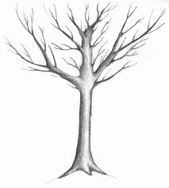
We do not like trees upside-down

Slide 19
Leaves are Up
type rules move
from leaves to root

Slide 21
Type Rules as Local Tree Constraints
x : Int y : Int
Type Rules
for every type T, if
b has type Boolean, and ...
then

Slide 22
Type Rules with Environment
x : Int y : Int
Type Rules

Slide 23
if the free variables of e have types given by gamma, then e (correctly) type checks and has type T
If e₁ type checks in gamma and has type T₁ and ... and e_{n} type checks in gamma and has type T_{n}
then e type checks in gamma and has type T

Slide 24
Derivation Using Type Rules
x : Int y : Int

Slide 25
Type Rule for Function Application
We can treat operators as variables that have function type
We can replace many previous rules with application rule:

Slide 26
Computing the Environment of a Class
object World { var data : Int var name : String def m(x : Int, y : Int) : Boolean { ... } def n(x : Int) : Int { if (x > 0) p(x – 1) else 3 } def p(r : Int) : Int = { var k = r + 2 m(k, n(k)) } }
Type check each function m,n,p in this global environment

Slide 27
Extending the Environment
class World { var data : Int var name : String def m(x : Int, y : Int) : Boolean { ... } def n(x : Int) : Int { if (x > 0) p(x – 1) else 3 } def p(r : Int) : Int = { var k:Int = r + 2 m(k, n(k)) } }

Slide 28
Type Checking Expression in a Body
class World { var data : Int var name : String def m(x : Int, y : Int) : Boolean { ... } def n(x : Int) : Int { if (x > 0) p(x – 1) else 3 } def p(r : Int) : Int = { var k:Int = r + 2 m(k, n(k)) } }

Slide 29
Remember Function Updates
{(x,T₁),(y,T₂)} $⊕$ {(x,T₃)} = {(x,T₃),(y,T₂)}

Slide 30
Type Rule for Method Bodies
Type Rule for Assignments
Type Rules for Block: { var x₁:T₁ ... var x_{n}:T_{n}; s₁; ... s_{m}; e }

Slide 31
Blocks with Declarations in the Middle
just
expression
empty
declaration is first
statement is first

Slide 32
Rule for While Statement

Slide 33
Rule for Method Call

Slide 34
Example to Type Check
class World { var z : Boolean var u : Int def f(y : Boolean) : Int { z = y if (u > 0) { u = u – 1 var z : Int z = f(!y) + 3 z+z } else { 0 }
}
}

