Slide 1
Compiler Construction Lecture 15
Introduction to Program Analysis

Slide 2
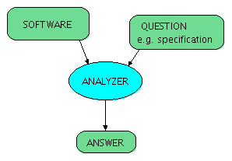
Program Analysis
Goal:
Automatically computes potentially useful information about the program.
Can come from compiler or user
auxiliary information
(hints, proof steps, types)

Slide 3
Uses of Program Analysis
Compute information about the program and use it for:
Program transformation
Use the information to transform the program, trying to make it more efficient (“optimization”)
Program checking and verification
Provide feedback to developer about possible errors in the program

Slide 4
Example Transformations
Common sub-expression elimination using available expression analysis
avoid re-computing (automatically or manually generated) identical expressions
Constant propagation
use constants instead of variables if variable value known
Copy propagation
use another variable with the same name
Dead code elimination
remove unnecessary code
Automatically generate code for parallel machines

Slide 5
Examples of Verification Questions
Example questions in analysis and verification (with sample links to tools or papers):
Will the program crash?
Does it compute the correct result?
Does it leak private information?
How long does it take to run?
How much power does it consume?
Will it turn off automated cruise control?

Slide 6
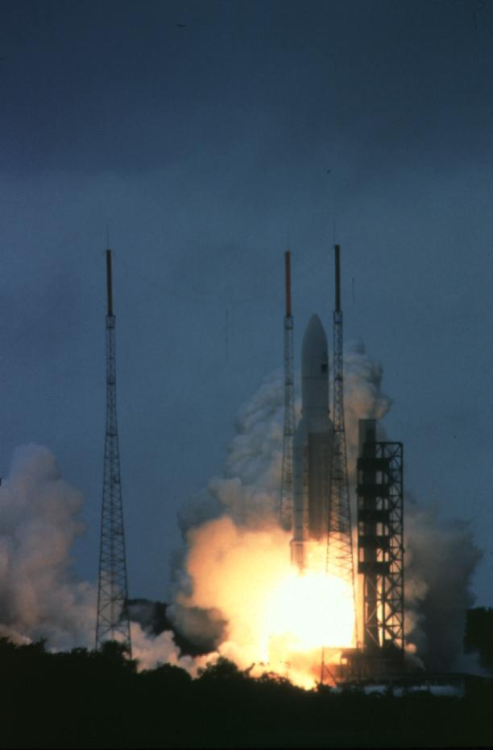
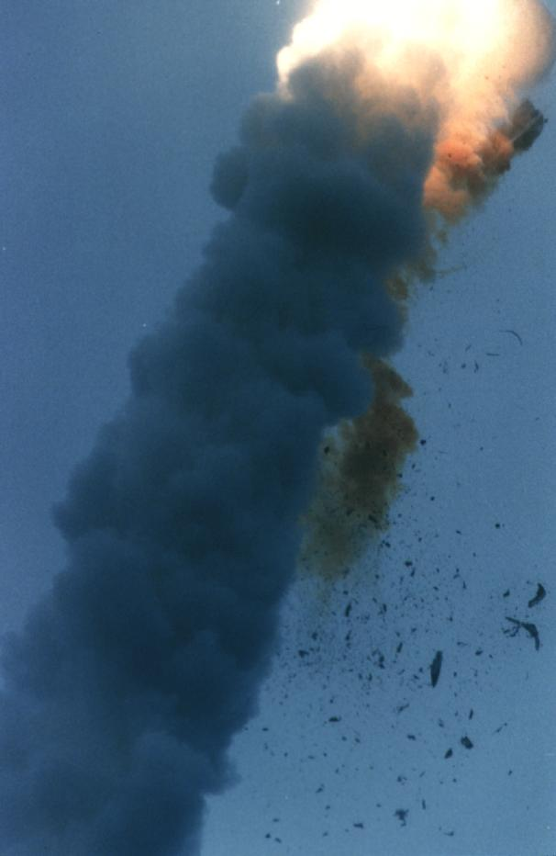
French Guyana, June 4, 1996
t = 0 sec
t = 40 sec
$800 million software failure
Space Missions

Slide 7
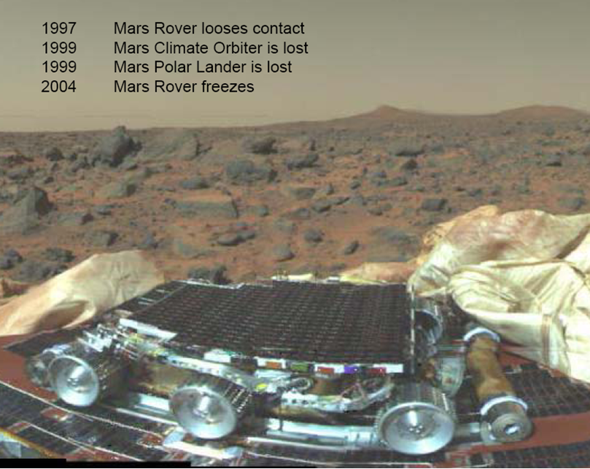
(Jun 18, 2008 – Scientific data lost from flash memory)
Space Missions

Slide 8
Air Transport

Slide 9
Air Transport

Slide 10
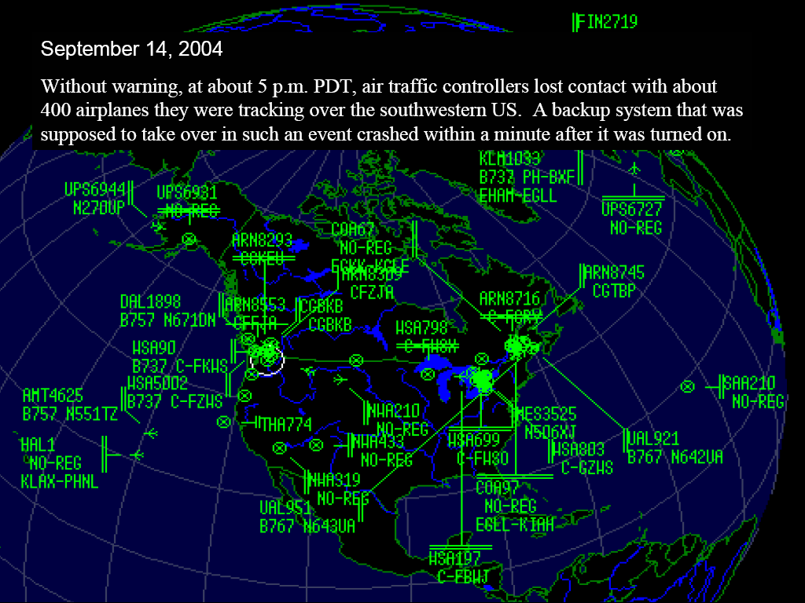
Air Transport

Slide 11
Air-Traffic Control System in LA Airport
Incident Date: 9/14/2004
(IEEE Spectrum) -- It was an air traffic controller's worst nightmare. Without warning, on Tuesday, 14 September, at about 5 p.m. Pacific daylight time, air traffic controllers lost voice contact with 400 airplanes they were tracking over the southwestern United States. Planes started to head toward one another, something that occurs routinely under careful control of the air traffic controllers, who keep airplanes safely apart. But now the controllers had no way to redirect the planes' courses.
The controllers lost contact with the planes when the main voice communications system shut down unexpectedly. To make matters worse, a backup system that was supposed to take over in such an event crashed within a minute after it was turned on. The outage disrupted about 800 flights across the country.
Inside the control system unit is a countdown timer that ticks off time in milliseconds. The VCSU uses the timer as a pulse to send out periodic queries to the VSCS. It starts out at the highest possible number that the system's server and its software can handle—2³². It's a number just over 4 billion milliseconds. When the counter reaches zero, the system runs out of ticks and can no longer time itself. So it shuts down.
Counting down from 2³² to zero in milliseconds takes just under 50 days. The FAA procedure of having a technician reboot the VSCS every 30 days resets the timer to 2³² almost three weeks before it runs out of digits.

Slide 12
Car Industry

Slide 13
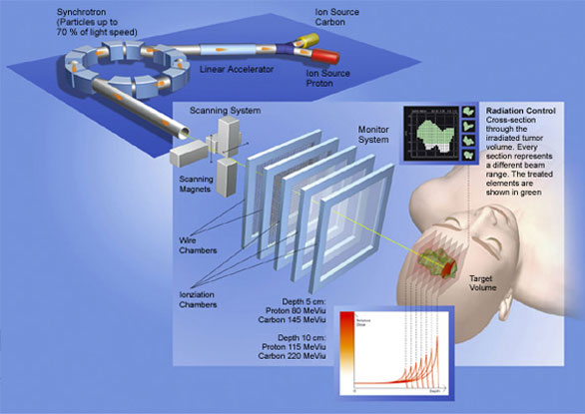
Radio Therapy
Nancy Leveson
Safeware: System Safety and Computers
Addison-Wesley, 1995
Life-Critical Medical Devices

Slide 14
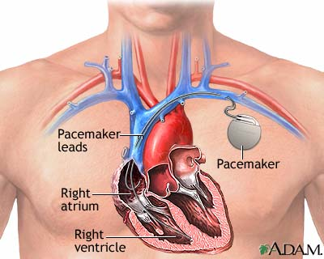
Life-Critical Medical Devices

Slide 15
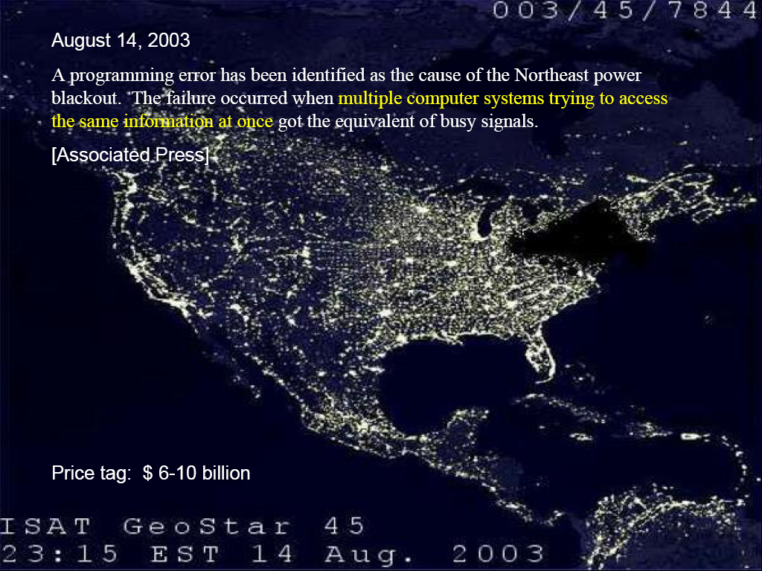
Essential Infrastructure: Northeast Blackout

Slide 16
Zune 30 leapyear problem
December 31, 2008
“After doing some poking around in the source code for the Zune’s clock driver (available free from the Freescale website), I found the root cause of the now-infamous Zune 30 leapyear issue that struck everyone on New Year’s Eve. The Zune’s real-time clock stores the time in terms of days and seconds since January 1st, 1980. When the Zune’s clock is accessed, the driver turns the number of days into years/months/days and the number of seconds into hours/minutes/seconds. Likewise, when the clock is set, the driver does the opposite.
The Zune frontend first accesses the clock toward the end of the boot sequence. Doing this triggers the code that reads the clock and converts it to a date and time...”
“...The function keeps subtracting either 365 or 366 until it gets down to less than a year’s worth of days, which it then turns into the month and day of month. Thing is, in the case of the last day of a leap year, it keeps going until it hits 366. Thanks to the if (days > 366), it stops subtracting anything if the loop happens to be on a leap year. But 366 is too large to break out of the main loop, meaning that the Zune keeps looping forever and doesn’t do anything else.”
http://www.zuneboards.com/forums/zune-news/38143-cause-zune-30-leapyear-problem-isolated.html

Slide 17
How can we automate verification?
Important algorithmic questions:
verification condition generation: compute formulas expressing program correctness
Hoare logic, weakest precondition, strongest postcondition
theorem proving: prove verification conditions
proof search, counterexample search
decision procedures
loop invariant inference
abstract interpretation and data-flow analysis
predicate abstraction
pointer analysis, typestate
reasoning about numerical computation
pre-condition and post-condition inference
ranking error reports and warnings
finding error causes from counterexample traces

Slide 18
Spec Sharp: the Movie
Webcasts by Mike Barnett minutes 12 to 22
http://rise4fun.com

Slide 19
More Success Stories

Slide 20
ASTREE Analyzer
“In Nov. 2003, ASTRÉE was able to prove completely automatically the absence of any RTE in the primary flight control software of the Airbus A340 fly-by-wire system, a program of 132,000 lines of C analyzed in 1h20 on a 2.8 GHz 32-bit PC using 300 Mb of memory (and 50mn on a 64-bit AMD Athlon™ 64 using 580 Mb of memory).”
http://www.astree.ens.fr/

Slide 21
AbsInt
7 April 2005. AbsInt contributes to guaranteeing the safety of the A380, the world's largest passenger aircraft. The Analyzer is able to verify the proper response time of the control software of all components by computing the worst-case execution time (WCET) of all tasks in the flight control software. This analysis is performed on the ground as a critical part of the safety certification of the aircraft.

Slide 22
Coverity Prevent
SAN FRANCISCO - January 8, 2008 - Coverity®, Inc., the leader in improving software quality and security, today announced that as a result of its contract with US Department of Homeland Security (DHS), potential security and quality defects in 11 popular open source software projects were identified and fixed. The 11 projects are Amanda, NTP, OpenPAM, OpenVPN, Overdose, Perl, PHP, Postfix, Python, Samba, and TCL.

Slide 23
Microsoft’s Static Driver Verifier
Static Driver Verifier (SDV) is a thorough, compile-time, static verification tool designed for kernel-mode drivers. SDV finds serious errors that are unlikely to be encountered even in thorough testing. SDV systematically analyzes the source code of Windows drivers that are written in the C language. SDV uses a set of interface rules and a model of the operating system to determine whether the driver interacts properly with the Windows operating system. SDV can verify device drivers (function drivers, filter drivers, and bus drivers) that use the Windows Driver Model (WDM), Kernel-Mode Driver Framework (KMDF), or NDIS miniport model. SDV is designed to be used throughout the development cycle. You should run SDV as soon as the basic structure of a driver is in place, and continue to run it as you make changes to the driver. Development teams at Microsoft use SDV to improve the quality of the WDM, KMDF, and NDIS miniport drivers that ship with the operating system and the sample drivers that ship with the Windows Driver Kit (WDK). SDV is included in the Windows Driver Kit (WDK) and supports all x86-based and x64-based build environments.

Slide 24
Impact on Computer Science
Turing award is ACM’s most prestigious award and equivalent to Nobel prize in Computing
(2012 is 100 years of Alan Turing’s birth)
In the next slides are some papers written by the award winners connected to the topics of this class

Slide 25
A Basis for a Mathematical Theory of Computation by John McCarthy, 1961.
“It is reasonable to hope that the relationship between computation and mathematical logic will be as fruitful in the next century as that between analysis and physics in the last. The development of this relationship demands a concern for both applications and for mathematical elegance.”
Social processes and proofs of theorems and programs a controversial article by Richard A. De Millo, Richard J. Lipton, and Alan J. Perlis
Guarded Commands, Nondeterminacy and Formal Derivation of Programs by Edsger W. Dijkstra from 1975, and other Manuscripts
Simple word problems in universal algebras by D. Knuth and P. Bendix (see Knuth-Bendix_completion_algorithm), used in automated reasoning

Slide 26
Decidability of second-order theories and automata on infinite trees by Michael O. Rabin in 1965, proving decidability for one of the most expressive decidable logics
Domains for Denotational Semantics by Dana Scott, 1982
Can programming be liberated from the von Neumann style?: a functional style and its algebra of programs by John Backus
Assigning meanings to programs by R. W. Floyd, 1967
The Ideal of Verified Software by C.A.R. Hoare
Soundness and Completeness of an Axiom System for Program Verification by Stephen A. Cook
An Axiomatic Definition of the Programming Language PASCAL by C. A. R. Hoare and Niklaus Wirth, 1973
On the Computational Power of Pushdown Automata, by Alfred V. Aho, Jeffrey D. Ullman, John E. Hopcroft in 1970
An Algorithm for Reduction of Operator Strength by John Cocke, Ken Kennedy in 1977

Slide 27
A Metalanguage for Interactive Proof in LCF by Michael J. C. Gordon, Robin Milner, L. Morris, Malcolm C. Newey, Christopher P. Wadsworth, 1978
Proof Rules for the Programming Language Euclid, by Ralph L. London, John V. Guttag, James J. Horning, Butler W. Lampson, James G. Mitchell, Gerald J. Popek, 1978
Computational Complexity and Mathematical Proofs by J. Hartmanis
Software reliability via run-time result-checking by Manuel Blum
The Temporal Logic of Programs, by Amir Pnueli (see also the others of a few hundreds of publications)
No Silver Bullet - Essence and Accidents of Software Engineering, by Frederick P. Brooks Jr., 1987

Slide 28
Formal Development with ABEL, by Ole-Johan Dahl and Olaf Owe
Abstraction Mechanisms in the Beta Programming Language, by Bent Bruun Kristensen, Ole Lehrmann Madsen, Birger Møller-Pedersen, Kristen Nygaard, 1983
Formalization in program development, by Peter Naur, 1982
Interprocedural Data Flow Analysis, by Frances E. Allen, 1974
Counterexample-guided abstraction refinement for symbolic model checking by Edmund Clarke, Orna Grumberg, Somesh Jha, Yuan Lu, Helmut Veith, 2003
Automatic Verification of Finite-State Concurrent Systems Using Temporal Logic Specifications by Edmund M. Clarke, E. Allen Emerson, A. Prasad Sistla
The Algorithmic Analysis of Hybrid Systems by Rajeev Alur, Costas Courcoubetis, Nicolas Halbwachs, Thomas A. Henzinger, Pei-Hsin Ho, Xavier Nicollin, Alfredo Olivero, Joseph Sifakis, Sergio Yovine

Slide 29
Recommended Reading
Recent Research Highlights from the Communications of the ACM
A Few Billion Lines of Code Later: Using Static Analysis to Find Bugs in the Real World
Retrospective: An Axiomatic Basis for Computer Programming
Model Checking: Algorithmic Verification and Debugging
Software Model Checking Takes Off
Formal Verification of a Realistic Compiler
seL4: Formal Verification of an Operating-System Kernel

